Slide 1
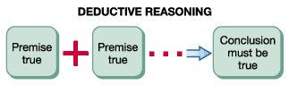
Logical Fallacies:
An Introduction to Deductive Reasoning
LessWrong Melbourne Dojo, 7th June 2015

Slide 2
Introduction
Sloppy reasoning is the default for all humans – including you and me!. It comes naturally. It takes effort and practise to reason carefully, rigorously, and rationally.
Today we will try to learn and practise some tools for getting better at this.
Logic is one tool that can help us.

Slide 3
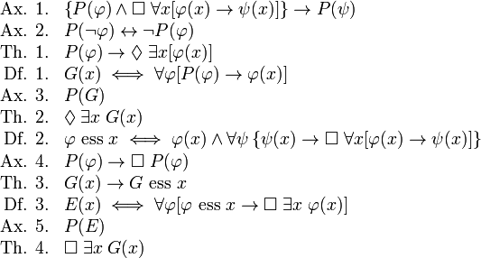
Formal Logic

Slide 4
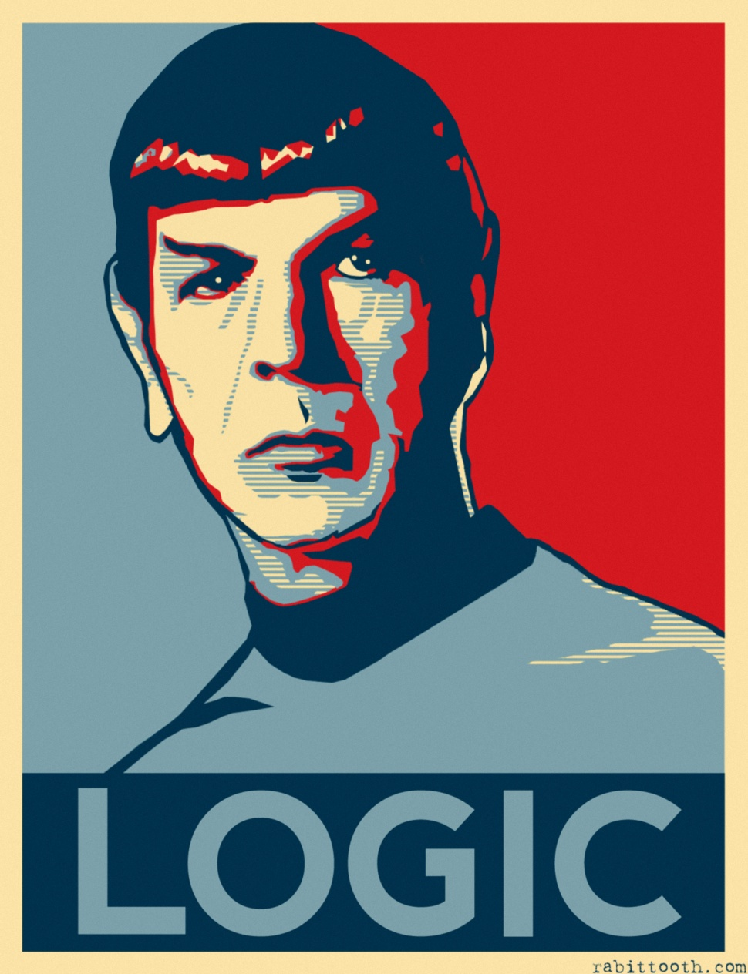
Informal Logic

Slide 5
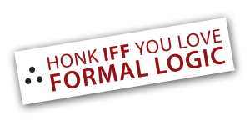

Propositions
A proposition is a statement of fact which bears a truth value, usually true or false.

Slide 6
Propositions
Which of the following are propositions?
Paris is the Capital of France
It is snowing outside
Stop talking so loudly!
4 + 16 = 21
Are you hungry?
I like chocolate ice cream
你好
Twas bryllyg, and ye slythy toves did gyre and gymble in ye wabe

Slide 7
Belief
Belief is a type of mental attitude which we hold with respect to a proposition and its truth value.
We may think the proposition is true “believe it”, think it is false “disbelieve it”, or have no opinion “neither believe nor disbelieve”.

Slide 8
Some of my Beliefs…
I believe that…
“This is the first point on this slide”
“Chocolate cake is delicious”
“The square root of 81 is 9”
“Moore’s law will hold for at least another decade”
… is a true/false proposition.

Slide 9
Arguments
In philosophy, an argument consists of a series of propositions called premises which, taken together, are intended to establish the truth of another proposition called the conclusion.

Slide 10
Arguments (examples)
Premise 1: All rationalists are tall
Premise 2: I (James Fodor) am a rationalist
Conclusion: I am ticklish

Slide 11
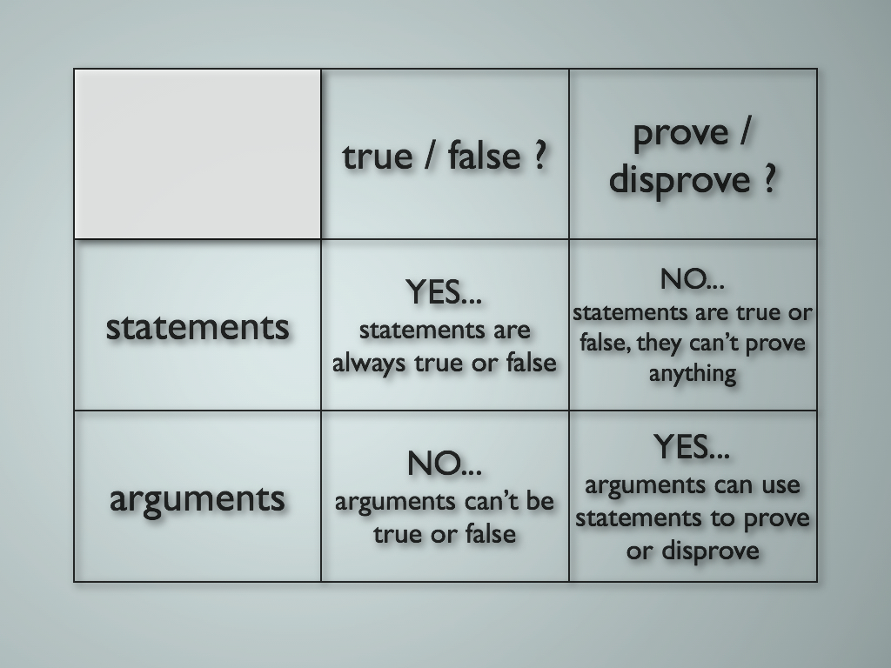
Statements vs Arguments

Slide 12
Validity
An argument is valid if its conclusion follows logically from its premises.

Slide 13
Validity (examples)
Premise 1: If Jesus performed many miracles, he must be the Son of God
Premise 2: Jesus performed many miracles
Conclusion: Jesus is the Son of God

Slide 14
Soundness
An argument is sound if it is valid (its conclusion follows from its premises), and all its premises are true.

Slide 15
Soundness (examples)
Premise 1: x is a real number
Premise 2: x^2 = 4
Premise 3: x > 0
Conclusion: x = 2

Slide 16
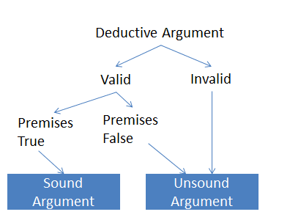
Summary

Slide 17
Logical Fallacies
A logical fallacy is a form of reasoning or type of argument which can appear to be valid, when in fact it is not valid.
Important: reasoning with a false premise is not a logical fallacy!

Slide 18

The Abuse of Logical Fallacies
Identifying and naming specific logical fallacies helps us to understand arguments better. They should be used to clarify a discussion, not as blunt instruments to hammer an opponent.
Most importantly…

Slide 19
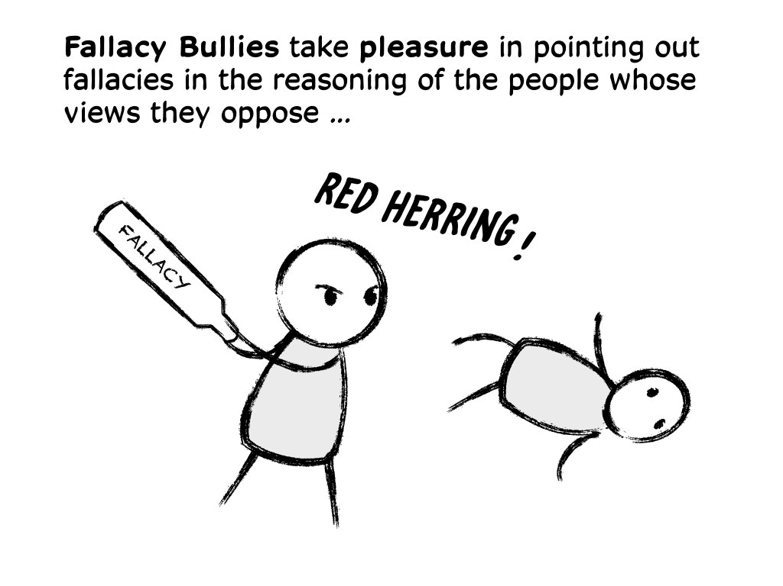
The Abuse of Logical Fallacies

Slide 20
The Abuse of Logical Fallacies
You can never prove an argument is fallacious by citing an informal logical fallacy!
Informal fallacies are always somewhat subjective matters of judgement. Often there will be just as much controversy about the fallacy label as the original debate topic.

Slide 21
The Abuse of Logical Fallacies
Logical fallacies are such because they usually look very similar to valid arguments. Distinguishing between then requires practise, skill, and wisdom.
Common problem cases:
Strawman
Slippery slope
Appeal to authority
Naturalistic fallacy

Slide 22
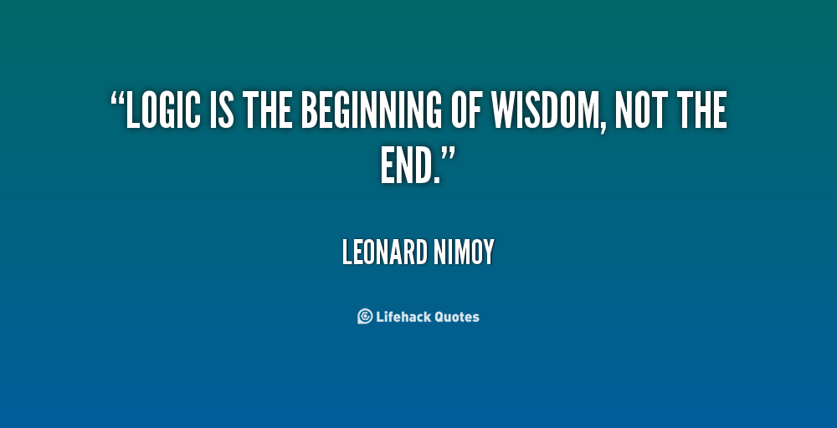
The Abuse of Logical Fallacies

Slide 23
How NOT to Evaluate an Argument
Do I agree with the point I think you are getting at?
No
Yes
Think of the first thing that ‘goes against’ your point, and say that
Express wholehearted agreement
Your ‘opponent’ responds

Slide 24
How to Evaluate an Argument
Is a proposition being asserted?
Yes (proposition)
No/unclear
Is an argument being presented to establish the truth of the proposition?
Ask for clarification
Yes (argument)
No/unclear
Does the conclusion follow from the premises?
Yes (valid)
No
Do you accept all the premises?
Identify the fallacy or gap in reasoning, then…
Yes (sound)
No
Congratulations! You just learned something
Then for each disputed premise…

Slide 25
A Caveat
The following examples are for illustration purposes only. No endorsement is made regarding their premises or conclusions. Nor do I claim that the arguments could not be reframed in a way to make them valid or sound.

Slide 26
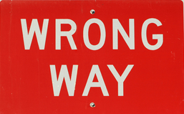
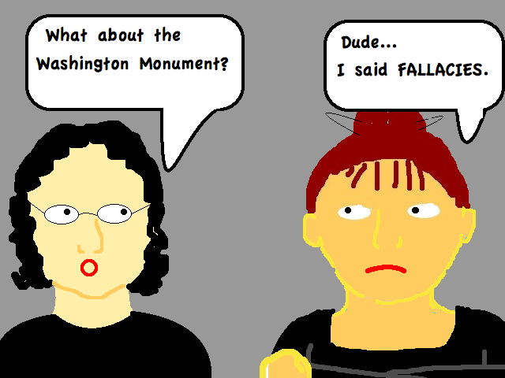
Fallacies

Slide 27
Fallacy Cheat Sheet
Argument from Ignorance | Deducing the truth of a proposition by the failure to show its falsity. More broadly, drawing any strong conclusion on the basis of lack of knowledge
Begging the Question | Using one’s desired conclusion, or a statement which is dependent on that conclusion, as a premise in one’s argument
Equivocation | The misleading or confusing use of a single word or phrase to mean different things in different parts of an argument.
Fallacy of Composition | Falsely concluding that a property obtains of a whole on the basis that the property obtains of the parts of the whole.
Fallacy of the Single Cause | An argument which infers that because some A is caused by B, that therefore C cannot also be a cause of A.
Appeal to Nature | An argument which infers the goodness of some act or outcome simply on the basis that it is natural.
Correlation and Causation | The false assertion that because two things are found to co-occur, that therefore one must be the cause of the other.
Reification Fallacy | Appealing to an abstraction as if it were a real, concrete entity.
The Fallacy Fallacy | Inferring the falsity of the conclusion of an argument on the basis that the argument is fallacious.

Slide 28
(examples)
Premise 1: Eliezer Yudkowsky is a man
Premise 2: All men are mortal
Conclusion: Eliezer Yudkowsky is mortal

Slide 29
(examples)
Premise 1: If you buy a lottery ticket, you might win a lot of money
Premise 2: It is good to win a lot of money
Premise 3: If something is good, you should do it
Conclusion: You should buy a lottery ticket

Slide 30
(examples)
How can an atheist justify morality in the absence of a God? On what basis can they claim that their subjective sense of goodness is superior to anyone else's? What place can a concept like goodness have in a purely naturalistic, material universe?

Slide 31
(examples)
The anti-vaccination movement is one of the most idiotic social movements of all time. Populated by ‘big pharma’ conspiracy theorists and the scientifically illiterate, this movement is responsible for the death of hundreds of children. All their claims are founded on lies or misunderstanding of science.

Slide 32
(examples)
Premise 1: There are many different concepts of God in different religions
Premise 2: Most of these ideas about God don’t many any rational sense
Premise 3: No objective evidence for God’s existence has ever been found
Conclusion: God does not exist

Slide 33
(examples)
Premise 1: There is no credible historical evidence that Jesus existed as a real person
Premise 2: If Jesus did not exist as a real person, Christianity is false
Conclusion: Christianity is false

Slide 34
(examples)
Premise 1: Greenhouse gas emissions are a major cause of global warming
Premise 2: A carbon tax would reduce greenhouse gas emissions
Conclusion: We should adopt a carbon tax

Slide 35
(examples)
‘Once a zygote is formed, the cell has a full set of human chromosomes, and so is a human being. Since human beings have a right to life, from fertilization on the embryo also has a right to life.’

Slide 36
(examples)
‘Capitalism is an economic system which systematically encourages the subjugation of the working masses by a small propertied elite. Capitalism is destructive of the human spirit, giving almost all the wealth to a tiny few and almost nothing to the rest.’

Slide 37
(examples)
‘A being as intelligent and powerful as God would have to be inconceivably complex. Such a complex entity is an unnecessary extravagant hypothesis. Thus it is very unlikely that God exists.’

Slide 38
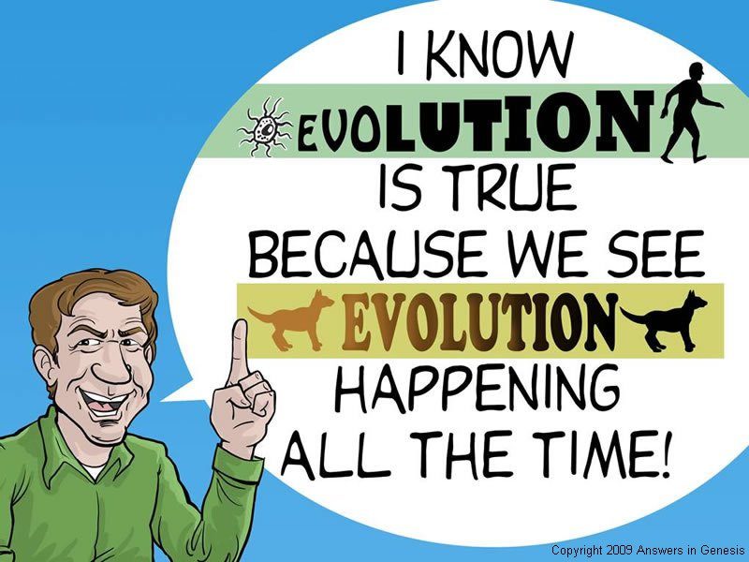
(examples)

Slide 39
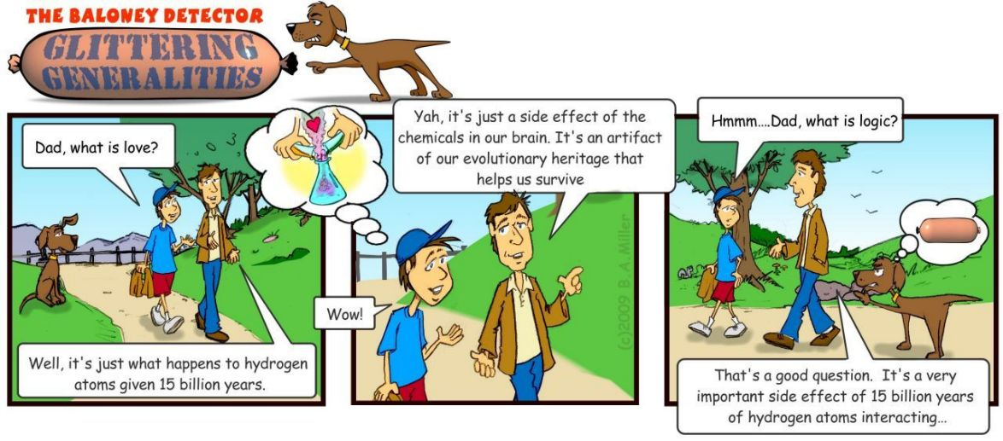
(examples)

Slide 40
(examples)
‘Homosexuality is found in many different species and across many human cultures – it’s a natural part of the animal world. People are born gay, they don’t choose to be gay. Thus it is absurd to say that homosexuality is immoral.’

Slide 41
(examples)
‘We don’t know what effects GM crops could have on the environment or on human health. This artificial “frankenfood” is simply too dangerous for human consumption. GM crops must be banned.’

Slide 42
(examples)
‘Mental function can be shown to be the result of activity in particular regions of the brain. As such, it is not caused by any supernatural or immaterial soul.’

Slide 43
(examples)
‘Global temperatures have risen in the past century in almost lock-step with human greenhouse gas emissions. The implication is clear: humans are the cause of global warming.’

Slide 44
(examples)
“You just argued that global warming is real by citing a number of prominent climate scientists. That’s invalid reasoning, its just an appeal to authority. You need to cite actual evidence to establish your conclusion.”

Slide 45
(examples)
‘In an atheistic world, humans are nothing more than atoms moving about under the laws of physics. Atoms don’t have any moral value – they just exist. Thus, under an atheistic worldview humans have no more moral status than puddles or slime or piles of rocks.’

