Slide 1
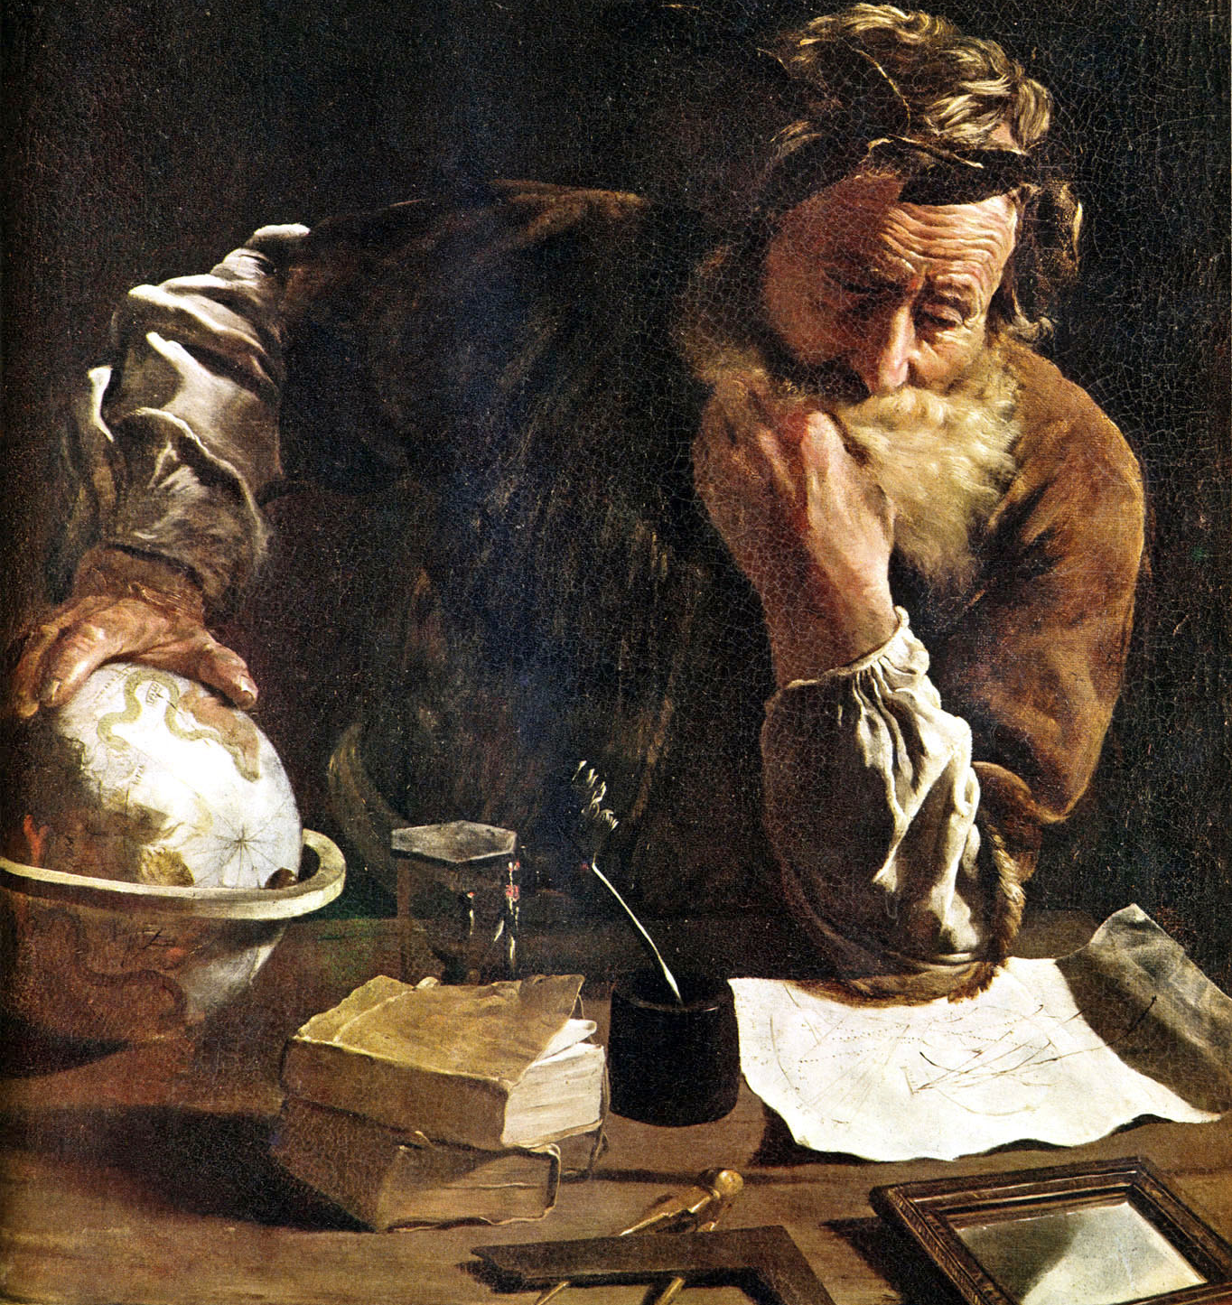
A Naturalistic Worldview
James Fodor, August 2017

Slide 2
Key Ideas
Key principles I will discuss:
Principle 1: Naturalism
Principle 2: Nominalism
Principle 3: Reductionism
Application: Morality
Arguments in favour of reductive naturalism

Slide 3
Key Ideas
Tonight I am not arguing that ‘nature is all there is’. Rather I am arguing that we have no good (philosophical/scientific) reasons to think there is anything beyond nature.

Slide 4
1. Naturalism

Slide 5
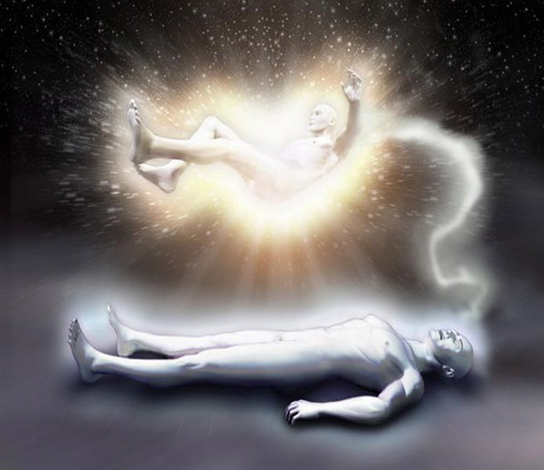
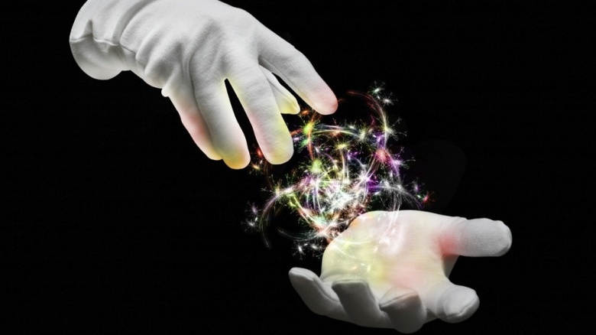

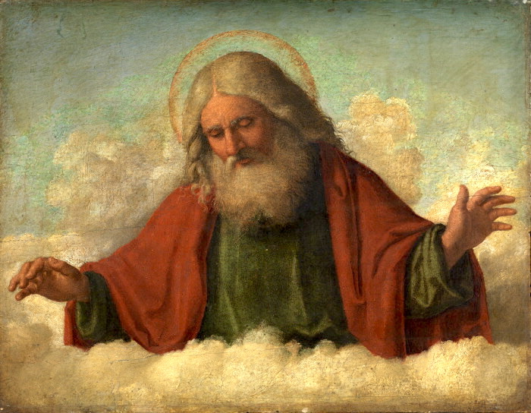

Non-natural entities

Slide 6
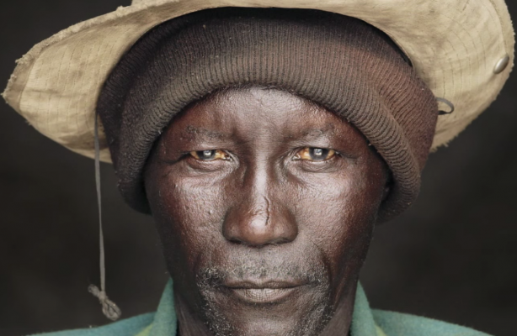

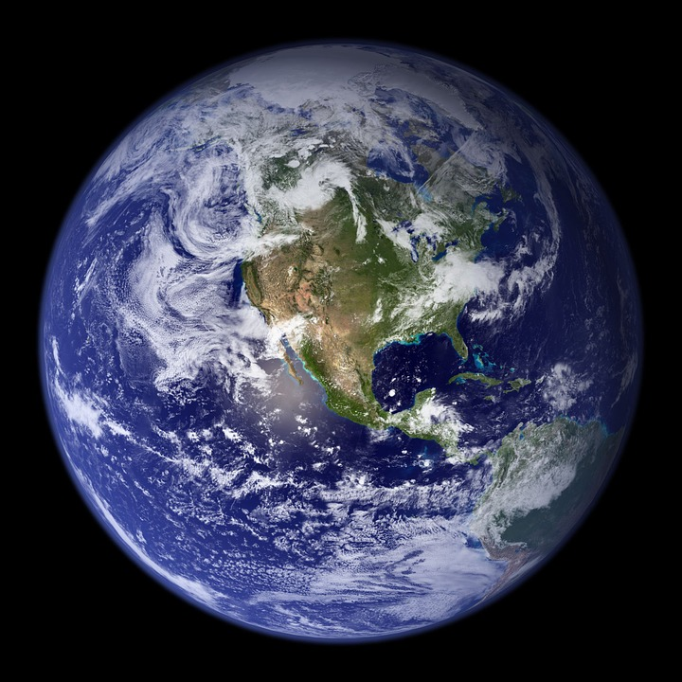

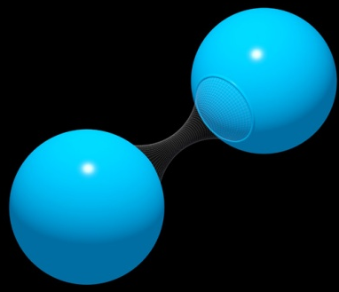

Natural entities

Slide 7
Naturalism
Non-natural entities
Things that are part of nature
Things that exist

Slide 8
Naturalism
{Things that exist} = {Things that are part of nature}
Things that are part of nature
“Reality is exhausted by nature”

Slide 9
2. Nominalism

Slide 10
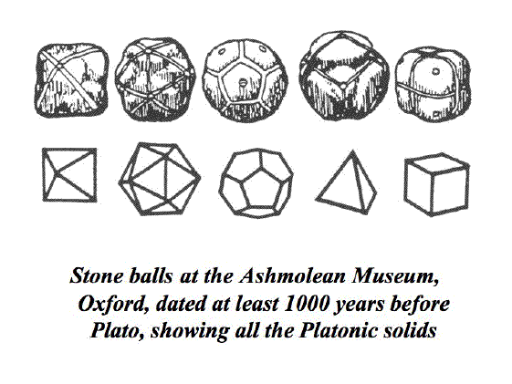
Nominalism
“The question that realists and nominalists try to answer is: What makes F-things F? For instance, what makes a square thing square? For the realist about universals if something is square, this is in virtue of the thing instantiating the universal ‘squareness’.”

Slide 11
Nominalism
Nominalism holds that universals do not exist
Only particulars exist
Concept nominalism holds that (for example) something is square if it fits our concept of ‘square’
Direct link to macrostates (stay tuned)

Slide 12
3. Reductionism

Slide 13
Reductionism
Everything (or all properties) that exists is either:
A fundamental particle/field/etc, or
Exists in virtue of certain specified arrangements and interactions of particles/fields/etc

Slide 14

Reductionism

Slide 15

Reductionism

Slide 16
Reductionism
“A dot-matrix picture has global properties — it is symmetrical, it is cluttered, and whatnot — and yet all there is to the picture is dots and non-dots at each point of the matrix. The global properties are nothing but patterns in the dots. They supervene: no two pictures could differ in their global properties without differing, somewhere, in whether there is or there isn't a dot.”

Slide 17

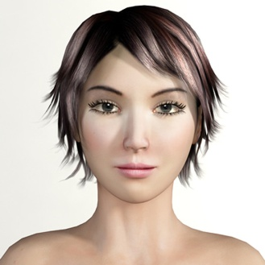
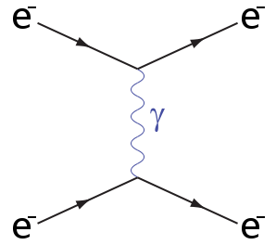
Is Reductionism Plausible?
“Bob loves his wife”

Slide 18
Is Reductionism Plausible?
Not a semantic claim about mental content
Not an epistemological claim about knowledge
An ontological claim about basis of existence

Slide 19
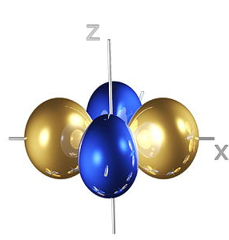
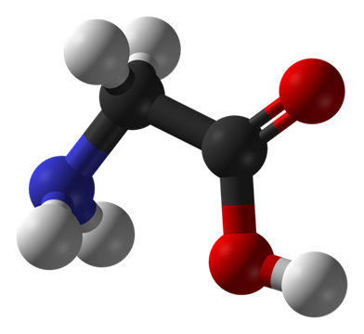
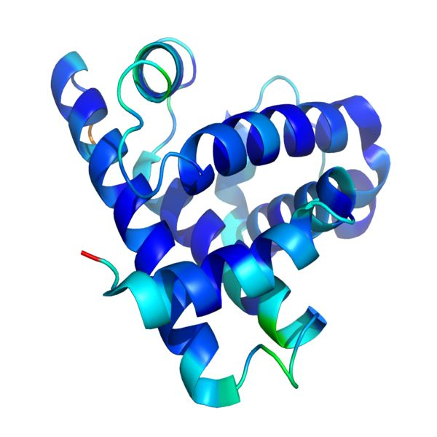
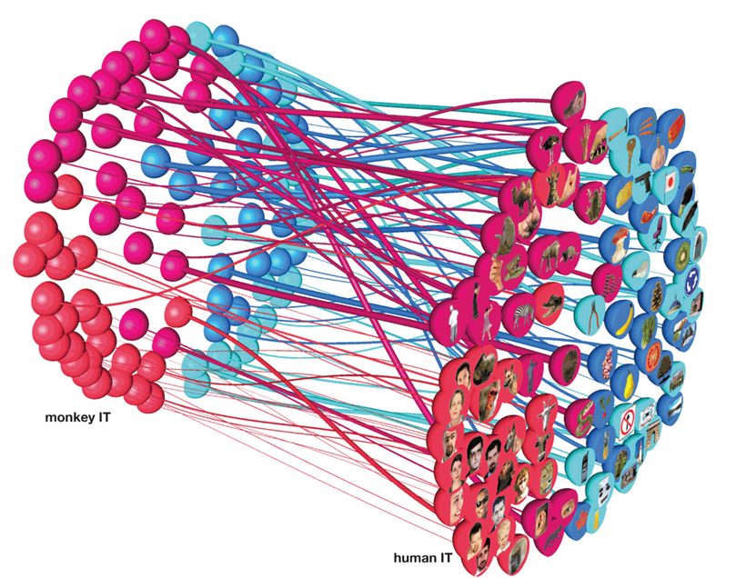
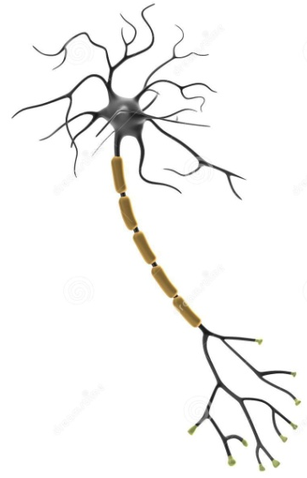
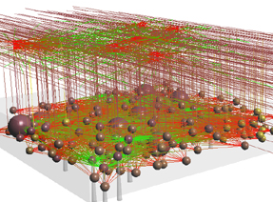
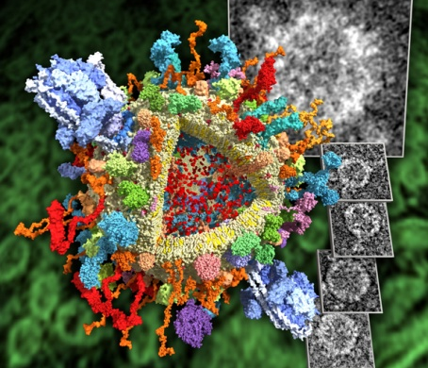
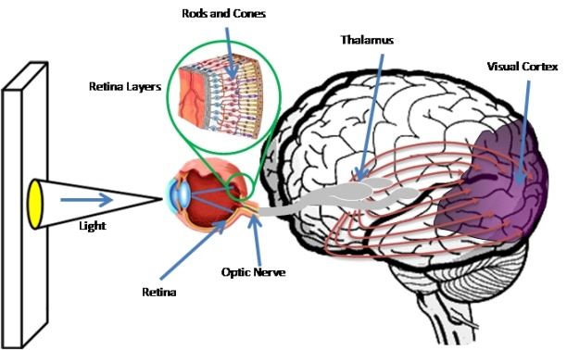


Reductionism

Slide 20
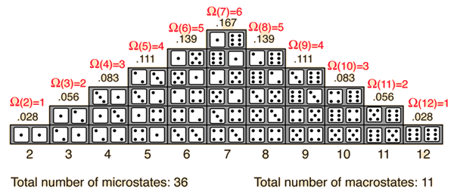
Macro and Microstates
Microstate: a single possible configuration of all fundamental particles in a system
Macrostate: a set of microstates that share some property or behaviour of interest

Slide 21
Application: Morality

Slide 22
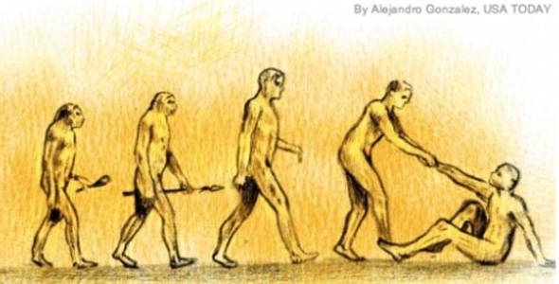
Morality in Nature
Moral statements refer to complex sets of physical states (ethical naturalism)
Macrostates: morally good states of affairs facilitate human flourishing and impede misery
Microstates: biological, social, political...

Slide 23
Morality in Nature
Morality is real and objective, based on characteristics of the natural world
No need for anything beyond nature to account for morality
Moral progress is possible as we learn more about human suffering and flourishing

Slide 24
Advantages of Naturalism

Slide 25
Advantages of Naturalism
Parsimony
Explanatory power
Paradoxes of identity

Slide 26
Parsimony
Naturalism is a minimal ontology
Can we account for what we need with so little?
If yes, no need to postulate anything else (Ockham's razor)

Slide 27
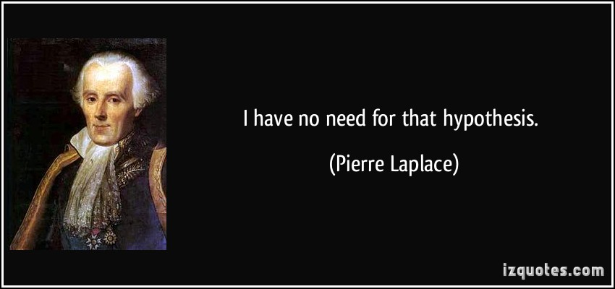
Parsimony

Slide 28
Explanatory Power
Non-natural entities are understood to be fundamentally mysterious and inexplicable
Not subject to regular causal laws
Thus they cannot give us explanatory power to account for other phenomena

Slide 29

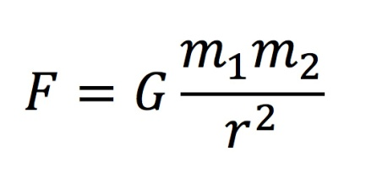
Explanatory Power
?
?
?
Non-natural entities
Things that are part of nature
?
?
?
Things that exist

Slide 30
Explanatory Power
Things that are part of nature
{Things that exist} = {Things that are part of nature}

Slide 31
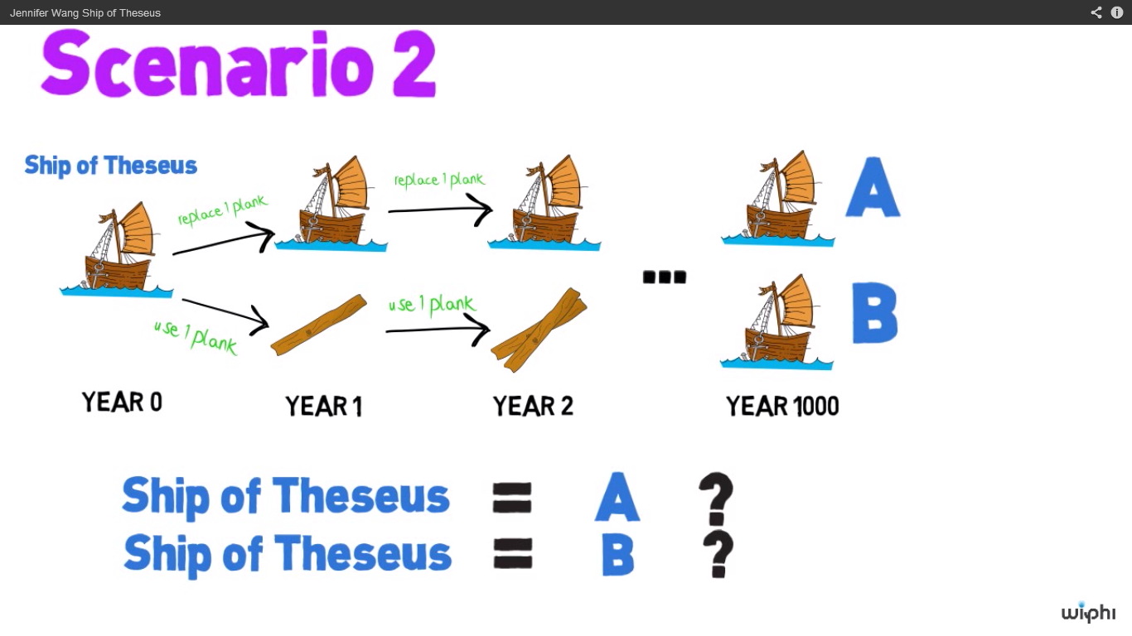
Paradoxes of Identity

Slide 32
Paradoxes of Identity
Many other related paradoxes of identity, change, personal continuity, etc
Trouble arises from granting macroscopic complex objects fundamental ontological standing
Resolved by using the language of macrostates; how broadly or narrowly are they defined?

Slide 33
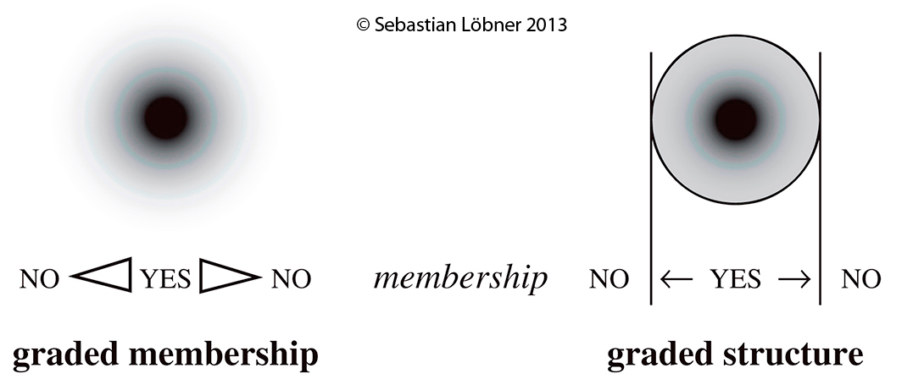
Paradoxes of Identity
Reductionism reframes these puzzles into semantic disputes without ontological import.

Slide 34
Summary
Principle 1: Naturalism
Principle 2: Nominalism
Principle 3: Reductionism
Application: Morality
Arguments for reductive naturalism
  Parsimony
  Explanatory power
  Paradoxes of identity

Slide 35
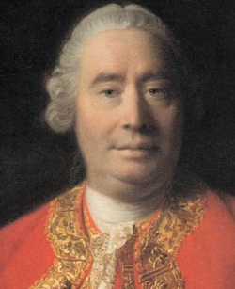
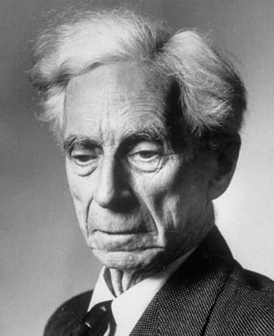
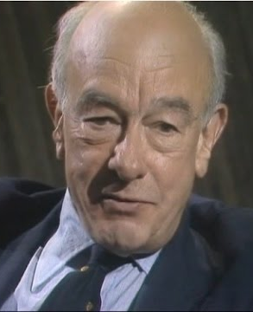
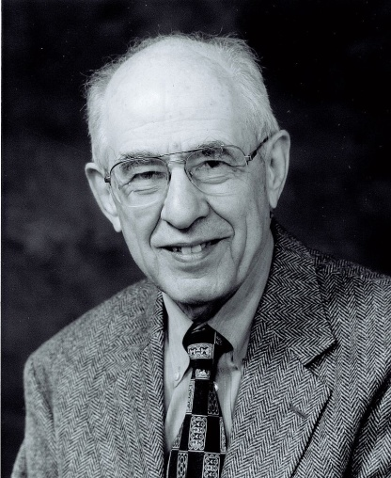
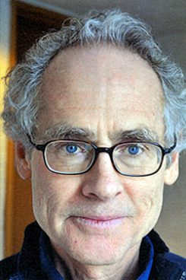
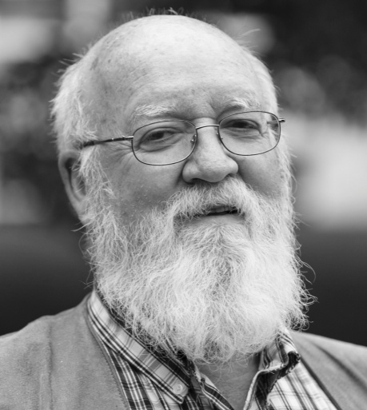
Influential Thinkers
David Hume
Bertrand Russell
Willard Quine
Hilary Putman
Peter Railton
Daniel Dennett

Slide 36
Rebuttals

Slide 37
A Cluttered Ontology

Slide 38
A Simple Ontology

Slide 39
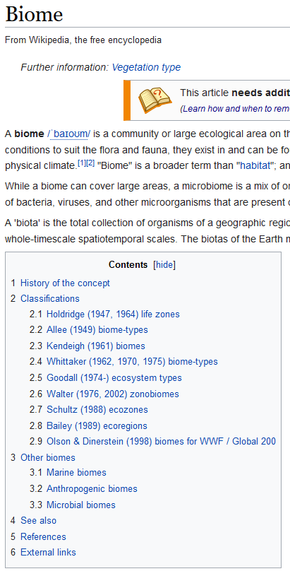
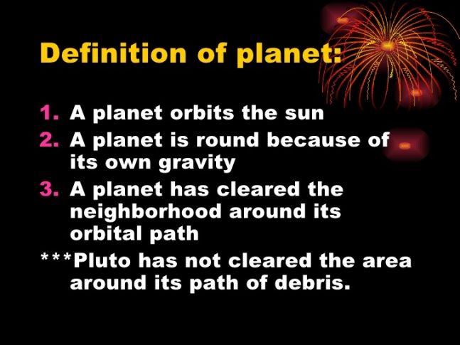
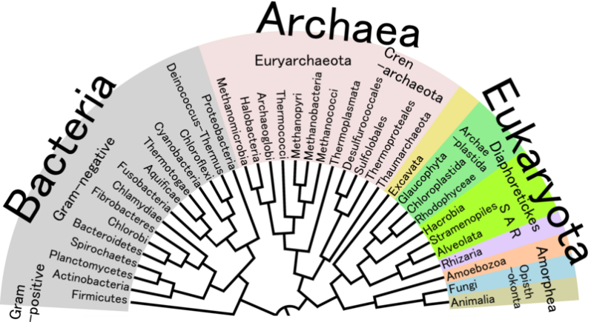
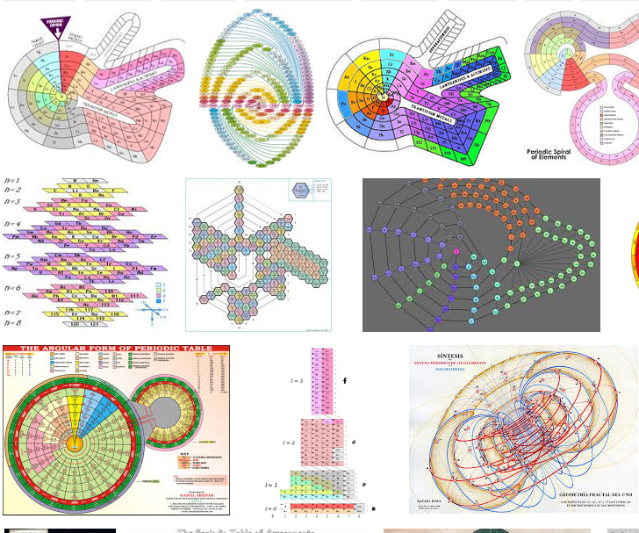
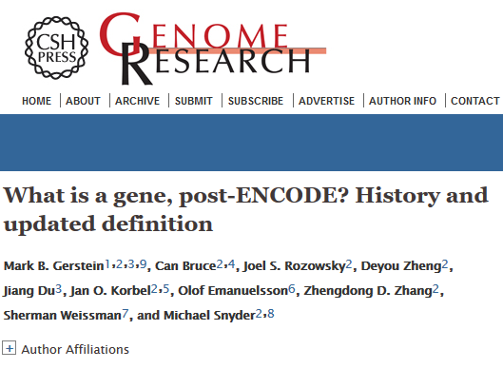
Carving Nature at its Joints?
Very hard to give any complex object a precise definition

Slide 40
A Puzzling Ontology
How do we establish the boundaries between universals and between particulars?
How do objects have causal powers beyond those of their component parts?
How do particulars ‘instantiate’ abstract objects if abstract objects have no causal powers?
How to reconcile abstract objects with divine aseity?
Et cetera

Slide 41
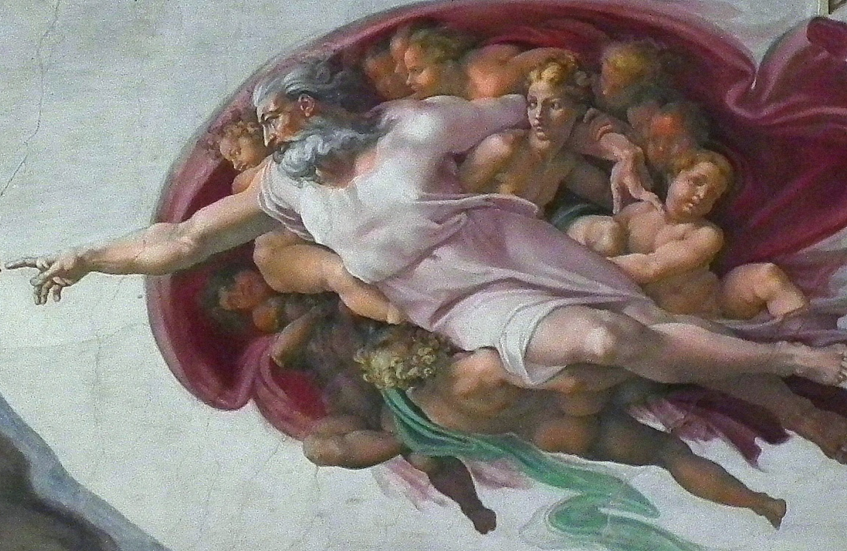
Lack of Explanatory Power
A
??
??
B
??
C
??
D
If God could do anything, he can never be used to explain anything – unless you already have a theology.

Slide 42
Other Slides

Slide 43
The Mind in Nature
Mental states are real (contra behaviourism); supervene on physical states
Free will exists as an emergent property of a fundamentally causal system
‘How’ questions now amenable to scientific inquiry
A place for the mind in nature

Slide 44
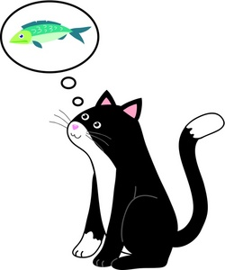

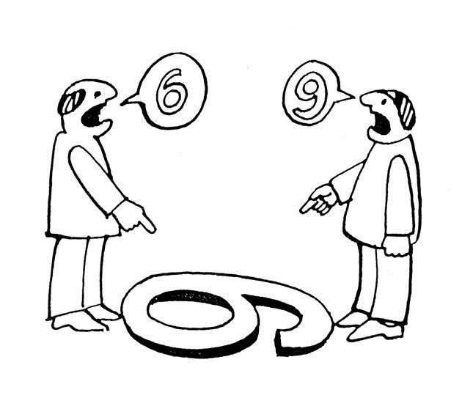
The Mind in Nature
Mental states are complex sets of physical states (materialist functionalism)
Mental macrostates: states of deciding, perceiving, remembering, etc – abstract states of complex system

Slide 45
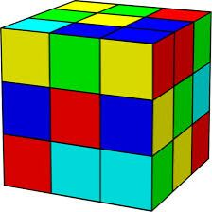
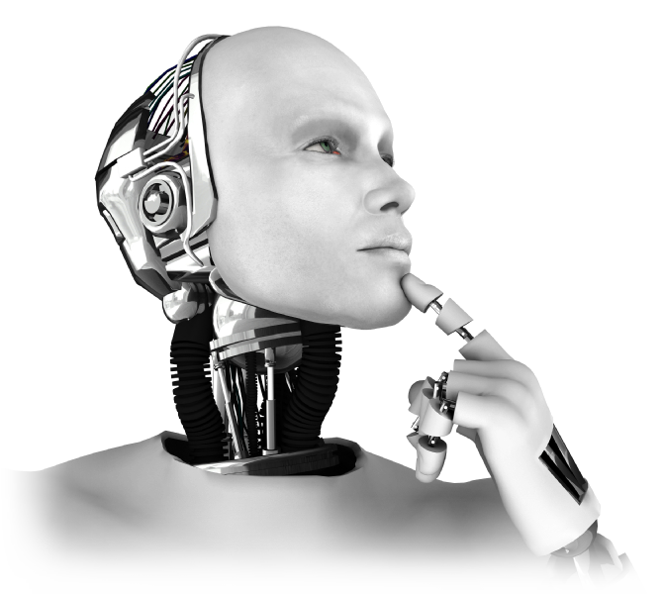
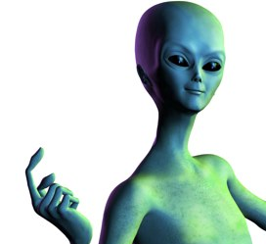
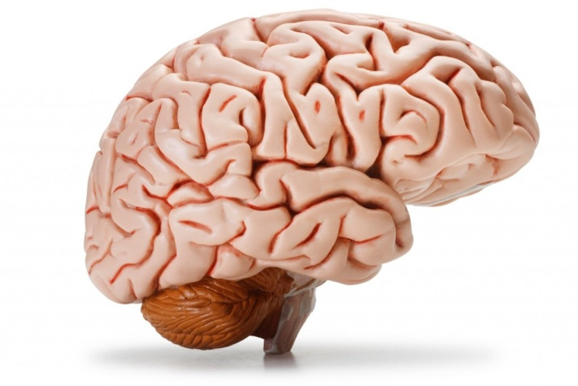
The Mind in Nature
Microstates: multiple realisability

Slide 46
Philosophical Method
Use conceptual analysis to determine what macrostates our concepts refer to
Use empirical analysis to identify which (if any) microstates instantiate those macrostates
Iterate between the two until reaching reflective equilibrium

