Slide 1
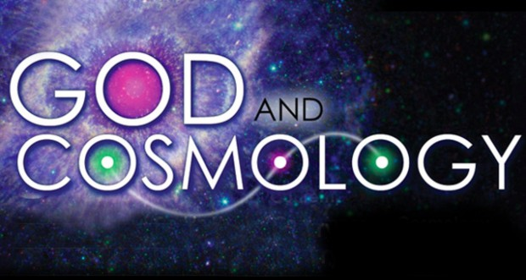
God and Cosmology
James Fodor, 13th Sept 2016

Slide 2
Physical Cosmology
Physical cosmology is the scientific study of the largest-scale structure and behaviour of the Universe. It studies fundamental questions concerning the origin, structure, evolution, and ultimate fate of the physical universe.

Slide 3
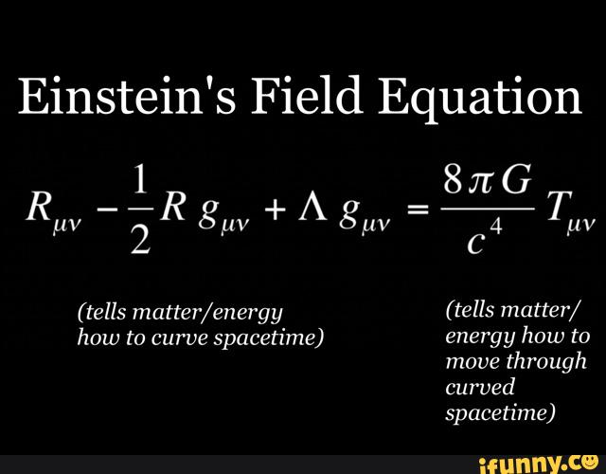
General Relativity

Slide 4
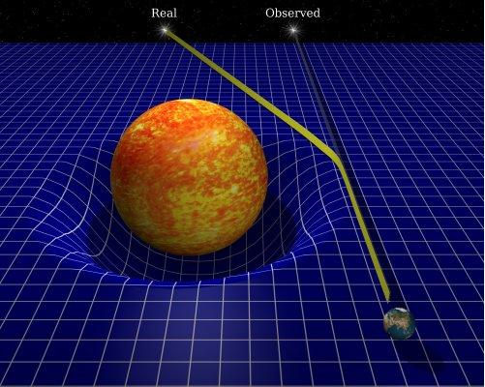
General Relativity

Slide 5

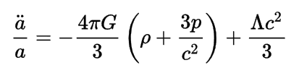
Friedmann Equations
If the universe is spatially homogenous and isotropic, these simplify to:

Slide 6
Friedmann Equations
Without the cosmological constant, these equations have no static solution. Prediction of the expansion of the universe!

Slide 7
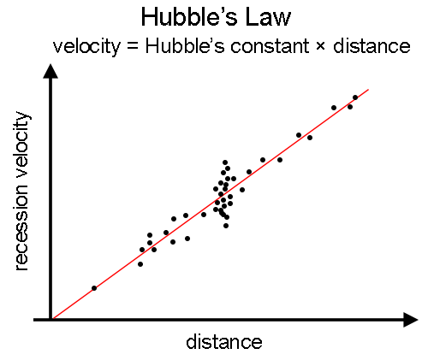
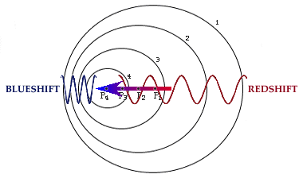
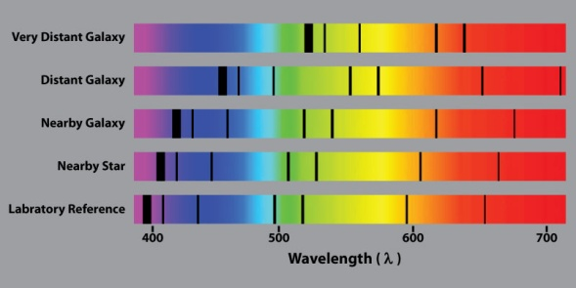
Hubble’s Law
Hubble discovered that all galaxies are moving away from us at a velocity proportional to their distance.

Slide 8
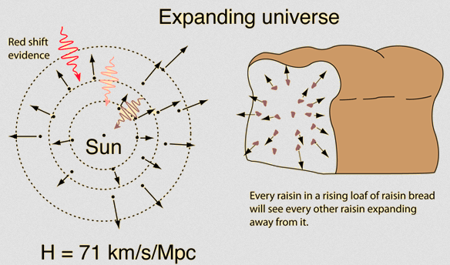
The Universe is Expanding!

Slide 9
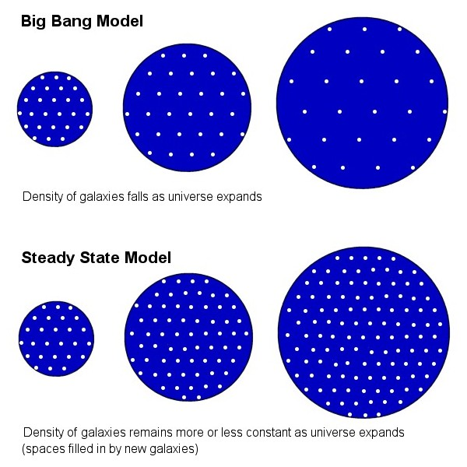
Two Competing Models

Slide 10
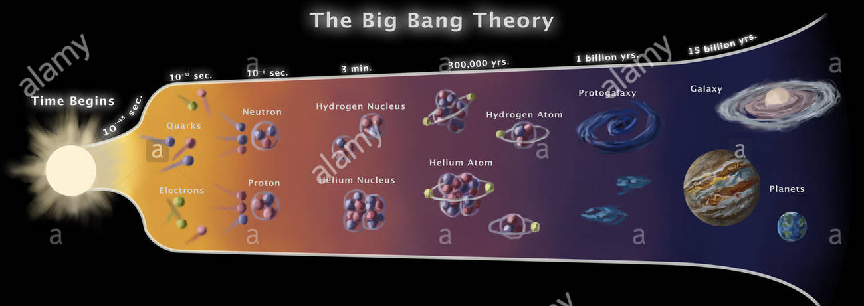
Two Competing Models

Slide 11
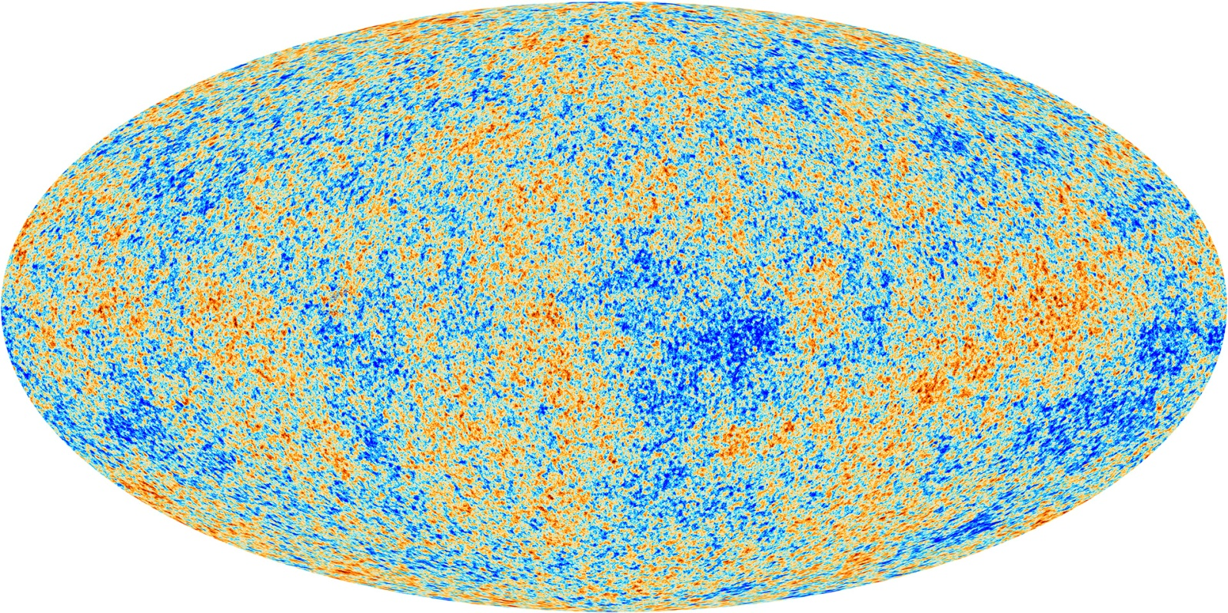
Cosmic Background Radiation
The cosmic microwave background (CMB) is the thermal radiation left over from the time of recombination when the universe became transparent to light.

Slide 12
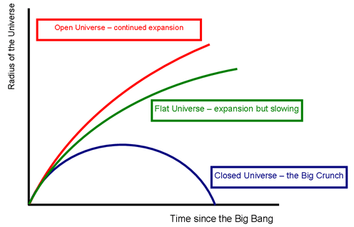
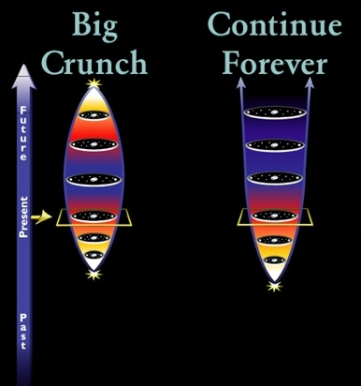
The Future of the Universe
The ultimate fate of the universe depends on how much mass/energy it contains.

Slide 13
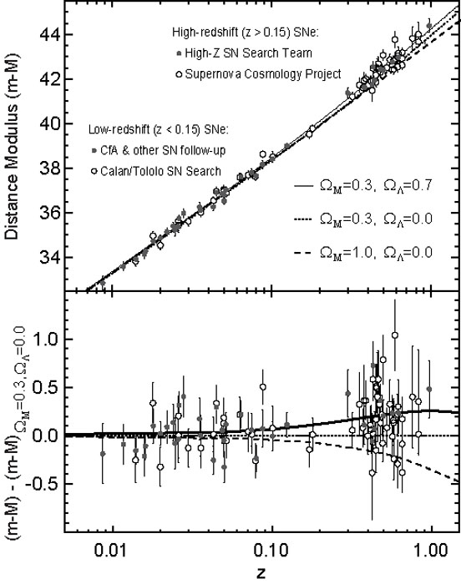
Dark Energy

Slide 14
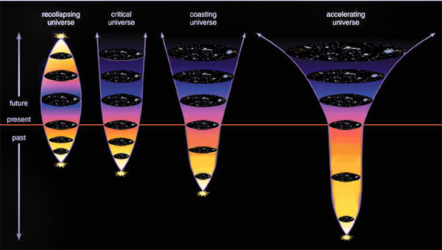
The Accelerating Expansion

Slide 15
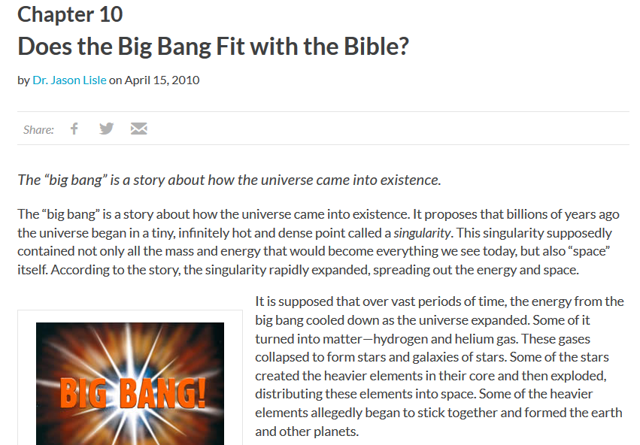
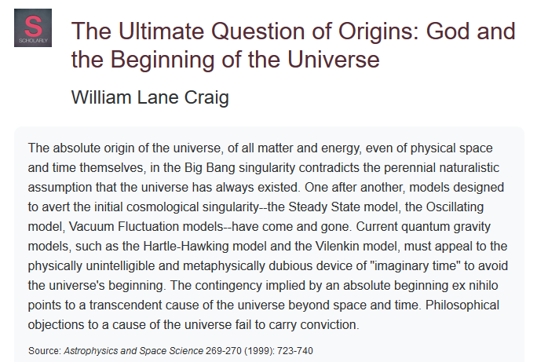
What Say Christians?
Young Earth Creationists must reject the Big Bang. Other evangelicals use it as an argument for the existence of God.

Slide 16
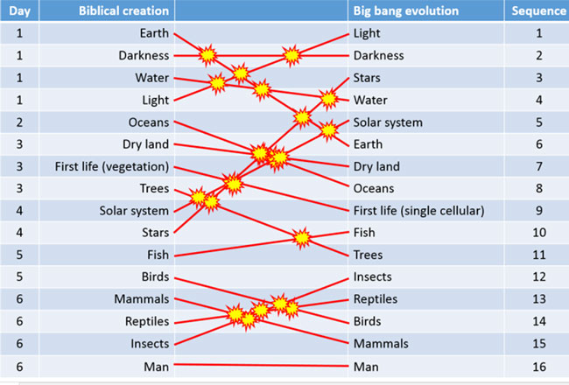
What Say Christians?
Hard core biblical literalists also take issue with the order of creation in the scientific account.

Slide 17
What Say Christians?
Hard core biblical literalists also take issue with the order of creation in the scientific account.

Slide 18
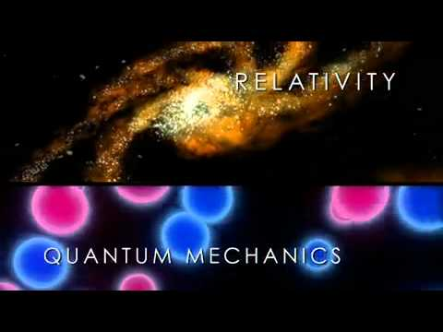
Limitations of the Big Bang Theory
The Big Bang Theory cannot explain how the universe began at the initial singularity because we do not have a quantum theory of gravity.

Slide 19
What Caused the Big Bang?
Since the Big Bang represents the very beginning of space and time, it cannot have been caused by anything in space or time.

Slide 20
What Caused the Big Bang?
P. C. W. Davies:
“'What caused the big bang?'... One might consider some supernatural force, some agency beyond space and time as being responsible for the big bang, or one might prefer to regard the big bang as an event without a cause. It seems to me that we don't have too much choice. Either... something outside of the physical world... or an event without a cause.”

Slide 21
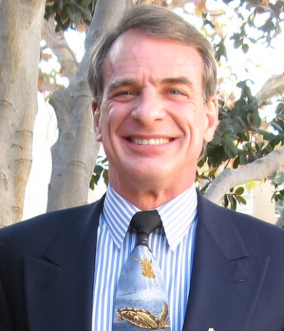
William Lane Craig’s Argument

Slide 22
William Lane Craig’s Argument
William Lane Craig:
“To claim that something can come into being from nothing is worse than magic. When a magician pulls a rabbit out of a hat, at least you’ve got the magician, not to mention the hat! ...you’ve got to think that the whole universe just appeared at some point in the past for no reason whatsoever. But nobody sincerely believes that things, say, a horse or an Eskimo village, can just pop into being without a cause.”

Slide 23
William Lane Craig’s Argument
William Lane Craig:
“Here’s the problem: If a cause is sufficient to produce its effect, then if the cause is there, the effect must be there, too... Now the cause of the universe is permanently there, since it is timeless. So why isn’t the universe permanently there as well? Why did the universe come into being only 14 billion years ago? Why isn’t it as permanent as its cause? ...the answer to this problem is that the First Cause must be a personal being endowed with freedom of the will. His creating the universe is a free act which is independent of any prior determining conditions. So his act of creating can be something spontaneous and new. Freedom of the will enables one to get an effect with a beginning from a permanent, timeless cause. Thus, we are brought not merely to a transcendent cause of the universe but to its Personal Creator.

