Slide 1

Introduction to Effective Altruism
Synopsis: Effective Altruism is a new social movement whose goal is to encourage everyone to use the best reason and evidence available to do the most good possible. Founded on the ideas of leading philosophers like Peter Singer, Effective Altruism is concerned with answering questions like how we can encourage people to be more generous in their giving, what charitable causes we should focus on, and how we can improve existing methods for measuring the impact of different charities. In this presentation I will present an introduction to some of these ideas, and highlight how ides from Effective Altruism can inform us in making important life decisions and in living good, fulfilling lives.
James Fodor, 17th Sept 2015

Slide 2
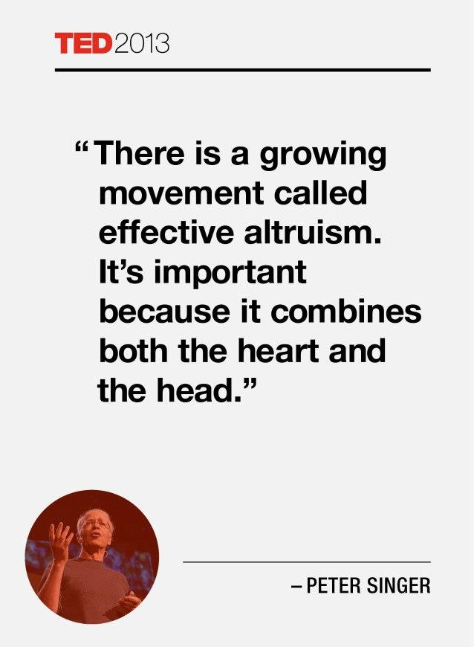
Effective Altruism

Slide 3

Principles of EA
If we can take an action that would do great good to others at comparatively small cost to ourselves, we should do it - drowning child example.

Slide 4

Principles of EA
We are all in this position, able to use of our significant means to do considerable good by donating our time and means to valuable causes.

Slide 5
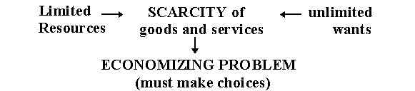
Principles of EA
Since there are too many possible beneficial actions for us to do all of them with limited resources, we should pick the possibilities that yield the most benefit. Opportunity cost.

Slide 6
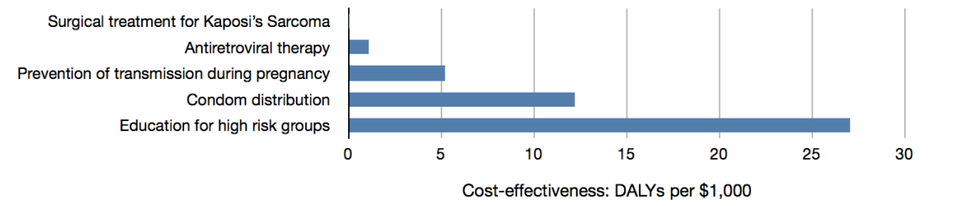
Principles of EA
To know which action will be the most beneficial, we must take advantage of the highest quality evidence we have available, and engage in careful, critical reasoning.

Slide 7
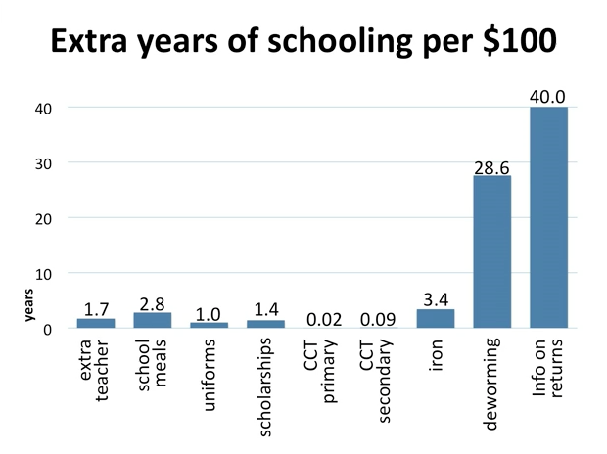
How is EA Different?
Strong emphasis on efficacy of interventions
Source: Esther Duflo TED talk

Slide 8
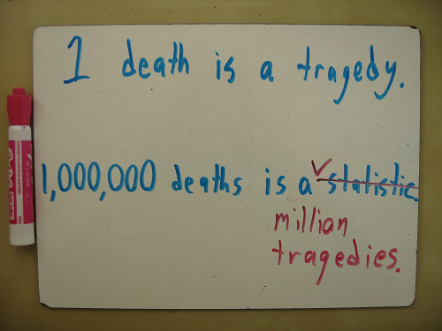
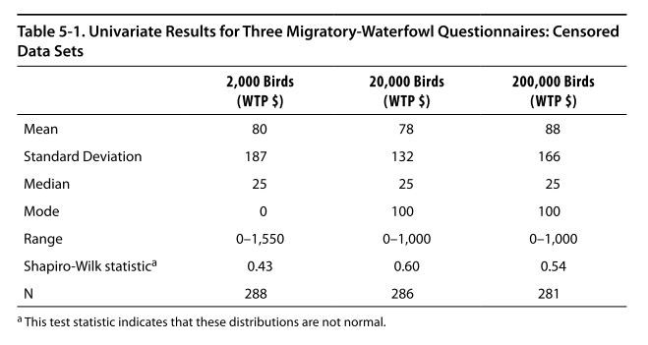
How is EA Different?
Sensitive to the scope of interventions

Slide 9


How is EA Different?
Belief that different causes are comparable

Slide 10
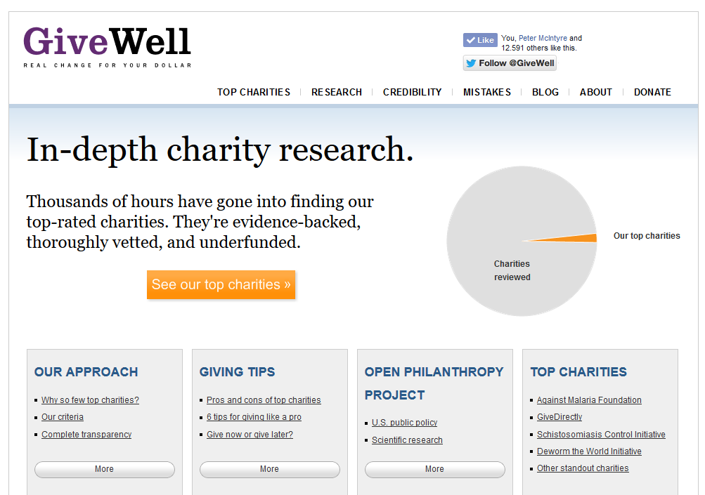
GiveWell

Slide 11
GiveWell Criteria
evidence-backed
cost-effective
capable of effectively using more funding

Slide 12

Centre for Effective Altruism

Slide 13

Giving What We Can

Slide 14
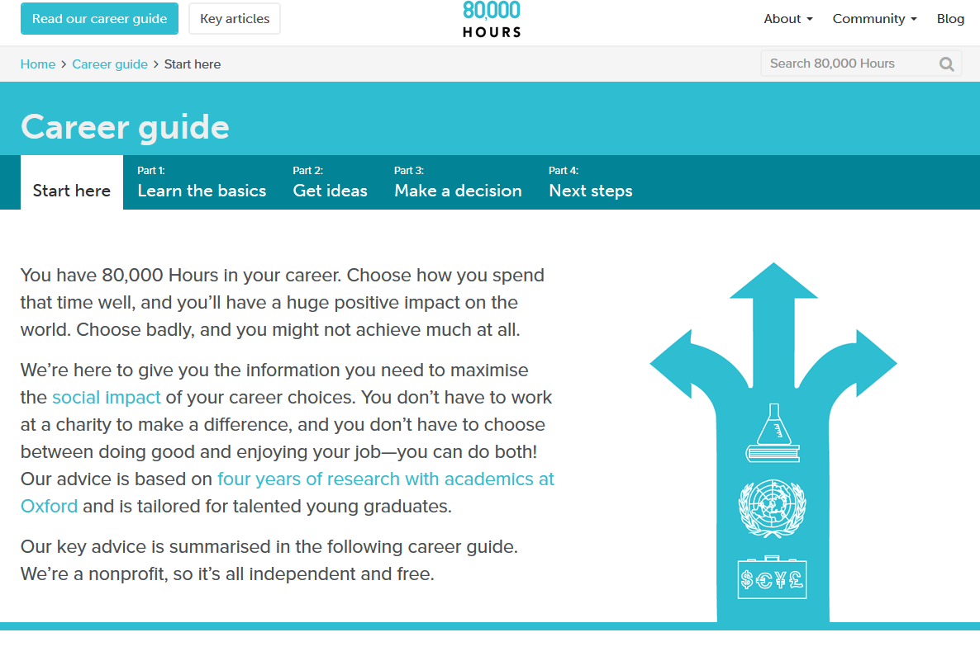
80,000 Hours

Slide 15
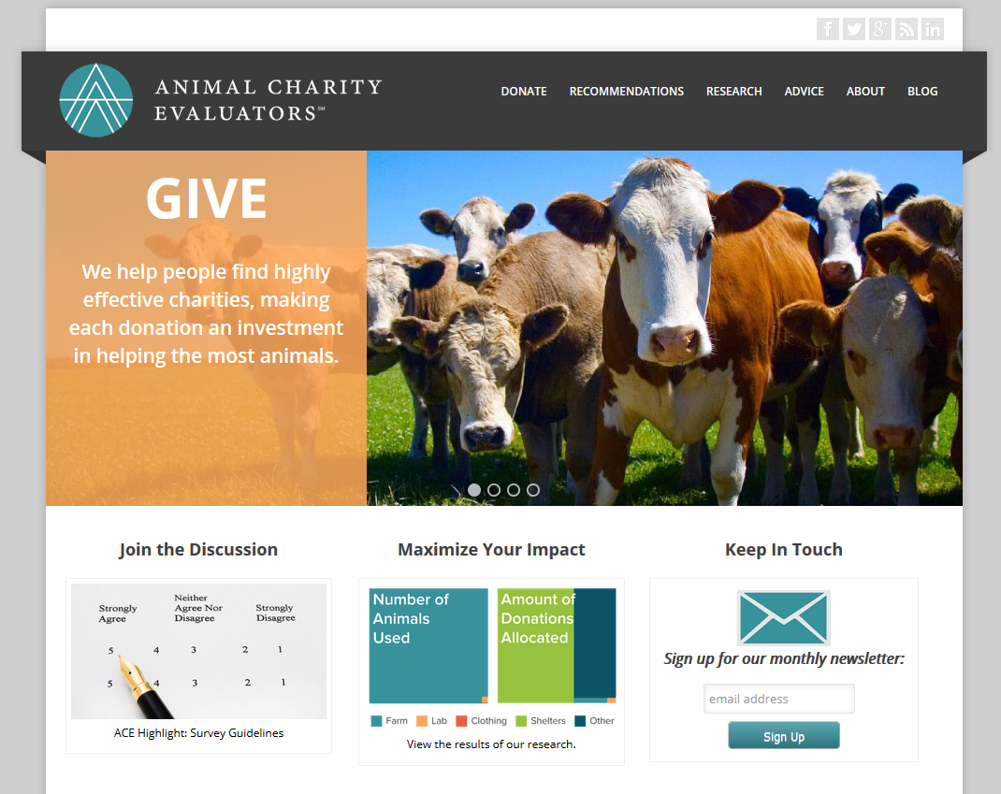
Animal Charity Evaluators

Slide 16
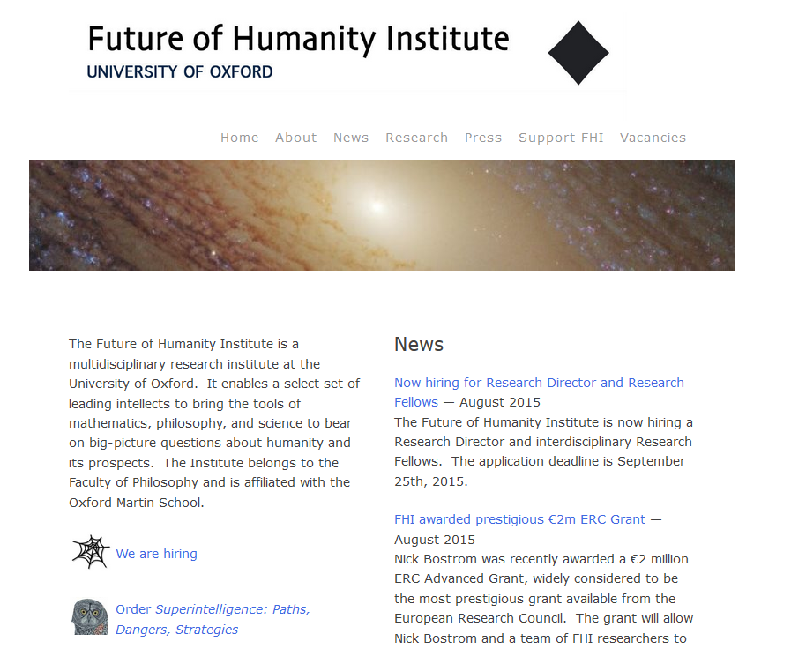
Future of Humanity Institute

Slide 17
Keen to Learn More?
Contact me at fods12@gmail.com
Join the EA Melbourne facebook group
Check out some of the organisations mentioned previously

