Slide 1

Synopsis: On many important issues of science, philosophy, politics, and religion, equally knowledgeable and intelligent people often disagree with one another. How, then, can one justify holding strong opinions on any of these matters? In this talk I will explore this problem, reviewing some common but ultimately uncompelling responses to this dilemma, and also discussing some practical strategies by which we can rationally respond to peer disagreement.
VicSkeptics Presentation, 20th Jan 2014

Slide 2
Defining Peer Disagreement
Disagreement between these of similar epistemic status, or those who are (roughly) equally intelligent, well informed, honest, rational, etc.

Slide 3


Peer Disagreement Example 1

Slide 4
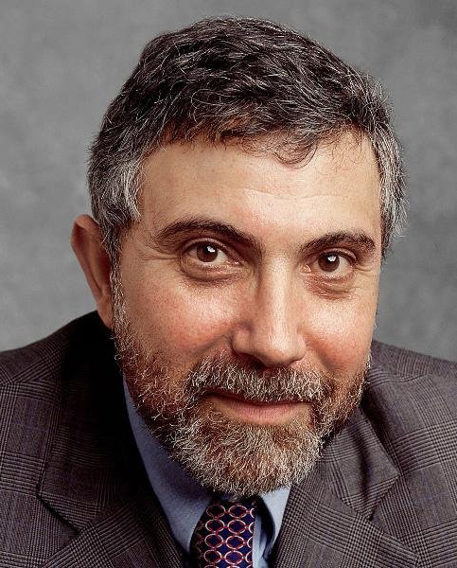
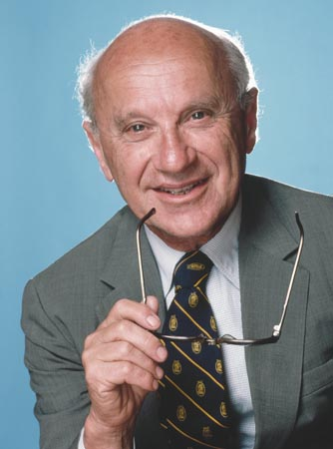
Peer Disagreement Example 2

Slide 5
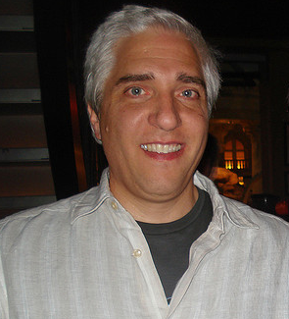
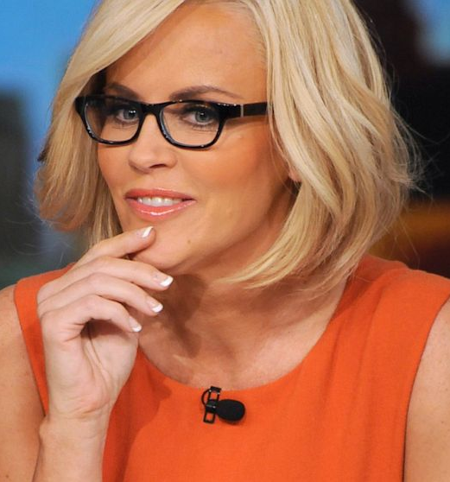
Not Peer Disagreement

Slide 6

The Core Problem
“On many issues of importance, there exists considerable peer disagreement.”

Slide 7
Issues of Importance?
Politics
Economics
Philosophy
Ethics
Religion
Evolutionary psychology
Health and fitness
Third World development
Historical debates
Future predictions
Kirk or Picard?

Slide 8
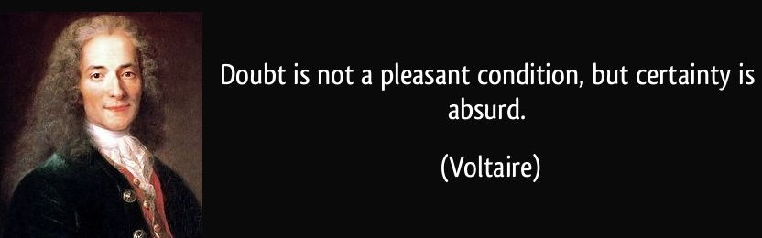
My Core Claim
“We should be much less confident in the correctness of our beliefs concerning matters in which there exists substantial peer disagreement.”

Slide 9
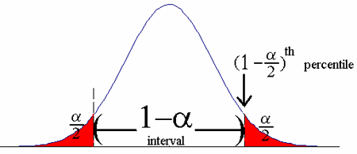
Response 1: I’m Right
“The fact that people disagree with me doesn’t mean I’m wrong.”
But: It’s about degree of confidence

Slide 10
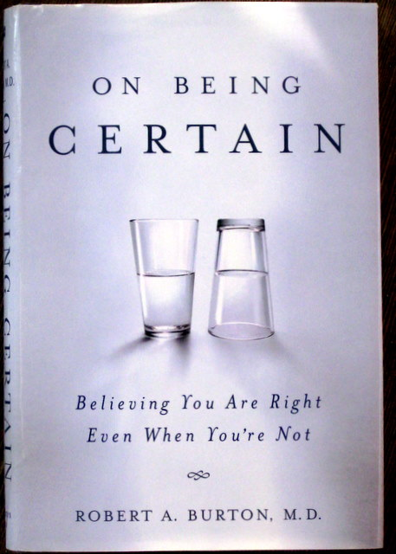
Response 2: It’s All Good
“Disagreement is good.”
But: False confidence isn’t

Slide 11

Response 3: I’m Still Right
“I am clearly right and they are clearly wrong because of reason X.”
But: Why is your view special?

Slide 12
Response 4: I Can Never be Certain
“We don’t have to be certain before forming beliefs.”
But: How confident should we be?

Slide 13
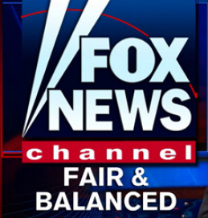
Response 5: I Listen to Both Sides
“I listen to both sides of a controversy, weigh up the evidence, and then determine who is probably right.”
But: The other guy does too

Slide 14
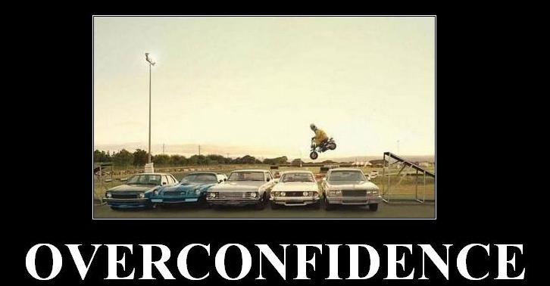
Response 6: I Still Must Act
“We still need to act and make decisions even if people do disagree.”
But: Doesn’t justify false confidence

Slide 15
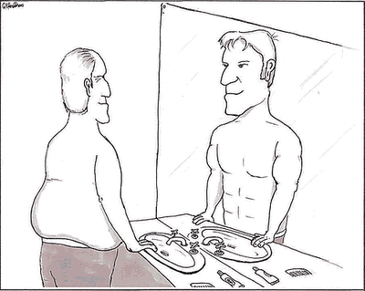
Response 7: I’m More Rational
“Most other people are biased and irrational.”
But: So are you

Slide 16
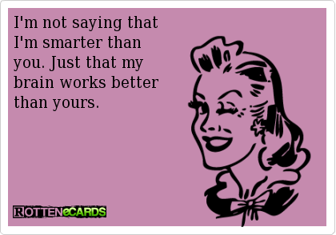
Response 8: I’m Smarter
“I have access to privileged information that other people don’t know.”
But: Not credible

Slide 17

What is to be Done?
Look for expert consensus
Where experts disagree, remain agnostic
Frequently engage in meta-reasoning
Don’t make yourself into the world expert
Seek disconfirming evidence and alternate views

Slide 18
How to Disagree 1
Not everyone is your epistemic peer
Ensure that your dispute is not merely semantic
Try to understand their position well enough to argue it for them
Try to break the argument down into very specific items of disagreement, identify those that are worth pursuing, and push those in depth
Don’t get sidetracked by minor points

Slide 19
How to Disagree 2
Figure out what evidence could determine who is right
Identify underlying assumptions (e.g. worldview differences) contributing to the disagreement
Don’t try to defend your position at all cost; try to work out exactly why you disagree
Ideas don’t need respect, but people do

Slide 20

Interested in More of This?
I run a Dealing with Disagreement discussion group
We also hold relevant events at the University of Melbourne Secular Society
Contact me at Fods12@gmail.com

