Slide 1

Synopsis: On many important issues of science, philosophy, politics, and religion, equally knowledgeable and intelligent people often disagree with one another. In this presentation I argue that on such matters, it is not epistemically justifiable to hold firmly to the correctness of one’s opinion, defined as one’s own subjective evaluation of the evidence. Rather, I argue that one’s opinion should receive no greater weight in constituting beliefs than does the opinion of any other equally informed person. I conclude by considering some common objections to my argument.
RAM Presentation, 21st May 2014

Slide 2
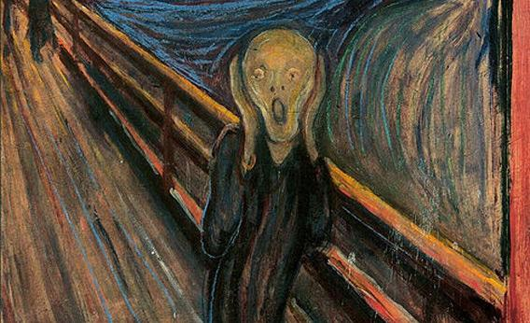
A Warning
If this talk does not disturb you, then you probably didn’t understand it…
…or maybe I’m just wrong.

Slide 3
Defining Peer Disagreement
Disagreement between these of similar epistemic status, or those who are (roughly) equally intelligent, well informed, honest, rational, etc.

Slide 4


Peer Disagreement Example 1

Slide 5
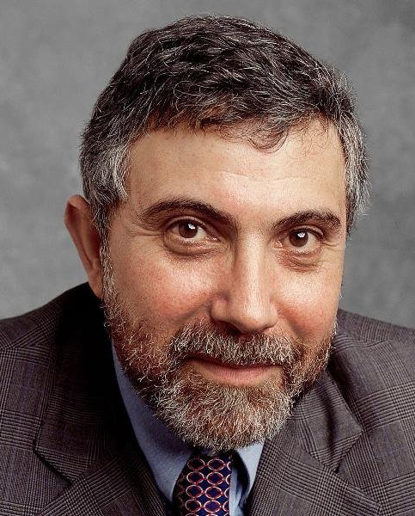
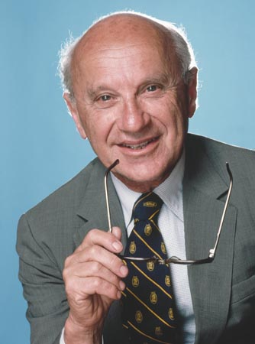
Peer Disagreement Example 2

Slide 6
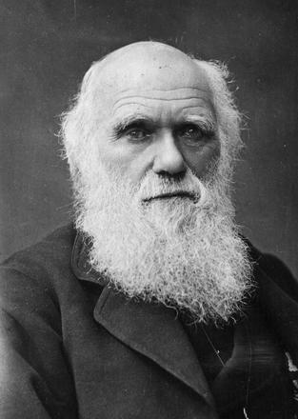
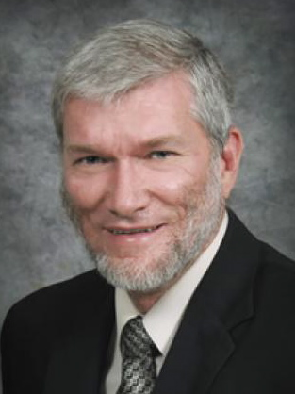
Not Peer Disagreement

Slide 7

The Core Problem
On many issues of importance, there exists considerable peer disagreement.

Slide 8
Examples of Peer Disagreement
Define P to a an arbitrary proposition that is controversial among respected experts.
“God exists”
“Objective morality is real”
“A priori knowledge is possible”
“Euthanasia should be legalised”
“Fiscal stimulus is effective”
“The mind is computable”
“Scientific Realism is true”
“String Theory is correct”
“Climate change is an existential risk”

Slide 9
A Technical Distinction
  Opinion = one’s considered view based on your reading and evaluation of the evidence
  Belief = your mental state of assenting to or not assenting to some proposition
  E.g. uncritical religious believer has belief without opinion, informed skeptic who witholds judgement has opinion but no firm belief

Slide 10
My Argument in a Nutshell
  Don’t believe your own opinion

Slide 11
Why Trust your Own Opinion?
I do some thinking and reading about a subject
On the basis of this I form a judgement that controversial proposition P is (probably) true
Question: what is the epistemic value of that judgement?

Slide 12
Example 1
“Some undergrad whom I don’t know at the University of Nova Sophia has done a moderate amount of reading on the subject, and has come to the conclusion that P is probably true. Therefore, it is rational for me to believe that P is probably true.”
Claim: that is a pretty lousy reason to believe that P is true, given how controversial it is even among experts.

Slide 13
Example 1
“I have done a moderate amount of reading on the subject, and have come to the conclusion that P is probably true. Therefore, it is rational for me to believe that P is probably true.”
Claim: changing the subject does not alter the degree of epistemic justification – this is still a lousy reason to believe P.

Slide 14
Example 2
“It seems to some undergrad who thinks they know what they are talking about at the University of Nova Sophia that there are good arguments for P and no cogent arguments for ~P. Therefore, it is rational for me to believe that P is probably true.”
Claim: that is a pretty lousy reason to believe that P is true, given how controversial it is even among experts.

Slide 15
Example 2
“It seems to me that there are good arguments for P and no cogent arguments for ~P. Therefore, it is rational for me to believe that P is probably true.”
Claim: changing the subject does not alter the degree of epistemic justification – this is still a lousy reason to believe P.

Slide 16
Why Trust your Own Opinion?
‘Traditional’ Beliefs
My Argument
Reason/evidence
Reason/evidence
My informed opinion
My informed opinion
One of many opinions
My belief
My belief

Slide 17
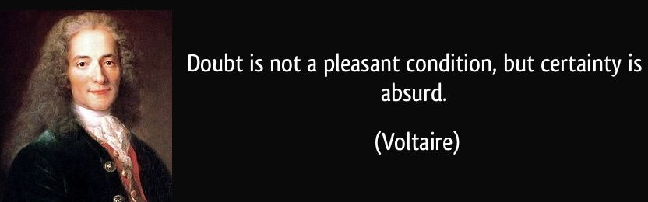
Why Trust your Own Opinion?
You have the right to form an opinion about whatever you like.
You do not have epistemic warrant to treat your own opinion as more significant over that of any other equally informed person.

Slide 18
Why Trust your Own Opinion?
Your own opinions:
Are easier to access (via introspection)
Seem more coherent (until you try to explain them)
Are yours and not someone else’s
Seem to fit better with your overall worldview
Are understood by you more intimately
Subjectively feel very persuasive (often)
But none of these are epistemically relevant!

Slide 19
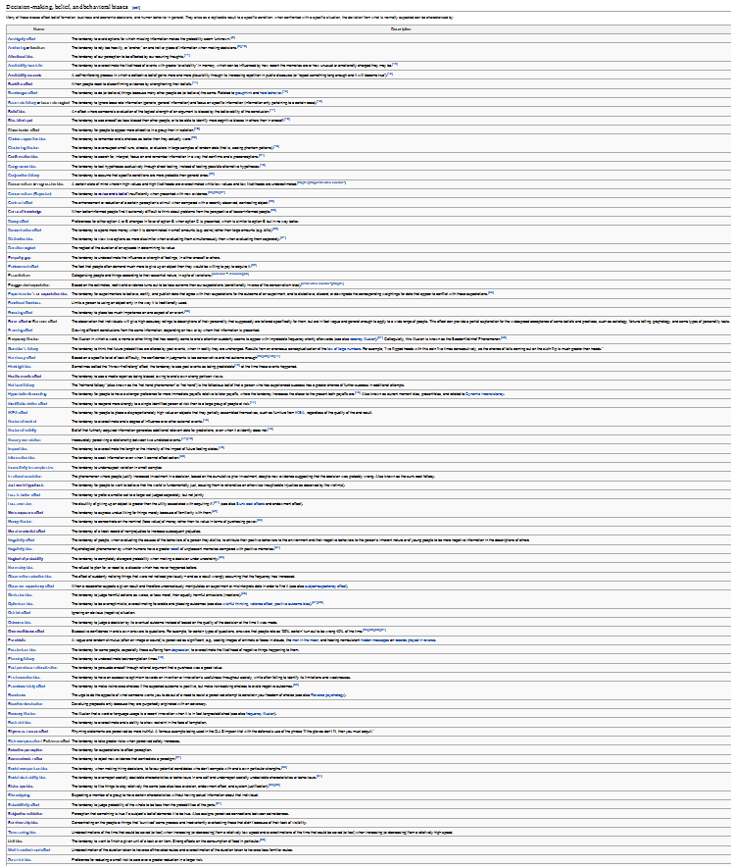
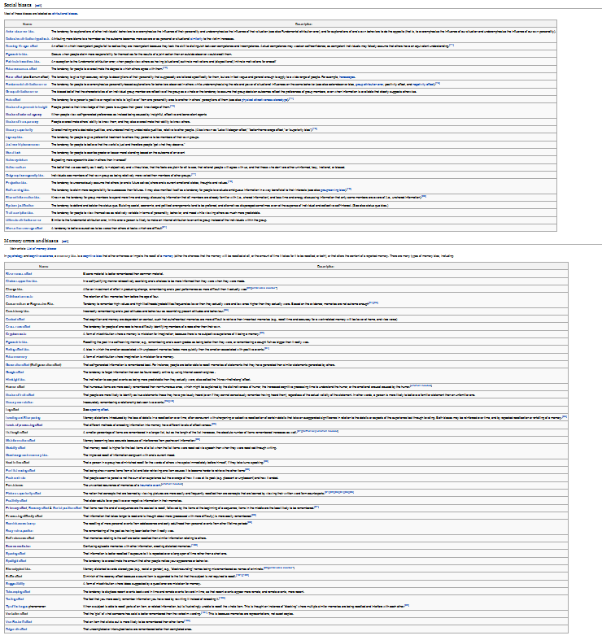
Opinions are Pretty Unreliable

Slide 20
Opinions are Pretty Unreliable
Steven E. Jones (PhD in physics) – 9/11 conspiracy
David Irving (historian) – holocaust denial
Rajan Sankaran (MD) – homeopathy
Linus Pauling (Nobel Prize in chemistry) – vitamin mega-dosing
J. Marvin Herndon (PhD in chemistry) – expanding Earth theory
David M. Jacobs (historian) – Ufology
David Icke – reptilians

Slide 21
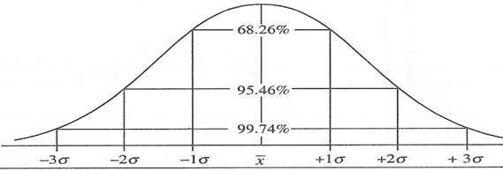
Response 1: We Can Never be Certain
“We don’t have to be certain before forming beliefs.”
But: How confident should we be?

Slide 22
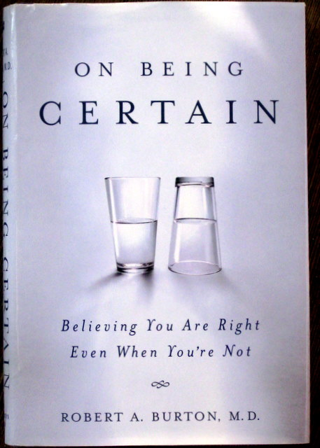
Response 2: I’m Right
“The fact that people disagree with me doesn’t mean I’m wrong.”
But: Why is your opinion more likely to be right than theirs?

Slide 23
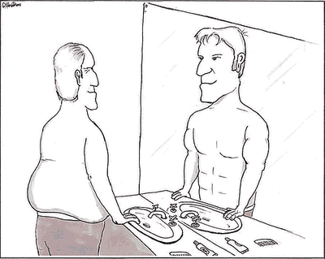
Response 3: Others are Biased
“Most other people are biased and irrational.”
But: What makes you think you are less biased than others?

Slide 24
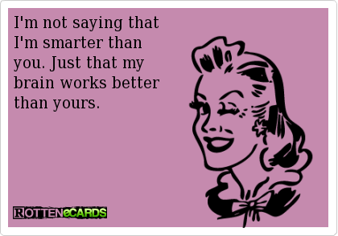
Response 4: I’m Smarter
“I have access to privileged information that other people don’t know.”
But: No you don’t

Slide 25
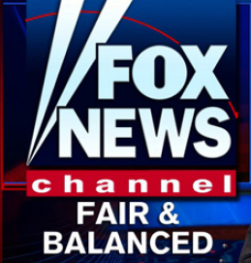
Response 5: I Listen to Both Sides
“I listen to both sides of a controversy, weigh up the evidence, and then determine who is probably right.”
But: The other guy does too

Slide 26

What is to be Done?
Look for expert consensus
Where experts disagree, remain agnostic
Frequently engage in meta-reasoning
Don’t make yourself into the world expert
Seek disconfirming evidence and viewpoints

Slide 27



Interested in More of This?
Check out the University of
Melbourne Secular Society
on facebook, or at umss.org
Visit my blog fods12.wordpress.com
Contact me at fods12@gmail.com
Check out my podcast at fods12.podbean.com

Slide 28
How to Disagree 1
Not everyone is your epistemic peer
Ensure that your dispute is not merely semantic
Try to understand their position well enough to argue it for them
Try to break the argument down into very specific items of disagreement, identify those that are worth pursuing, and push those in depth
Don’t get sidetracked by minor points

Slide 29
How to Disagree 2
Figure out what evidence could determine who is right
Identify underlying assumptions (e.g. worldview differences) contributing to the disagreement
Don’t try to defend your position at all cost; try to work out exactly why you disagree
Ideas don’t need respect, but people do

Slide 30
Response 6: View is Self-Refuting
“Since most people disagree with you, how can you justify believing your opinion?”
Reply 1: almost any epistemic position can potentially be described as self-refuting
Reply 2: consumer choice magazine example

Slide 31
Response 7: Still Have to Act
“We still need to make decisions and act in the world.”
Reply: yes, but that doesn’t justify false confidence

