Slide 1
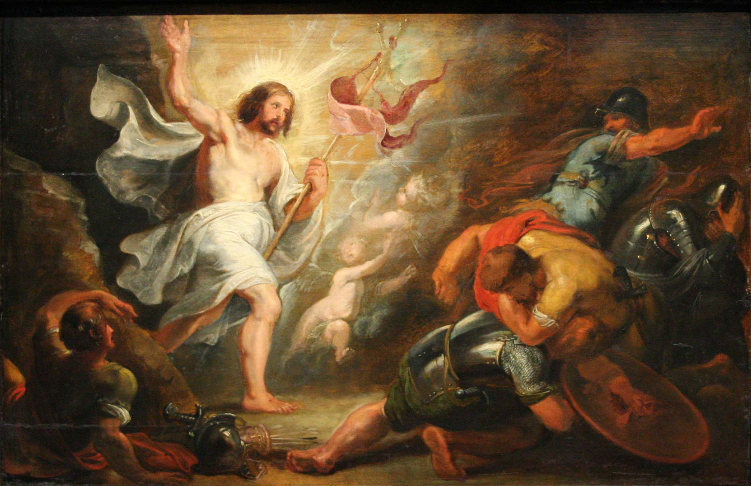
The Argument for the Resurrection of Jesus: A Critique
James Fodor, May 2018
Sea of Faith in Australia

Slide 2
Introduction
What I am not saying:
The resurrection didn’t happen
It is irrational to believe in the resurrection
One should not believe in the resurrection
There is no evidence that the resurrection occurred
What I am saying:
Absent particular (Christian) theological commitments, the resurrection argument does not provide sufficient warrant for belief in the resurrection.

Slide 3
Inference and Explanation

Slide 4
What is an Explanation
“An explanation consists of a set of propositions which, taken together, entail the facts to be explained. The facts don’t have to follow with deductive certainty, but they should follow with reasonable probability. In the words of philosopher Charles Pierce, given an explanation, the facts to be explained should follow as ‘a matter of course’. Without an explanation, a given set of facts may initially seem unusual, strange, or mysterious, but given an appropriate explanation, these facts should seem to make perfect sense and not be strange at all. Explanations should account for strange features and render the otherwise inexplicable readily understandable.”

Slide 5
Explanatory Quality
Explanatory scope: the larger the range of facts that an explanation can account for, the better is that explanation.
Explanatory power: the more likely the facts are rendered by the explanation, the more clearly they are accounted for by it, the better is the explanation.
Plausibility: the more likely are the propositions posited by the explanation given existing background knowledge (outside of the facts to be explained), the better is the explanation.

Slide 6
Example Explanation
Suppose we return home from a day out to discover the following two facts:
A flower vase is smashed next to a small table.
The cat is found nearby with wet fur.
One explanation for these facts would be that the vase had been left too close to the edge, and fell as the result of a slight breeze or shifting of air.
An alternative explanation is that the cat walked into the table and knocked off the vase.

Slide 7
The Resurrection Argument
Premise one: Four historical facts regarding the death of Jesus have been established by the consensus of biblical scholars. (The ‘minimal facts’)
Premise two: A set of criteria describes the quality of a proposed explanation in accounting for a given body of facts. (Explanatory scope and power, plausibility)
Premise three: The resurrection hypothesis meets these criteria for explaining the four facts far better than any rival hypothesis.
Premise four: If one explanation is far superior to all others, it should be accepted as probably true. (Inference to the Best Explanation)
Conclusion: The resurrection hypothesis should be accepted as probably true.

Slide 8
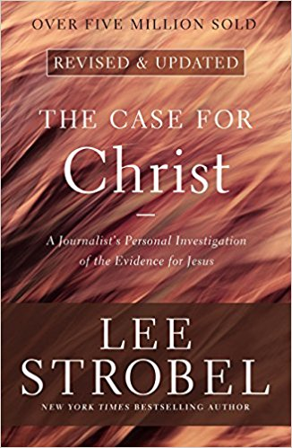
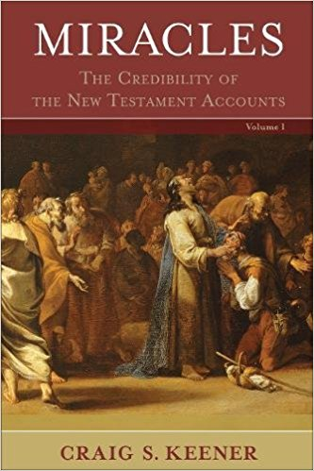
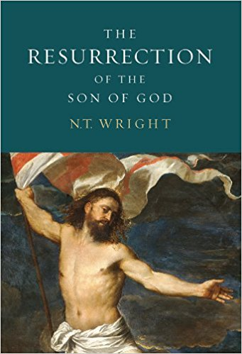
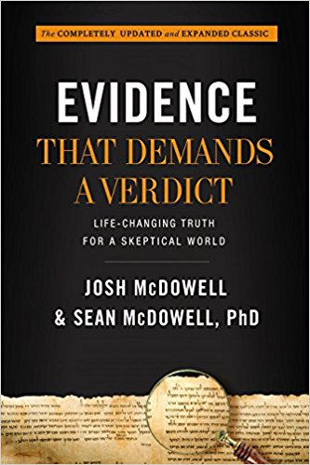
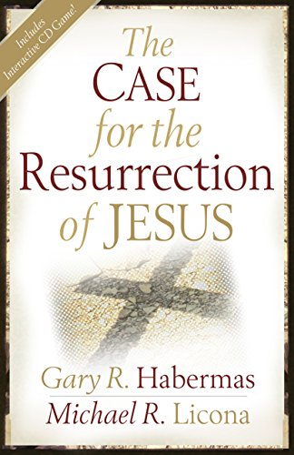
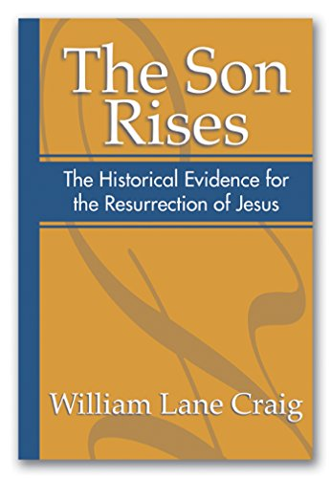
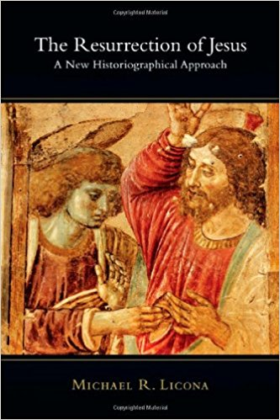
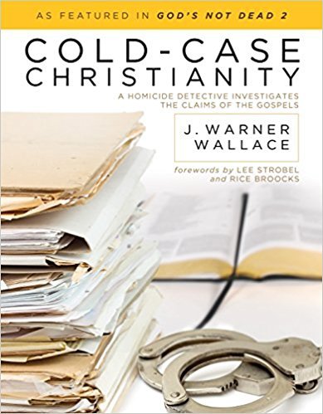
Proponents of the Argument
William Lane Craig
Gary Habermas
Mike Licona
NT Wright
Lee Strobel
J. Warner Wallace
Josh McDowell
Craig Keener

Slide 9
Quotes from Synopses
“The modern apologetics classic that started it all is now completely revised and updated—because the truth of the Bible doesn’t change, but its critics do. With the original Evidence That Demands a Verdict, bestselling author Josh McDowell gave Christian readers the answers they needed to defend their faith against the harshest critics and skeptics. Since that time, Evidence has remained a trusted resource for believers young and old. Bringing historical documentation and the best modern scholarship to bear on the trustworthiness of the Bible and its teachings, this extensive volume has encouraged and strengthened millions. Now, with his son Sean McDowell, Josh McDowell has updated and expanded this classic resource for a new generation. This is a book that invites readers to bring their doubts and doesn’t shy away from the tough questions.”
“The early Christians answer was that Jesus had indeed been bodily raised from the dead; that was why they hailed him as the messianic "son of God." No modern historian has come up with a more convincing explanation. Facing this question, we are confronted to this day with the most central issues of the Christian worldview and theology.”

Slide 10
The Minimal Facts

Slide 11
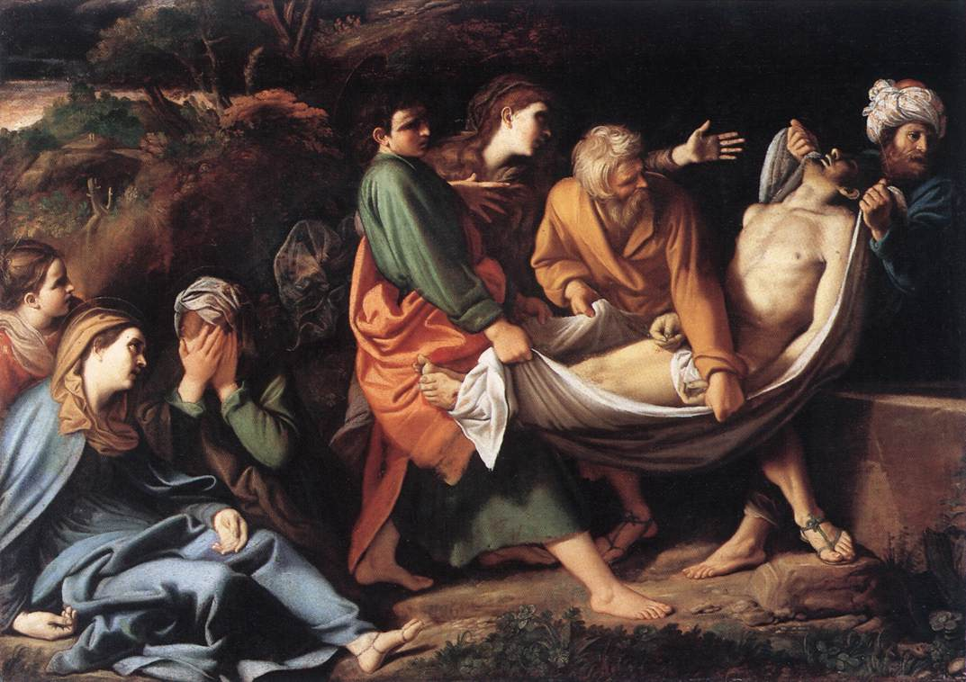
1. Burial
After his crucifixion Jesus was buried by Joseph of Arimathea in the tomb.

Slide 12
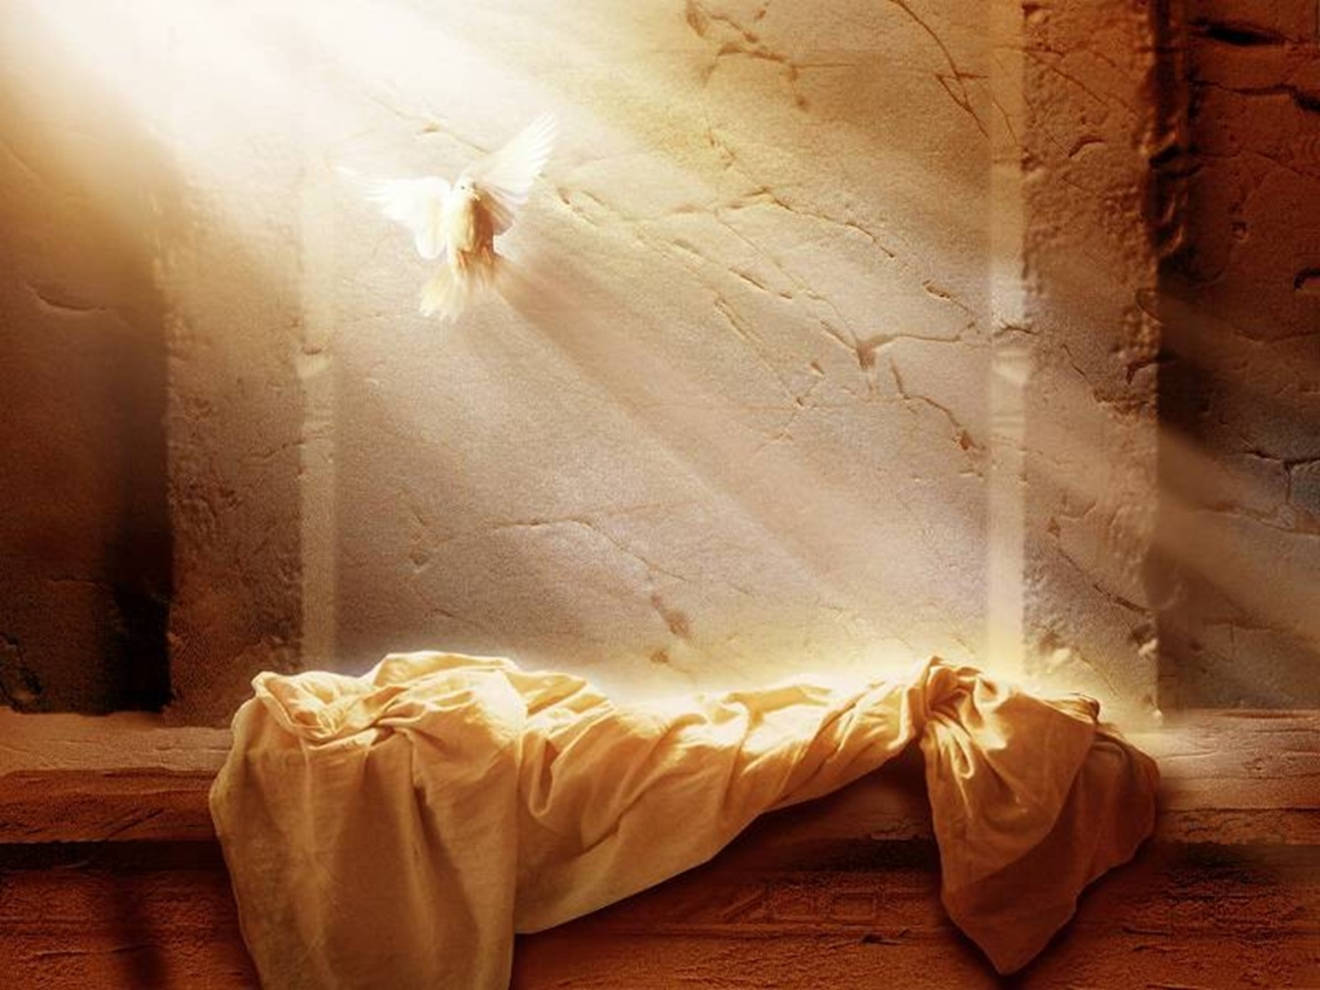
2. Empty Tomb
On the Sunday following the crucifixion, Jesus' tomb was found empty by a group of his women followers.

Slide 13
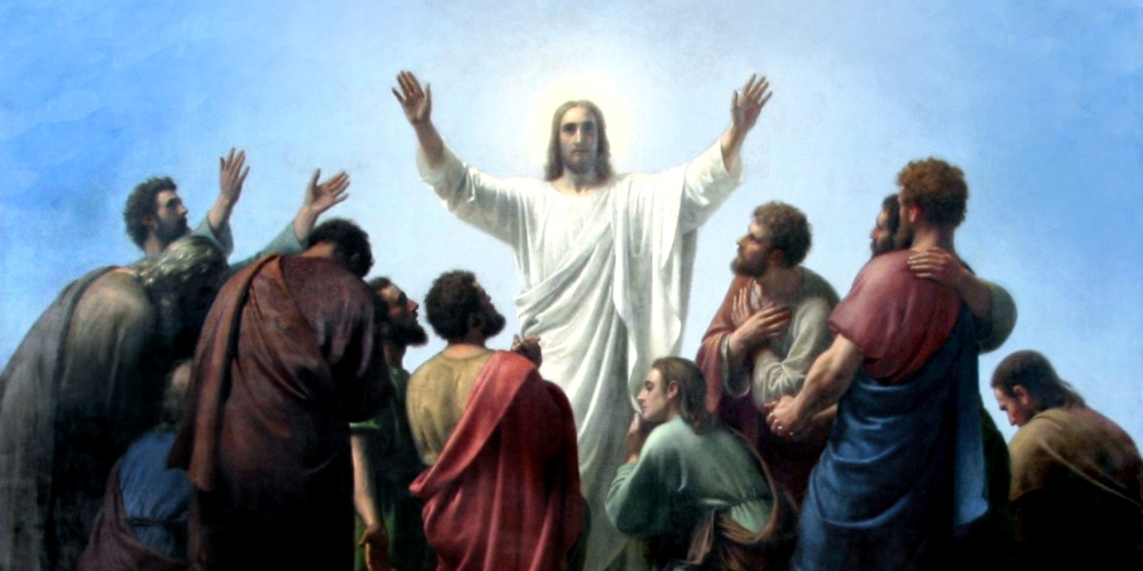
3. Appearances
On multiple occasions and under various circumstances, different individuals and groups of people experienced appearances of Jesus alive from the dead.

Slide 14
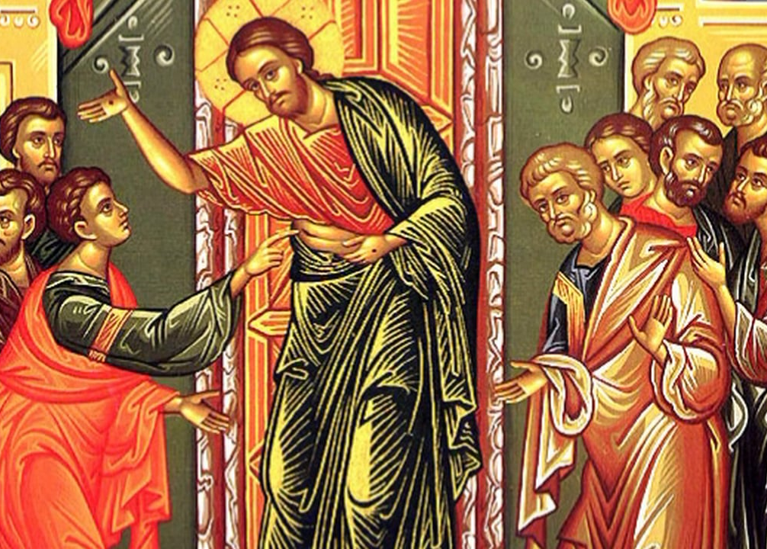
4. Belief in Resurrection
The original disciples came to believe that Jesus had risen from the dead despite predisposition to the contrary.

Slide 15
Competing Hypotheses

Slide 16
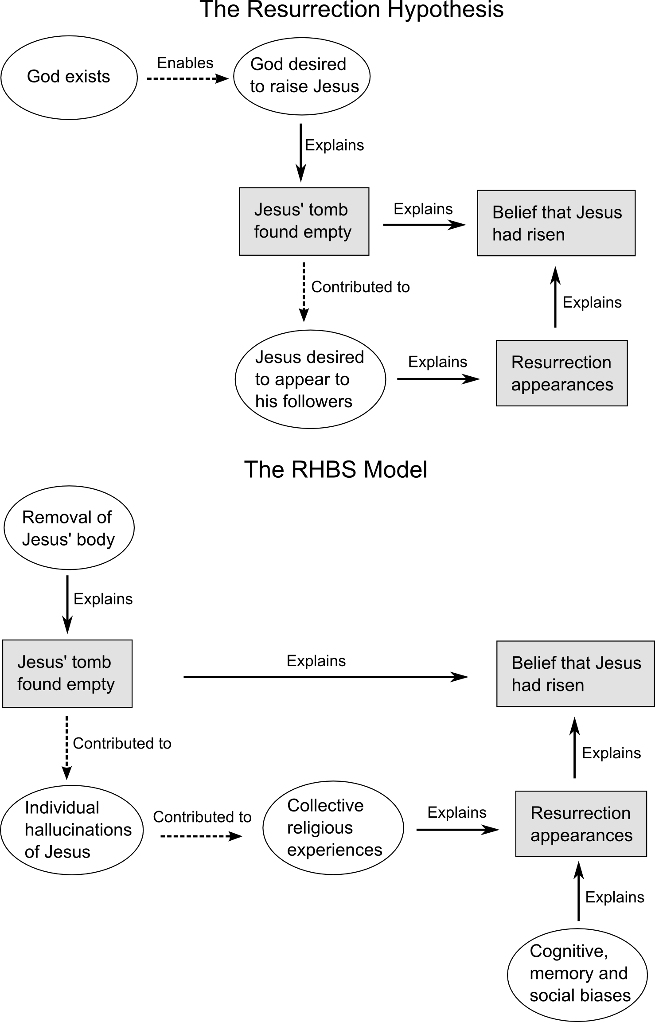
The Resurrection Hypothesis

Slide 17
The Resurrection Hypothesis

Slide 18
The RHBS Model

Slide 19
Examining Plausibility

Slide 20
The RHBS Model

Slide 21
Jewish Burial Practices
  Jewish law required bodies to be taken down before evening: (Deuteronomy 21:22) “If a man has committed a sin worthy of death... and you hang him from a tree, his corpse shall not hang all night on the tree, but you shall surely bury him on the same day” (also mentioned in John 19:31 “so that the bodies would not remain on the cross on the Sabbath”)
  The gospels indicate the burial was rushed: Mark 15:42 Joseph asked for Jesus’ body “When evening had already come, because it was the preparation day, that is, the day before the Sabbath”, and John 19:42 “Therefore because of the Jewish day of preparation, since the tomb was nearby, they laid Jesus there”. That the women came on the Sunday morning to anoint Jesus shows that the burial had not been completed on Friday night.
  The Romans put pressure on the Jews to keep things as quiet and private as possible so as to reduce the risk of more riots or uprisings.

Slide 22
Jewish Tombs
These were for family use:
“Bodies would be laid on rock shelves provided on three sides of the chamber, or on the floor, and as generations of the same family used the tomb, skeletons and grave goods might be heaped up along the sides or put into a side chamber to make room for new burials. This practice of family burial, though not universal if only because not all could afford it... was common enough to give rise to the Hebrew expressions ‘to sleep with one's fathers’ and ‘to be gathered to one's kin’ as synonyms for ‘to die’.”

Slide 23
The RHBS Model

Slide 24
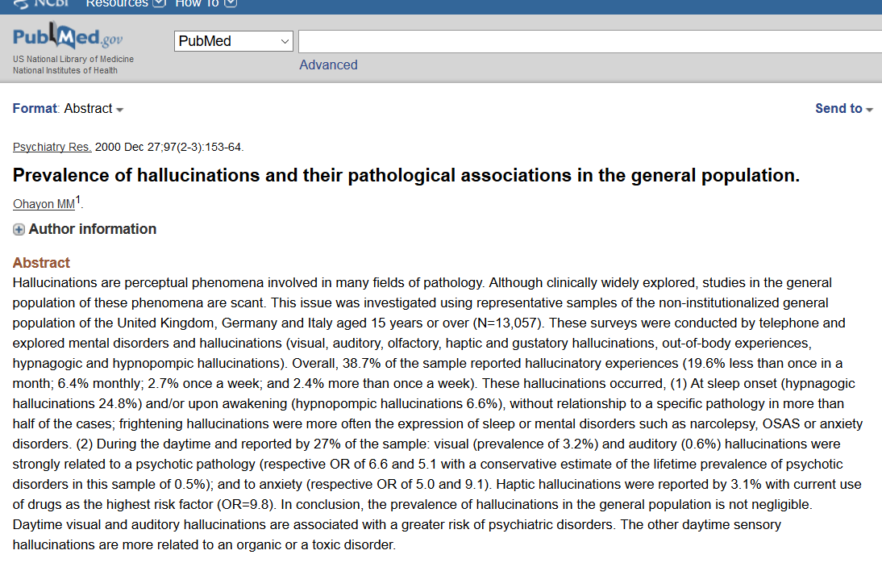
Private Hallucinations

Slide 25
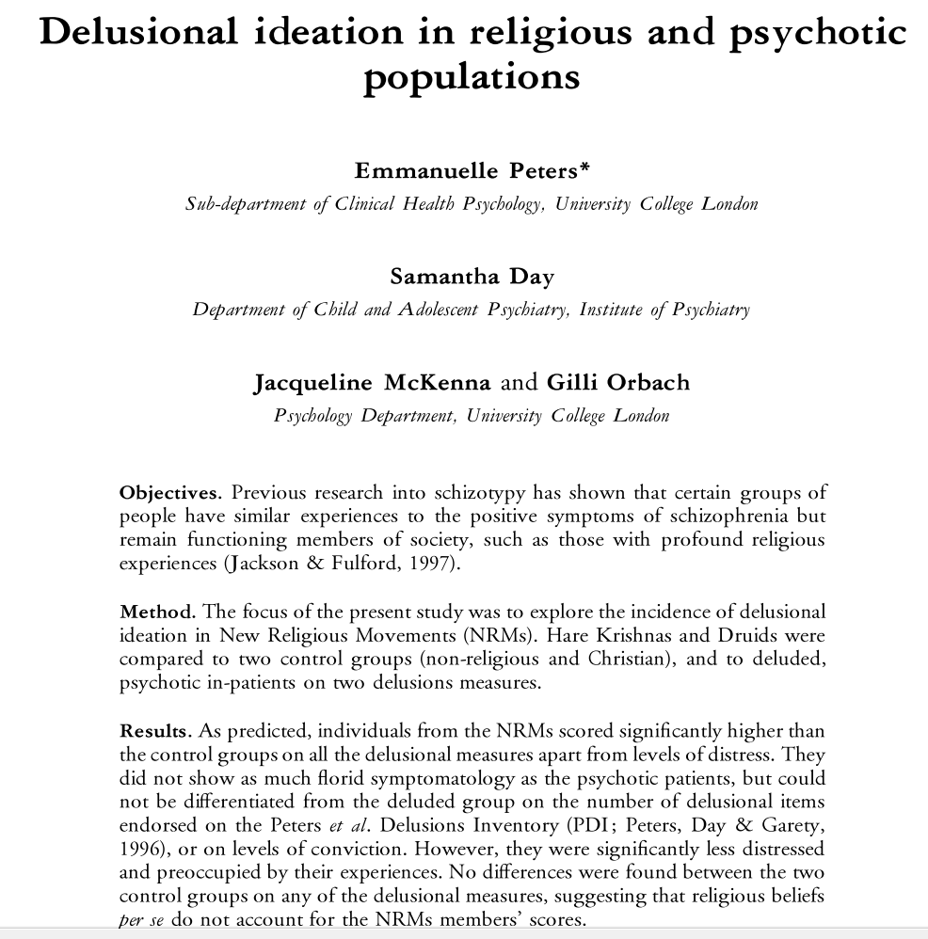
New Religious Movements

Slide 26
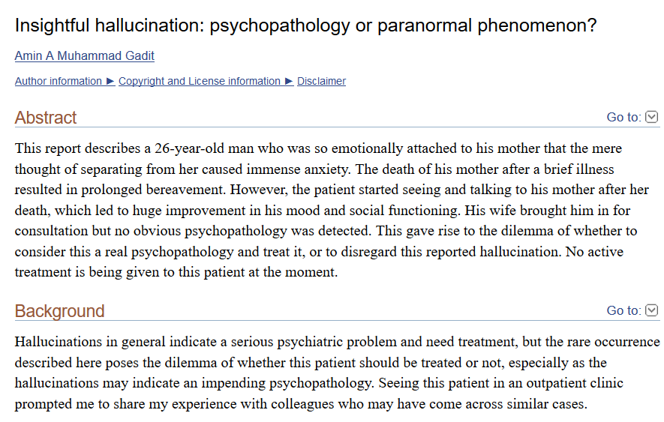
Complicated Bereavement

Slide 27
The RHBS Model

Slide 28
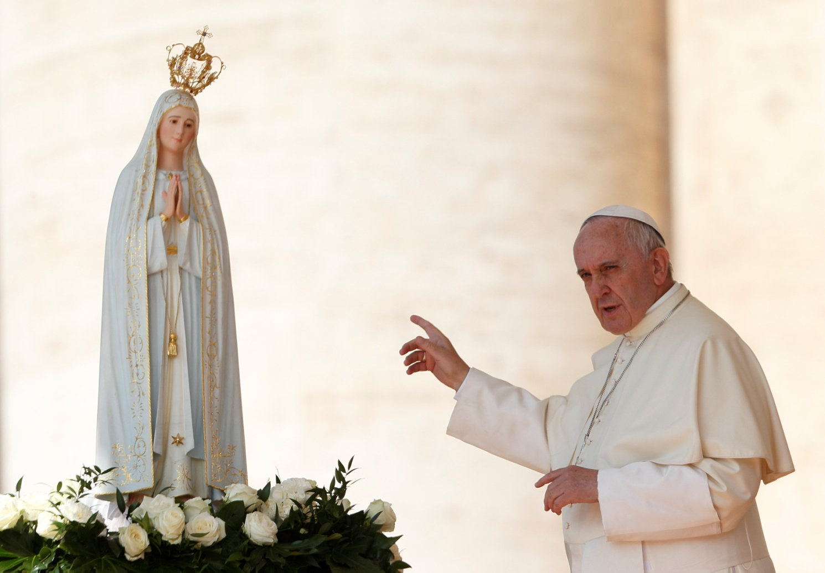
Our Lady of Fátima

Slide 29
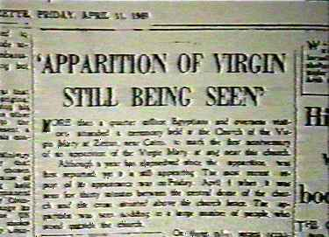
Our Lady of Zeitoun
Egyptian Gazette of Friday, April 11, 1969

Slide 30
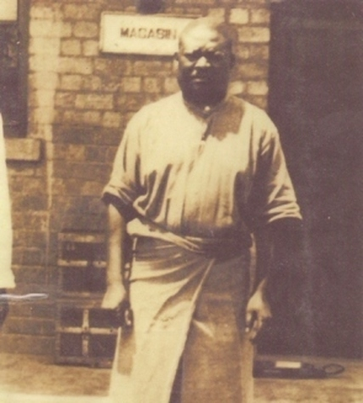
Simon Kimbangu

Slide 31
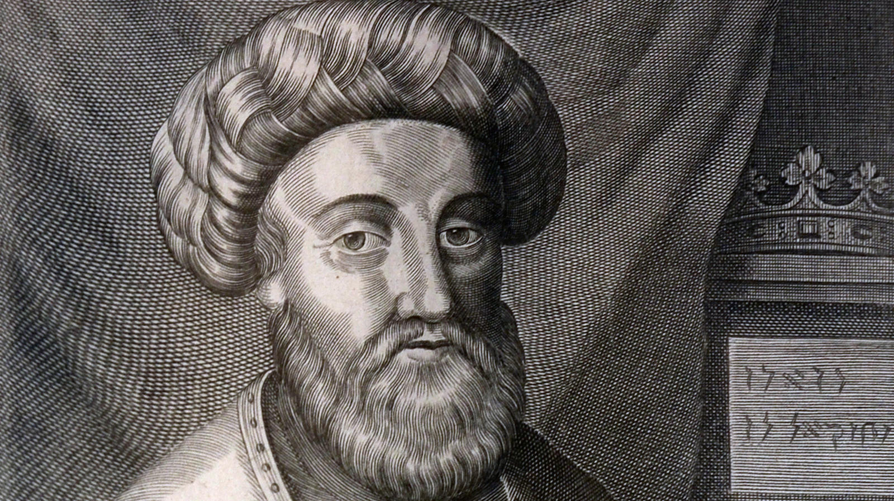
Sabbatai Zevi

Slide 32
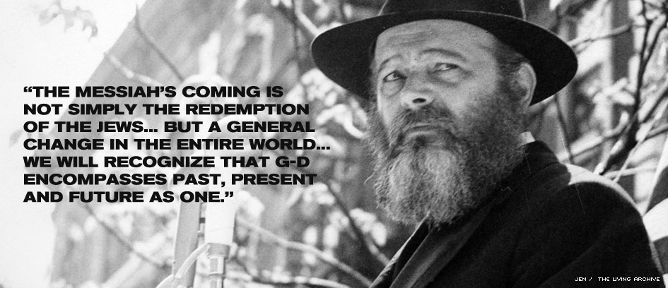
Menachem Mendel Schneerson

Slide 33
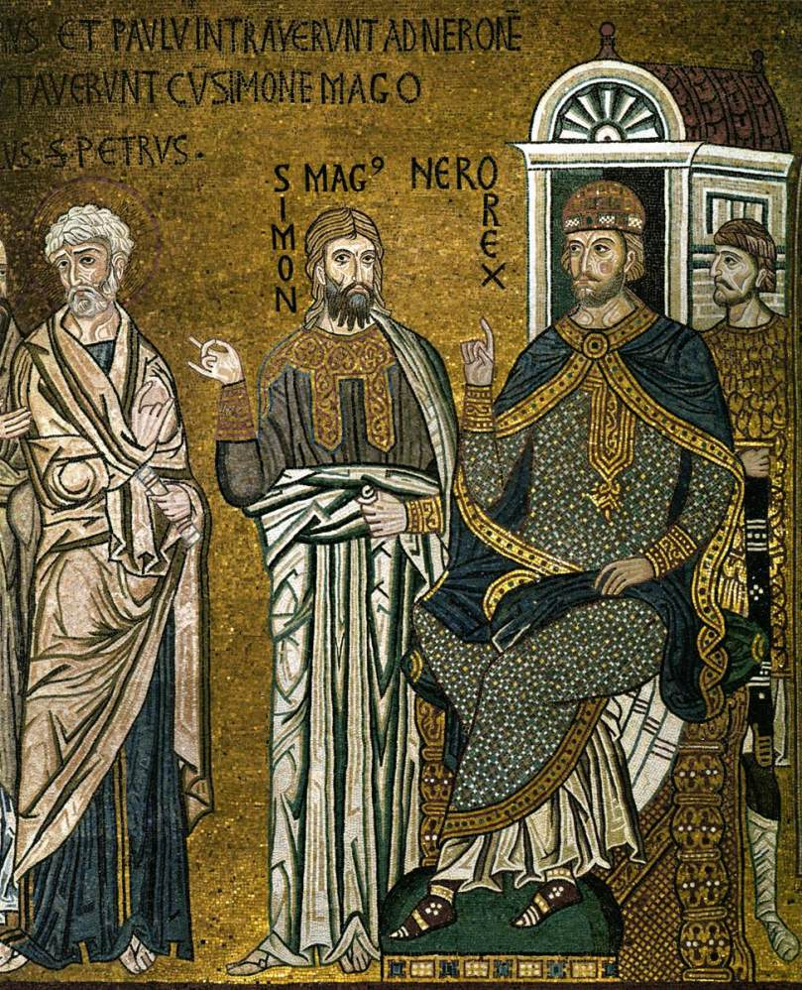
Simon Magus

Slide 34
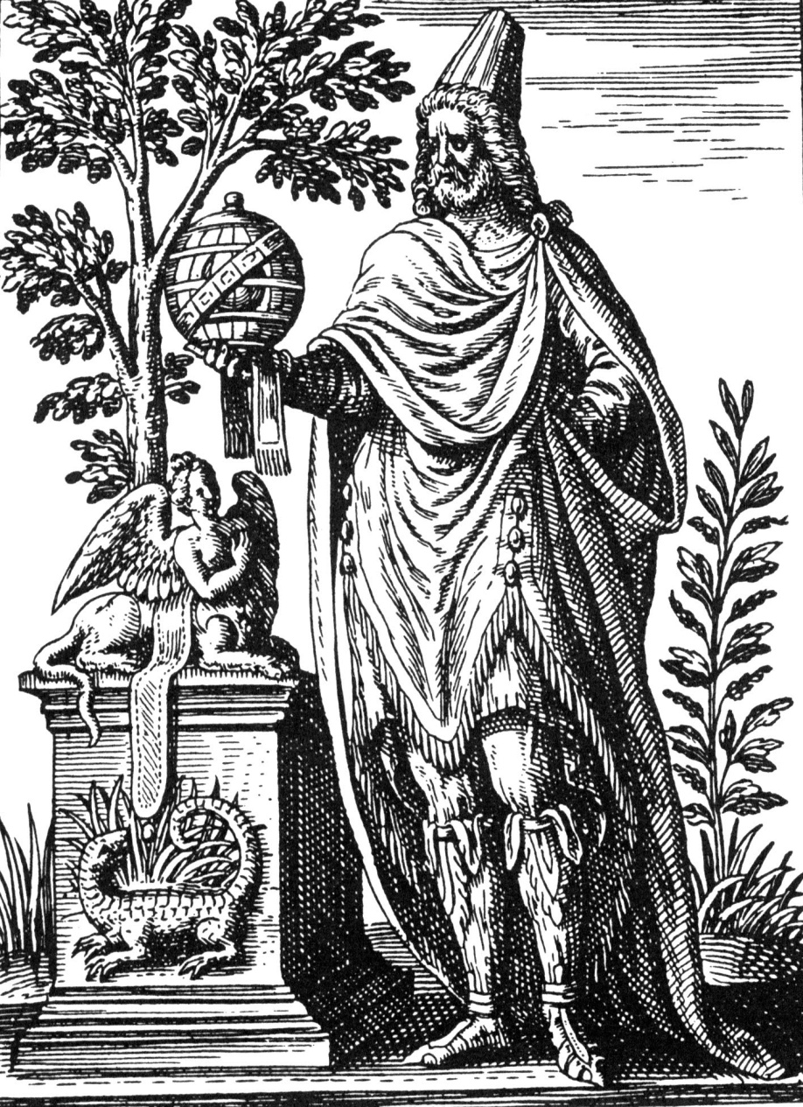
Apollonius of Tyana

Slide 35
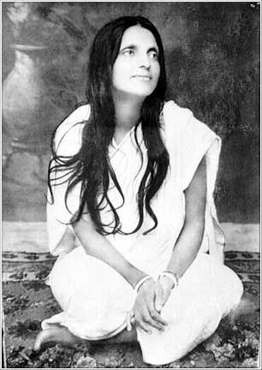
Anandamayi Ma

Slide 36
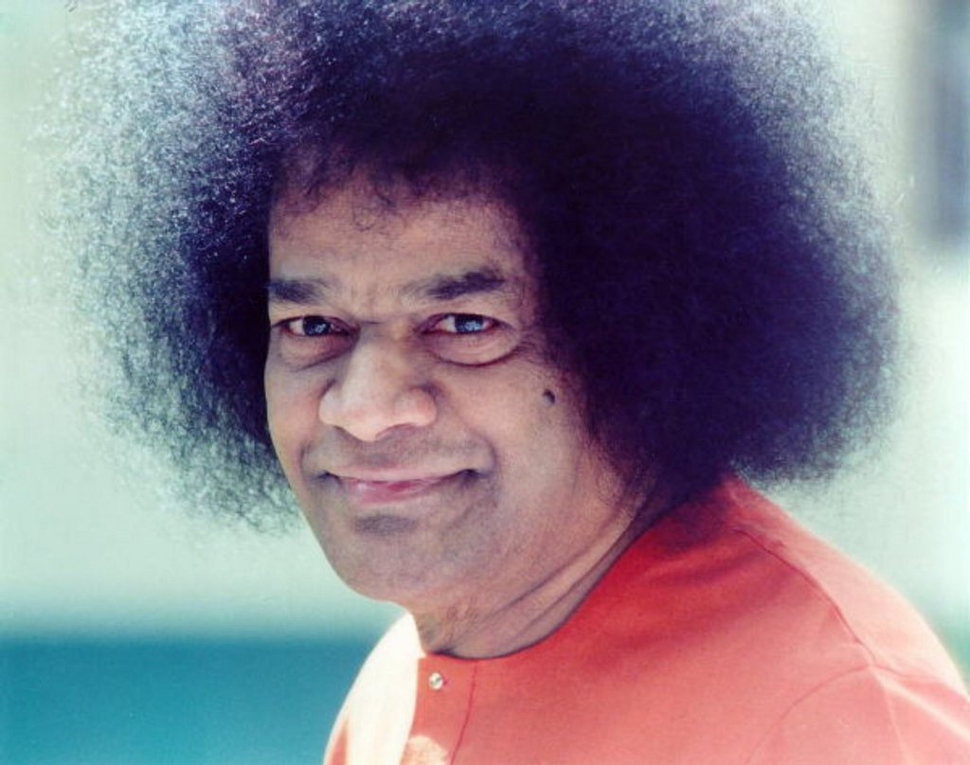
Anandamayi Ma

Slide 37
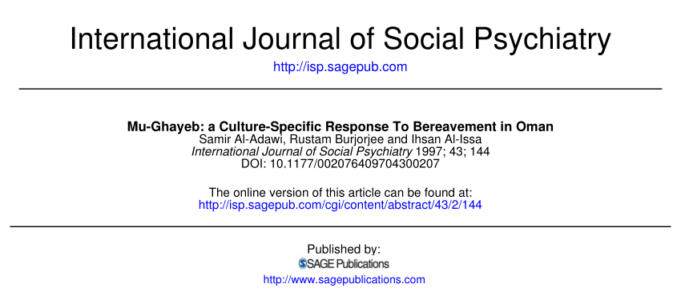
Mu-Ghayeb in Oman

Slide 38
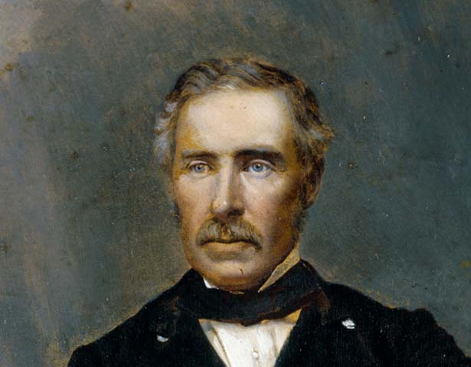
Sir George Grey

Slide 39
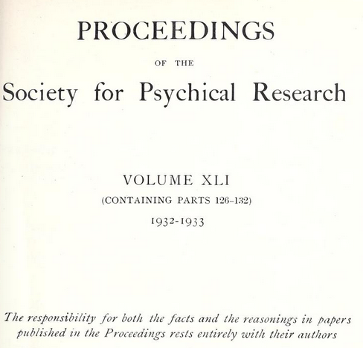
Society for Psychical Research

Slide 40
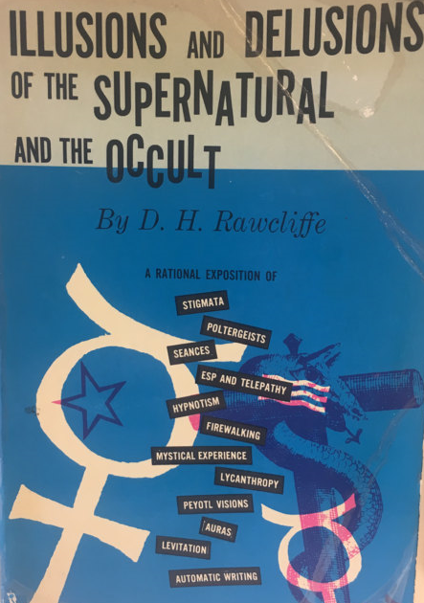
Donovan H. Rawcliffe
“The same factors which operate for a single individual in the induction of hallucinations... may become even more effective in an excited or expectant crowd, and on occasion may result in mass hallucinations. This is not to say that any two people are capable of having precisely the same hallucination identical in every respect. But similar preconceptions and expectations can undoubtedly result in hallucinatory visions so alike that subsequent comparisons would not disclose any major discrepancy... dissimilar hallucinatory experiences often attain a spurious similarity by a process of harmonisation in subsequent recollection and conversation.”

Slide 41
The RHBS Model

Slide 42
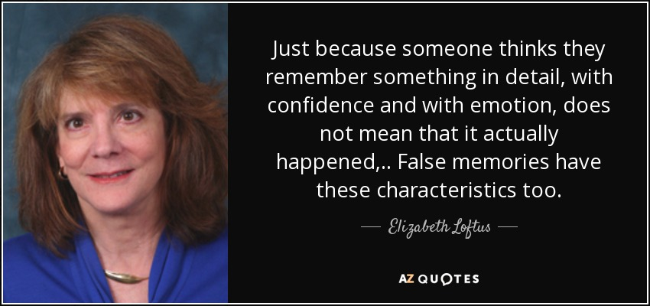
Elizabeth Loftus

Slide 43
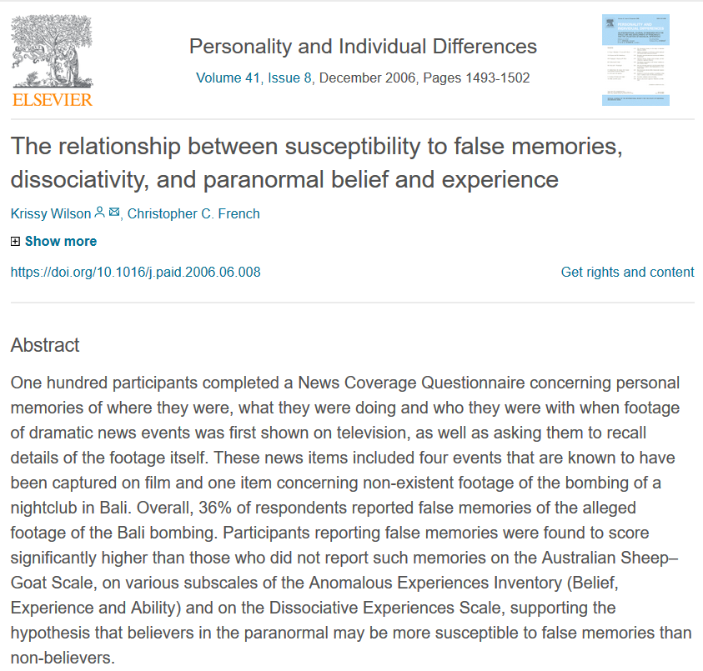
Eyewitness Testimony

Slide 44
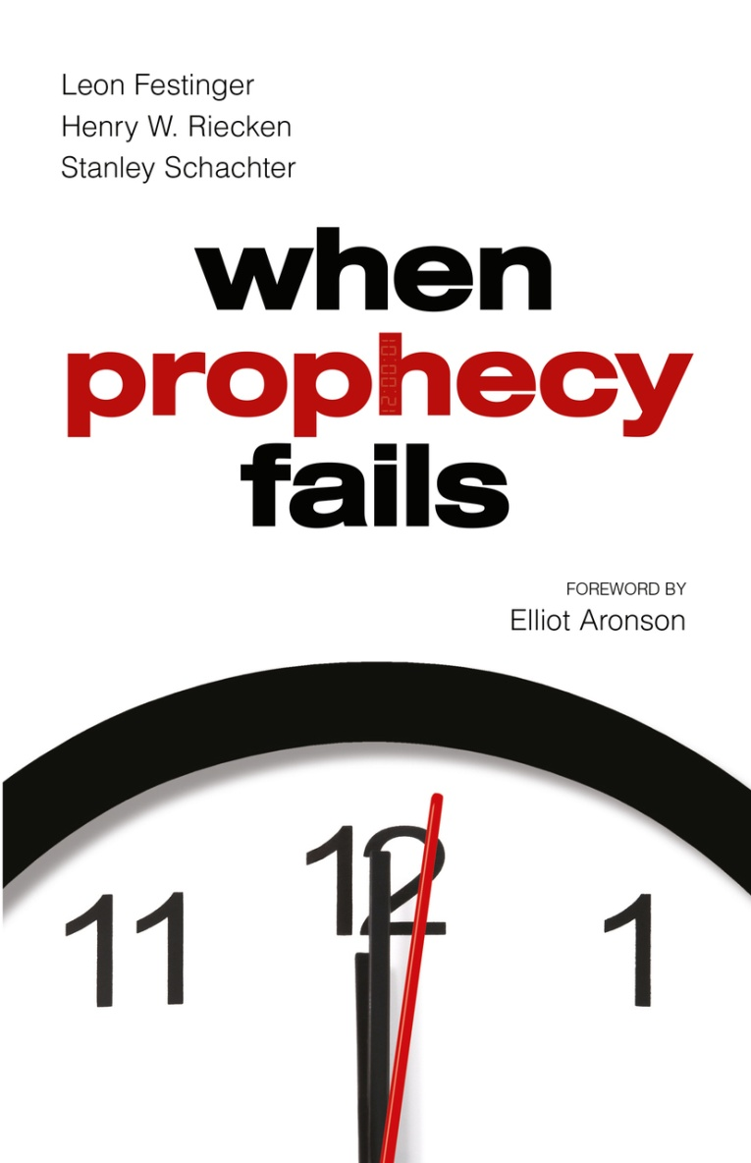
Cognitive Dissonance
“Jehovah’s Witness’ multiple failed end of world predictions are a well-known example of this. Another famous example was the 1844 so-called “Great Disappointment”, following the failed prediction of the Millerites that Jesus would return in that year. There were many attempted justifications, and some fell away, but the movement continued and gave rise to the contemporary Seventh Day Adventist church. One form such of rationalisation has been described by religious scholar J. Gordon Melton as ‘spiritualisation’:
“The prophesied event is reinterpreted in such a way that what was supposed to have been a visible, verifiable occurrence is seen to have been in reality an invisible, spiritual occurrence. The event occurred as predicted, only on a spiritual level.””

Slide 45
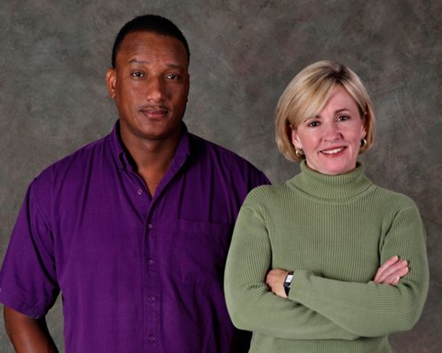
Ronald Cotton
Ronald Cotton and Jennifer Thompson-Canino

Slide 46
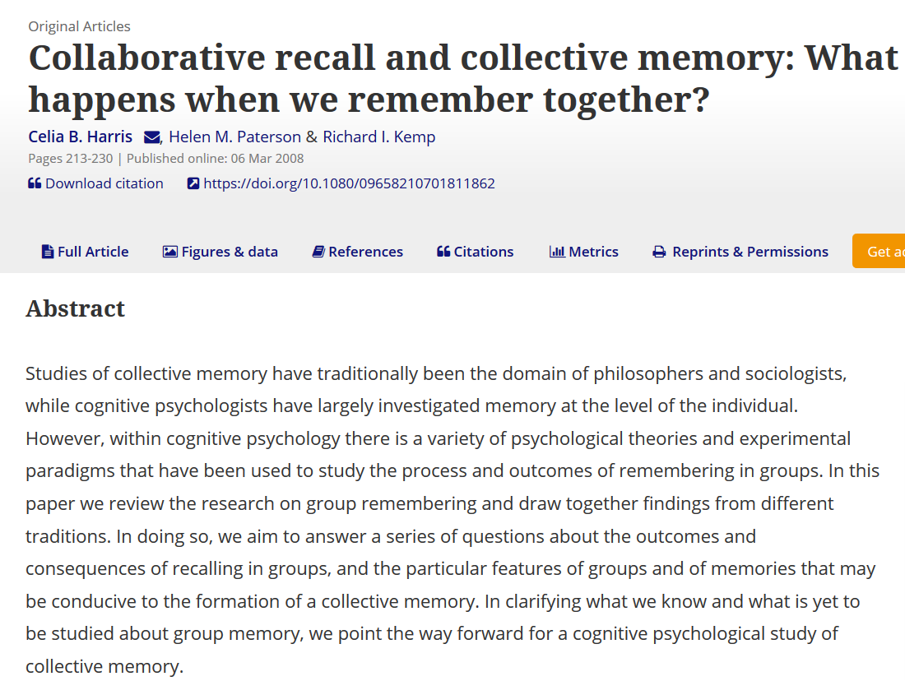
Memory Contamination

Slide 47
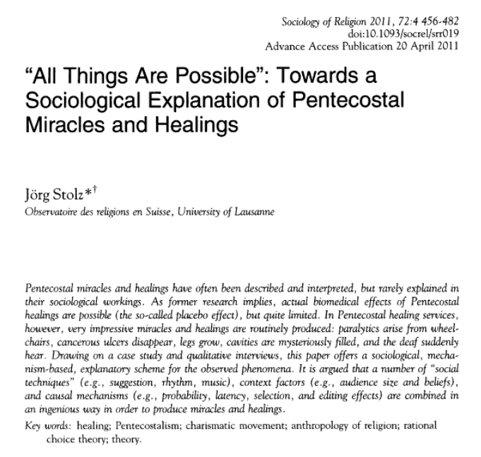
Sociological Effects

Slide 48
Weighing the Explanations

Slide 49
The Resurrection Hypothesis
?
?

Slide 50
The RHBS Model

Slide 51
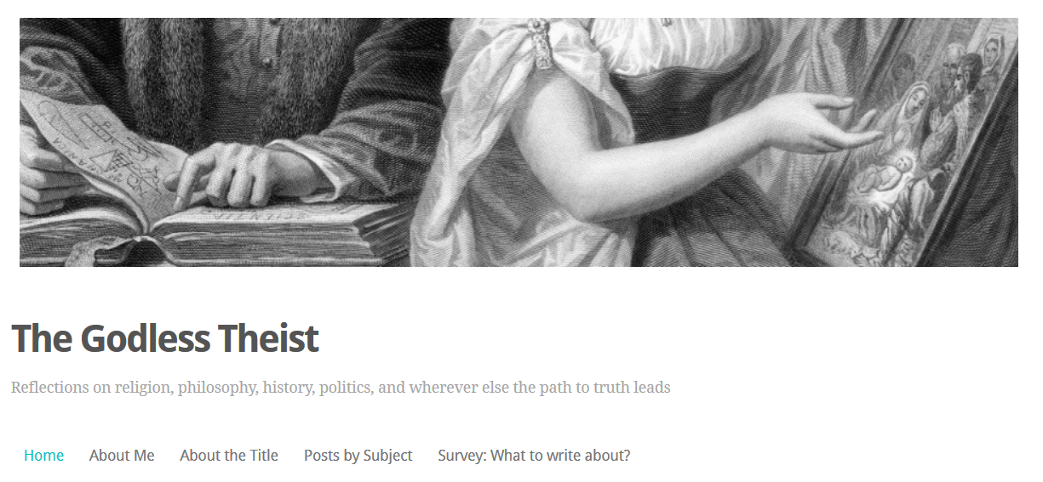
My Blog

