Slide 1

Introduction to Counter-Apologetics
James Fodor, September 2015

Slide 2
1. Cosmological Argument
A contingent thing (such that if it exists it could have not-existed or could cease to be) exists (often ‘the universe’).
All contingent things must has a cause or explanation for its existence (principle of sufficient reason)
The cause or explanation for its existence must be something other than the contingent thing itself.
What causes or explains the existence of a contingent thing must either be solely other contingent beings or include a non-contingent (necessary) thing.
Contingent beings alone cannot provide an adequate (ultimate) account or explanation for the existence of a contingent thing.
Therefore, what causes or explains the existence of this contingent thing must include a non-contingent thing.
Therefore, a necessary thing (a thing such that if it exists cannot fail or cease to exist) must exist.

Slide 3
Not so good responses
Who created God?
The Big Bang explains the origin of the universe
Lawrence Kraus/quantum mechanics shows how the universe could come from nothing (but see later)
God is necessarily a more complex explanation
This argument does not get you to Christianity
‘God of the gaps’: "gaps which they will fill up with God... an immanent God, which is the God of Evolution, is infinitely grander than the occasional wonder-worker, who is the God of an old theolog”

Slide 4
Potentially better responses
The universe (or multiverse) is not contingent
The Principle of Sufficient Reason is debatable (QM)
It is very unclear what ‘causation’ is or how it works
The concept of a necessary being is problematic (logical vs metaphysical necessity)

Slide 5
2. Teleological Argument
The combination of physical constants that we observe in our universe is (within very narrow bounds) the only one capable of sustaining life as we know it.
Other combinations of physical constants are conceivable.
Therefore, some explanation is needed why our actual combination of physical constants exists rather than a different one.
The existence of an all-powerful creator God provides a good explanation for why the physical constants are ‘fine-tuned for life’ in this way.
Therefore, there is reason to believe that God exists.

Slide 6
Not so good responses
Evolution...
Argument from poor design (waste of space etc)
The Universe is not adapted to us, we are adapted to it

Slide 7
Potentially better responses
Deny fine-tuning: we don’t know what alternate forms of life might be possible in counterfactual universes
Explain fine-tuning: we could live in one of many multiverses
Problematic use of probability (infinite uniform distribution)
Anthropic principle

Slide 8
3. Moral Argument
Morality consists of a set of (objective, binding) commands.
For every command there is a commander.
Therefore: there is a commander that commanded morality.
Commands only carry as much authority as does their commander.
Morality carries ultimate authority.
Therefore the commander that commanded morality carries ultimate authority.
Only God carries ultimate authority.
Therefore the commander that commanded morality is God.
Therefore God exists.

Slide 9
Not so good responses
Appeals to evolution or survival advantage
God does evil things in the Bible
Appeal to rational self-interest

Slide 10
Potentially better responses
Reject moral realism – does not entail moral nihilism
Accept moral realism but adopt a naturalistic theory: Cornell Realism, Jackson’s Moral Functionalism, Railton’s Reductive Naturalism, Neo-Aristotelianism, Discourse Ethics
Euthyphro Dilemma
‘God’s character’ response: in virtue of what characteristics does God warrant the predict ‘is good’? Apply Euthyphro to those
‘Who decides?’ argument just plain silly

Slide 11
4. Resurrection Argument
Jesus was killed by crucifixion
Many of his followers, including skeptics like James and Paul, claimed to have seen him (in group and individual settings) after his death
At least some of these followers were willing to suffer persecution and death because of this belief
Proposed naturalistic explanations for these facts (resuscitation, fabrication, mass hallucination) are exceptionally implausible
Therefore, the only plausible explanation for these facts is that God rose Jesus from the dead
Therefore, there is reason to believe that God exists and rose Jesus from the dead

Slide 12
Not so good responses
Jesus never even existed
The Gospels were written decades after the event
We don’t know who wrote the gospels
The apostles stole the body and made up the appearances
Oral tradition is unreliable
There are lots of other ‘dying and rising God’ accounts

Slide 13
Potentially better responses
We have many miracle accounts from other religions (Three Witnesses to BoM, Jesus in Nairobi 1988, Sathya Sai Baba, Marian apparitions)
Eyewitness testimony is highly unreliable
Memories can be distorted over time, especially in groups
Irrational belief persistence (‘When Prophecy Fails’)
Empty tomb: likely reburial by Joseph of Arimethea, possible grave robbery
Conversion of Paul: unusual but not unknown, e.g. Arnoud van Doorn an anti-Islam film-maker who converted to Islam

Slide 14

The HBS Model
http://thegodlesstheist.com/2015/03/31/the-resurrection-appearances-a-naturalistic-explanation-executive-summary/

Slide 15
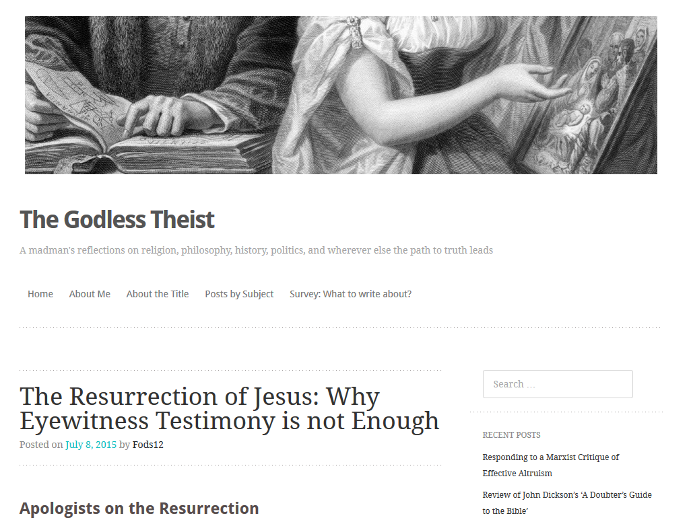
My Blog

