Slide 1
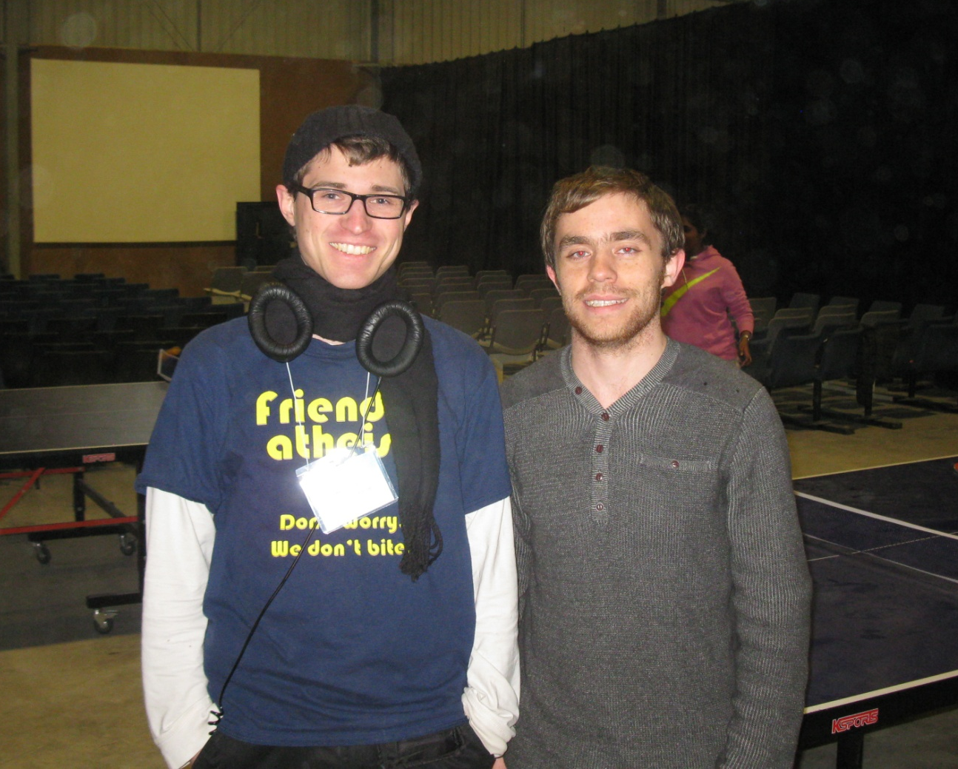
An Atheist at Christian Camp
The Importance of Dialogue
Secular Society, 28th July 2015

Slide 2

CU Summit 2015

Slide 3
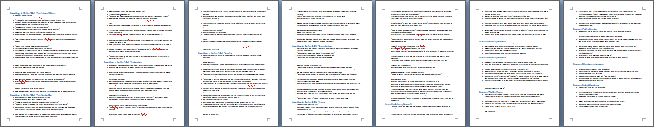
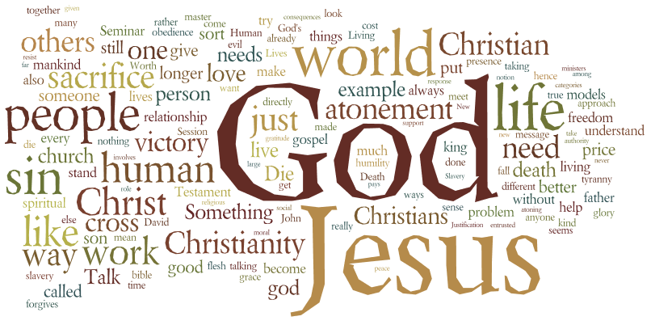
Sermons and Talks

Slide 4

But What’s it all For?

Slide 5
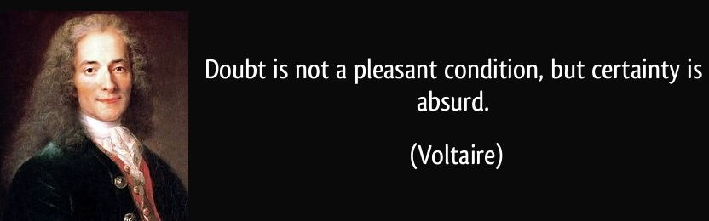
Voltaire on Doubt

Slide 6
…with Context
“Doubt is not a pleasant condition, but certainty is an absurd one. What is most repellent in the System of Nature [d'Holbach]…is the audacity with which it decides that there is no God, without even having tried to prove the impossibility.”

Slide 7

Further Examples
“Faith is the great cop-out, the great excuse to evade the need to think and evaluate evidence. Faith is belief in spite of, even perhaps because of, the lack of evidence...Faith is not allowed to justify itself by argument.” – Richard Dawkins

Slide 8
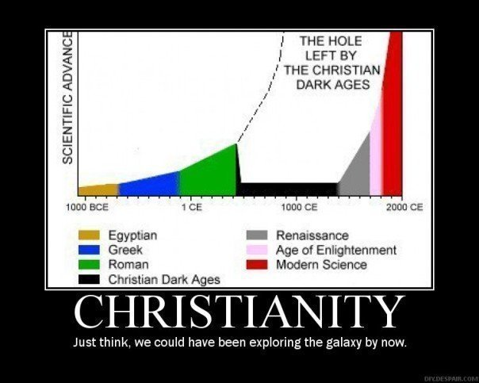
Further Examples

Slide 9
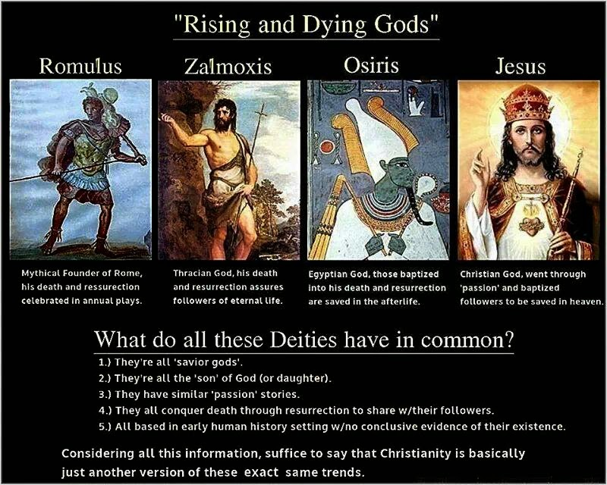
Further Examples

Slide 10

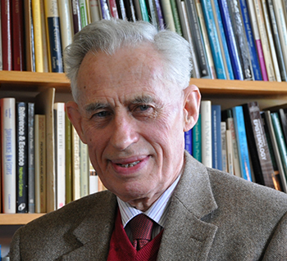
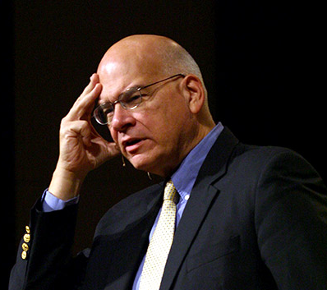
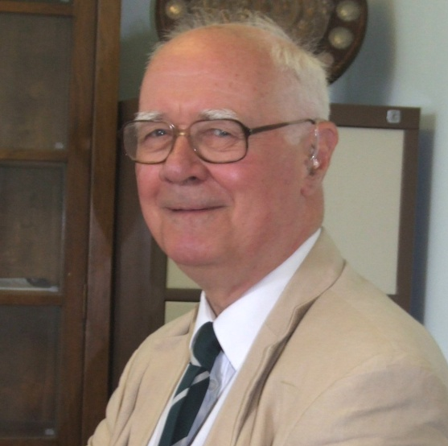
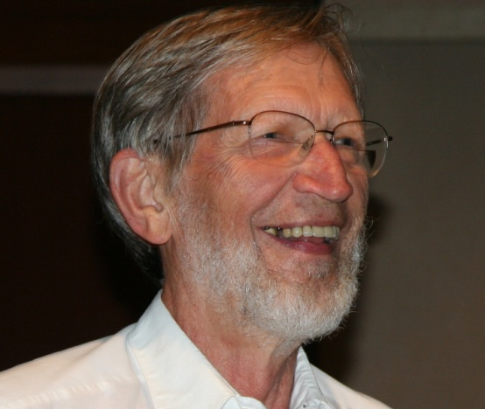

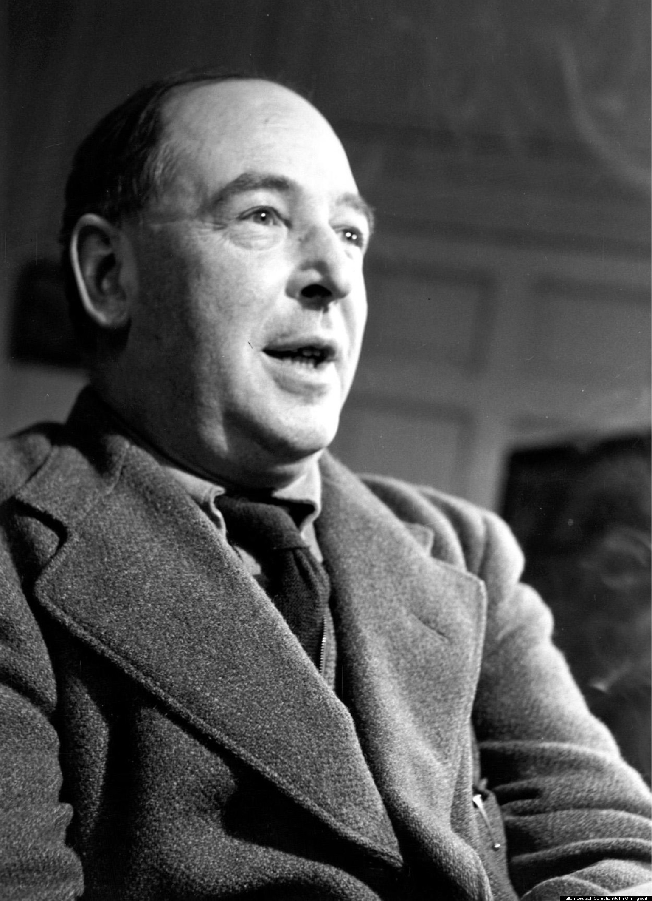
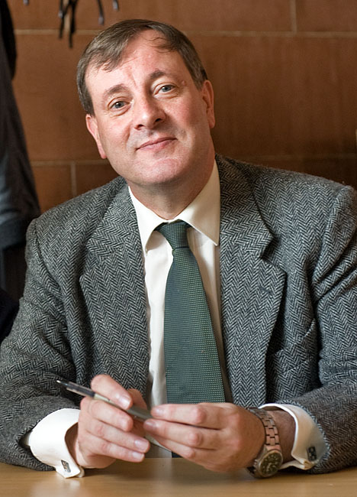
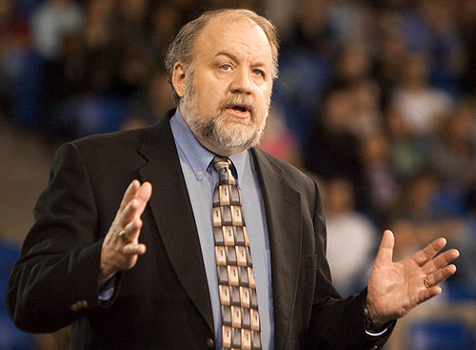
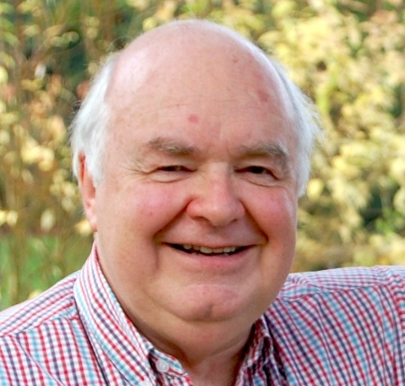
We Must Live up to our Standards

Slide 11
Rationalist/Skeptic/Freethinker Values
Important beliefs should be based on reason and evidence
It is not acceptable to believe things strongly with sufficient evidence
Respect for science, scholarship, rigorous inquiry
Curiosity, burning desire to know
Willingness to critique and question everything – in a fair and appropriate manner
Intellectual humility in the face of uncertainty

Slide 12
As ‘Rationalists’, we need to…
Use arguments that are relevant and sound
Fact-check
Avoid straw-manning arguments
Be informed about relevant facts and views
Think through positions carefully
Strive to overcome our biases

Slide 13
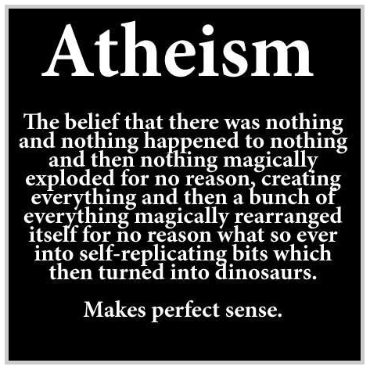
Strawmen?

Slide 14
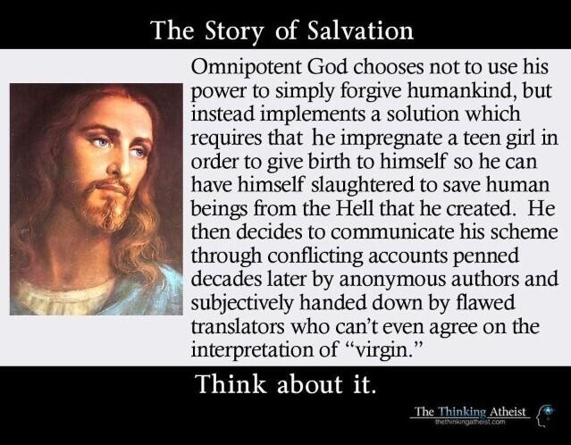
Strawmen?

Slide 15


The Bottom Line
If we are earnest about arriving at justified beliefs about what is true concerning God, morality, history, and meaning in life, then we ought to take dialogue seriously.

Slide 16

We Need Better Dialogue

Slide 17


Interested in More of This?
Visit my blog The Godless Theist fods12.wordpress.com
Get involved in my discussion group Dealing with Disagreement

