Slide 1
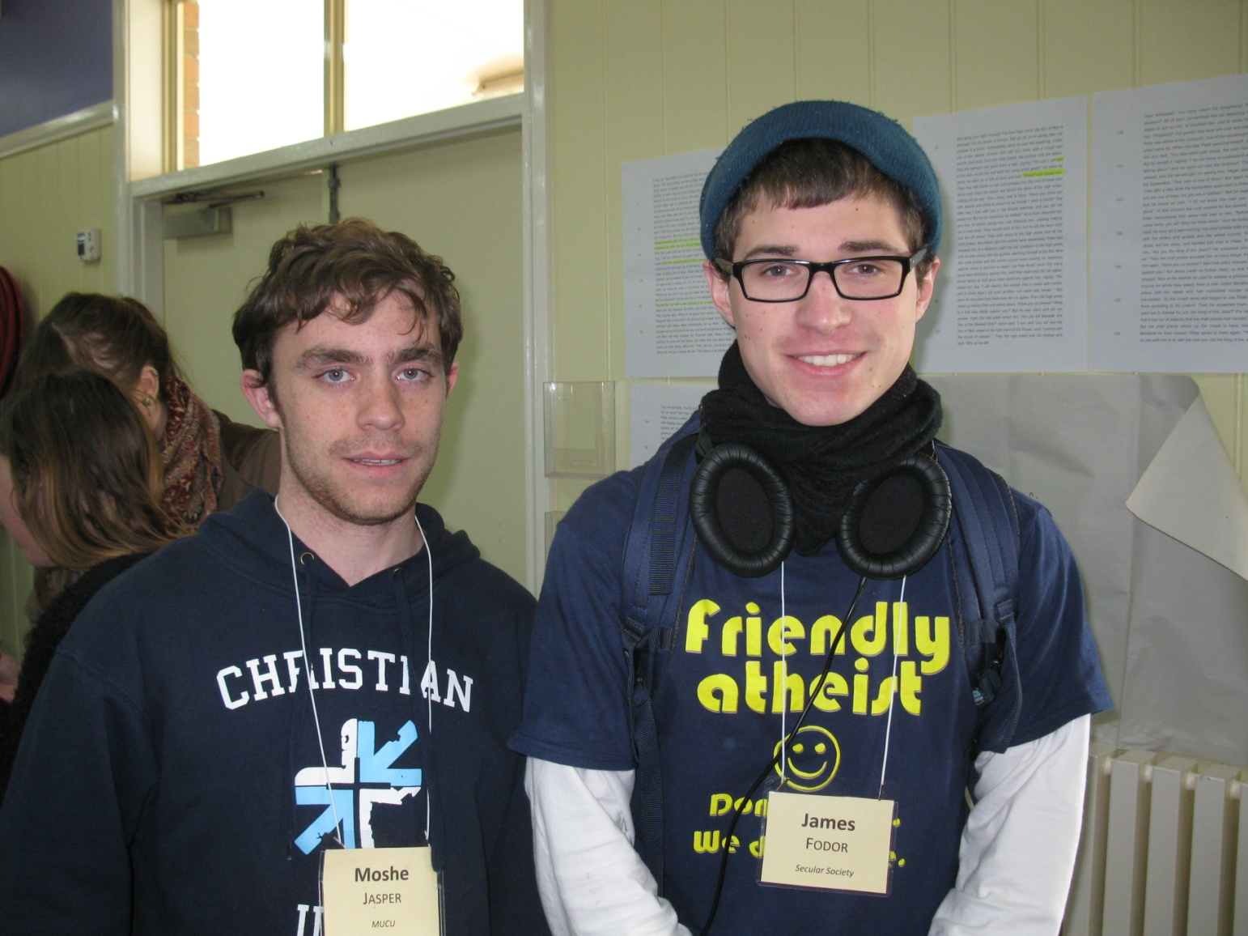
An Atheist at Christian Camp
The Importance of Dialogue
LessWrong, 6th July 2014

Slide 2
A Caveat
I can only comment about ‘Christians’ and ‘Atheists’ based on the people I have spoken to and events I have attended
My comments are not intended to be universally valid, just based on ‘my experience’
All observations and conclusions are coloured by my own biases and preconceptions

Slide 3

CU Summit 2014

Slide 4
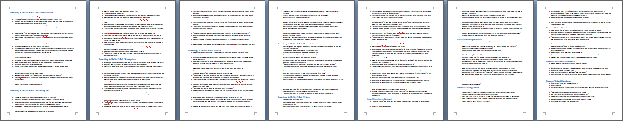
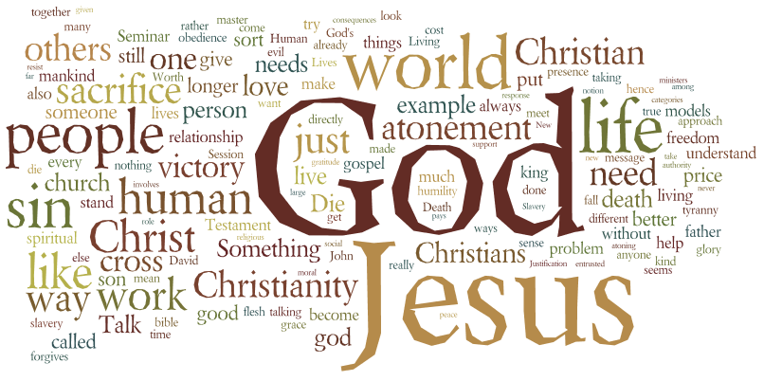
Sermons and Talks

Slide 5
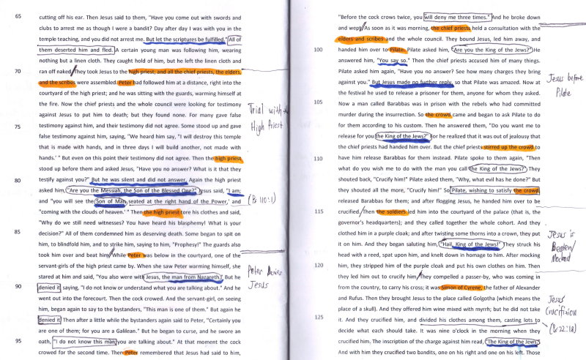
Bible Study

Slide 6
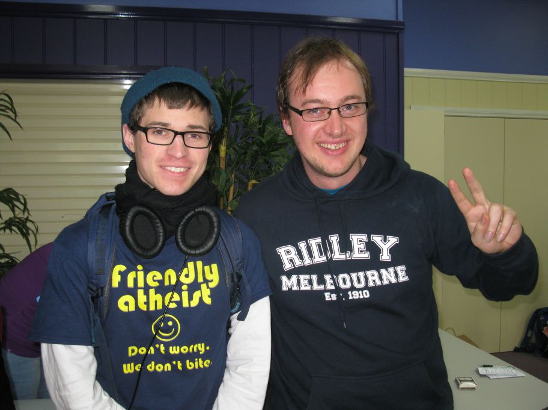
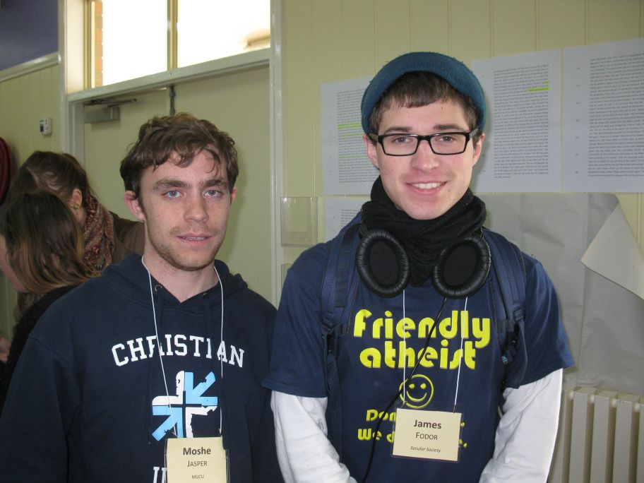
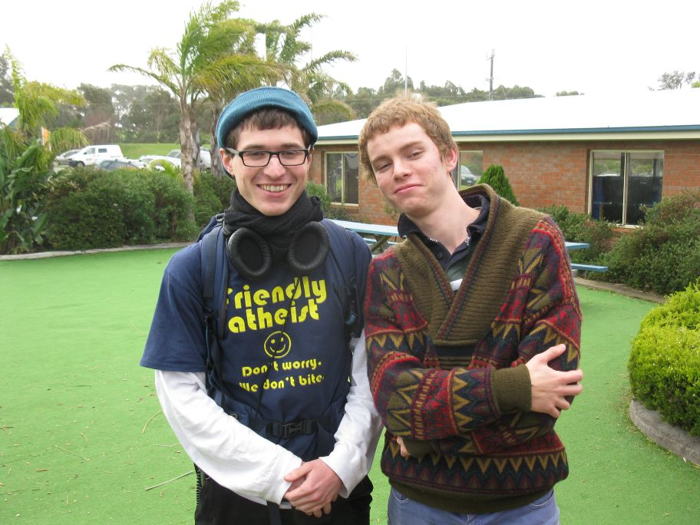
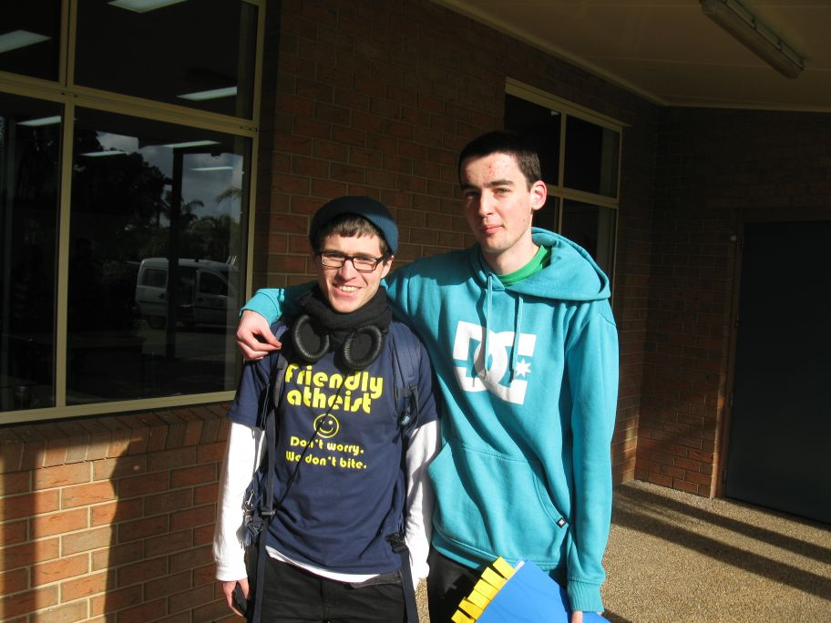
Friends

Slide 7

Other Stuff…

Slide 8
Other Events I’ve Attended
Public Bible Talks
Forums
Discussion groups
Bible study
Church
Public debates
Alpha course
Apologetics conference (next weekend!)

Slide 9

But What’s it all For?

Slide 10
Sundry Benefits of Dialogue
Make new friends
Understand other’s views better
Work toward common goals (e.g. opposing extremism)
Improve level of public discourse
Make a good impression
But there’s more to it than that…

Slide 11
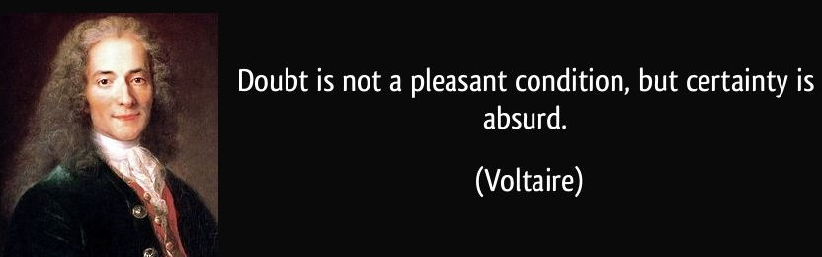
Voltaire on Doubt

Slide 12
…with Context
“Doubt is not a pleasant condition, but certainty is an absurd one. What is most repellent in the System of Nature [d'Holbach]…is the audacity with which it decides that there is no God, without even having tried to prove the impossibility.”

Slide 13

Another Example
“Faith is the great cop-out, the great excuse to evade the need to think and evaluate evidence. Faith is belief in spite of, even perhaps because of, the lack of evidence...Faith is not allowed to justify itself by argument.” – Richard Dawkins

Slide 14

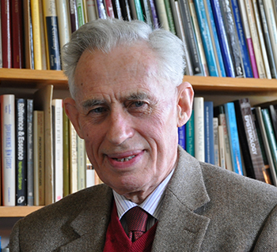
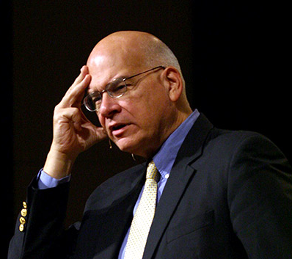
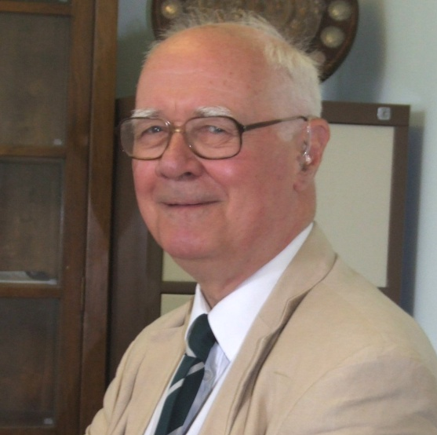
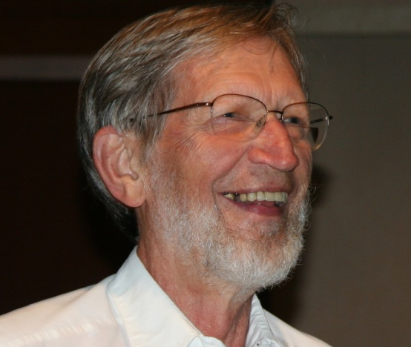
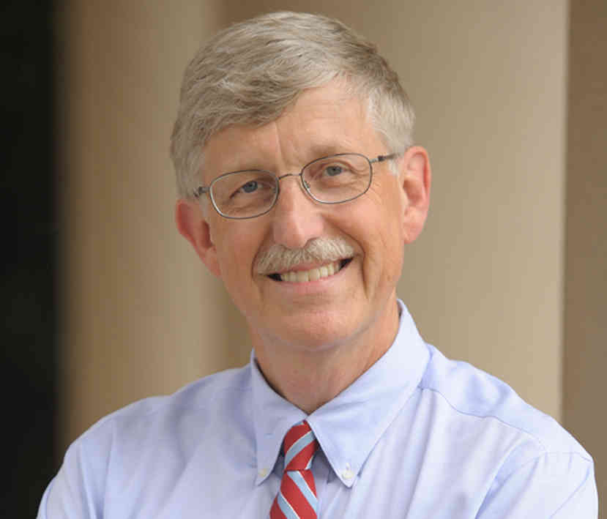
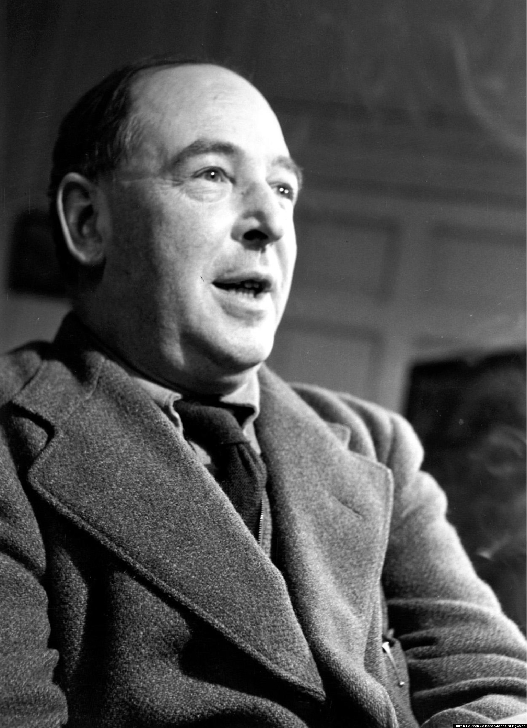
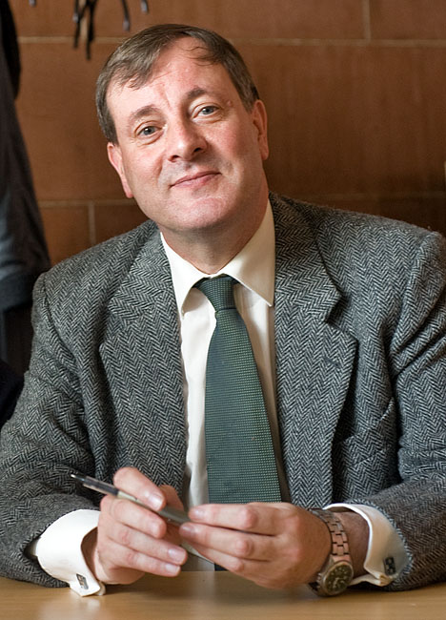
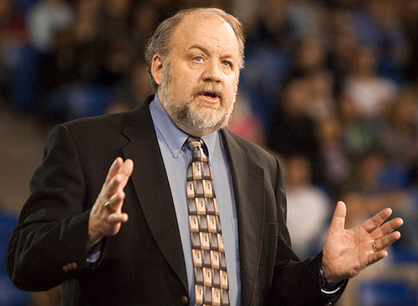
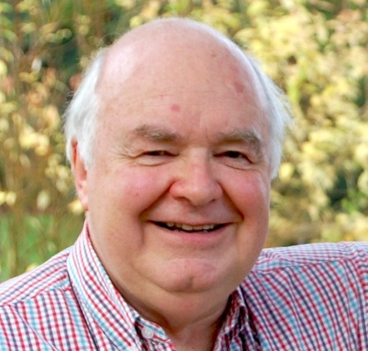
We Must Live up to our Standards

Slide 15
We Must Live up to our own Standards
Use arguments that are relevant and sound
Fact-check
Don’t strawman
Be informed about relevant facts and views
Do the research
Think through positions carefully
Strive to overcome biases
Search for the truth

Slide 16
On the Other Hand Christians…
Confidently reject other religions while knowing very little about them
Claim that there can be no objective morality without god but no knowing of metaethics
Claim the bible is the word of god but no little or nothing about biblical historicity
Value subjective evidence without concern for cognitive biases
Etc, etc…

Slide 17


The Bottom Line
If we are earnest about arriving at justified beliefs about what is true concerning God, morality, history, and meaning in life, then we ought to take dialogue seriously.

Slide 18
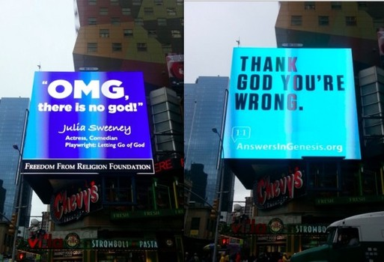
We Need Better Dialogue

Slide 19


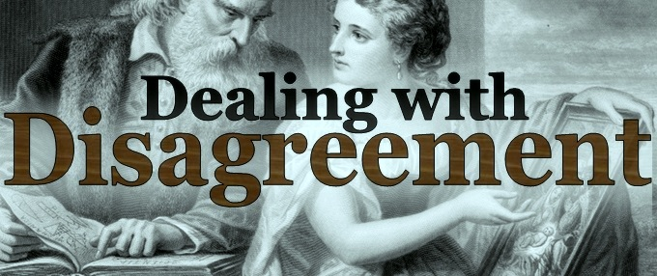
Interested in More of This?
Visit my blog The Godless Theist fods12.wordpress.com
Check out my podcast at fods12.podbean.com
Get involved in my discussion group Dealing with Disagreement

