Slide 1

Advanced Tools and Techniques of Program Evaluation
James Fodor, July 2018
Effective Altruism Melbourne

Slide 2
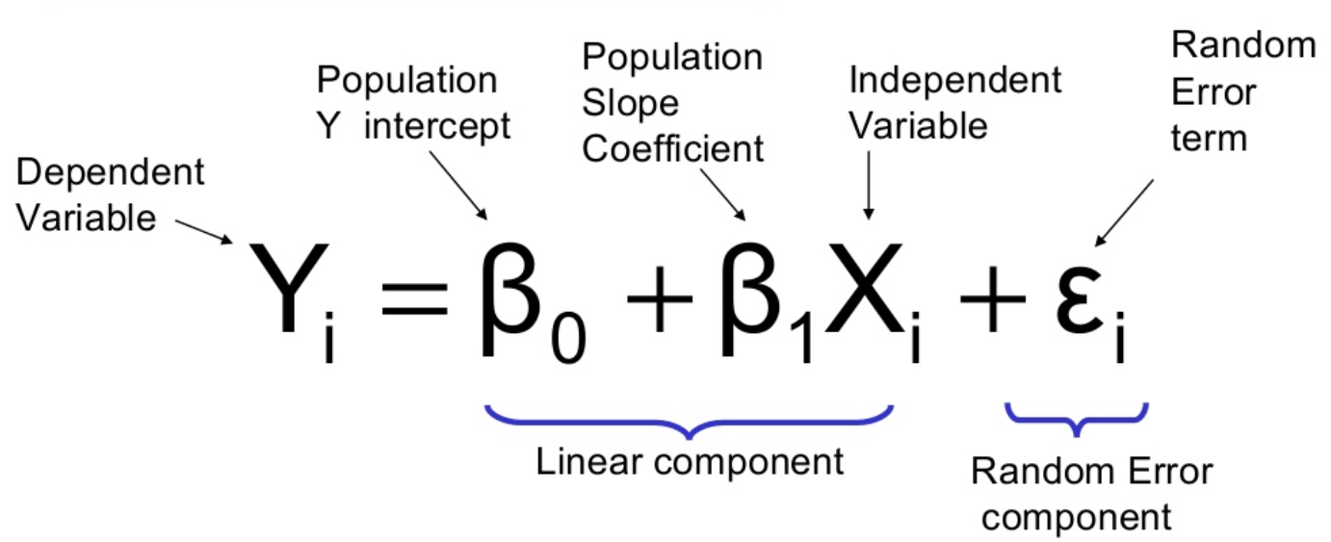
Simple Linear Regression

Slide 3
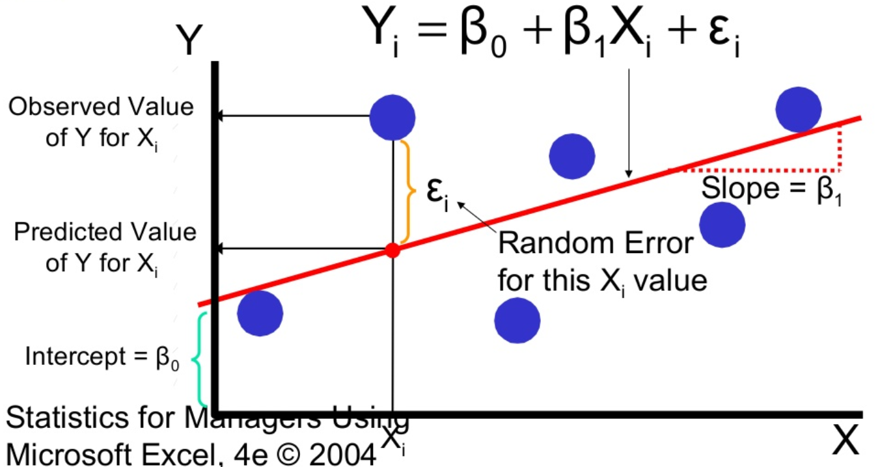
Simple Linear Regression

Slide 4
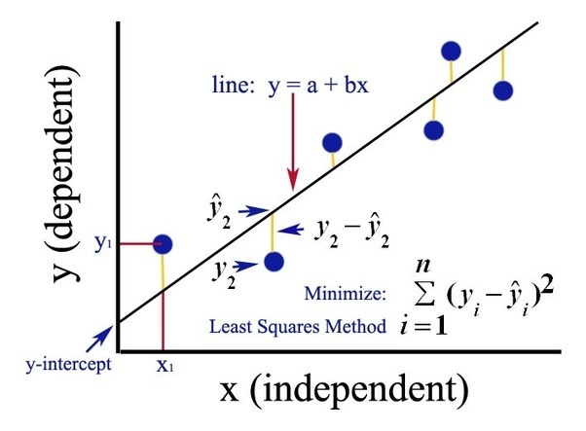
Least Squares Method
The “right” parameters are the ones which minimise the sum of squared residuals of the model. This is called Ordinary Least Squares (OLS).
If our model is correctly specified and we have no endogeneity, OLS gives unbiased estimates for the population parameters.

Slide 5
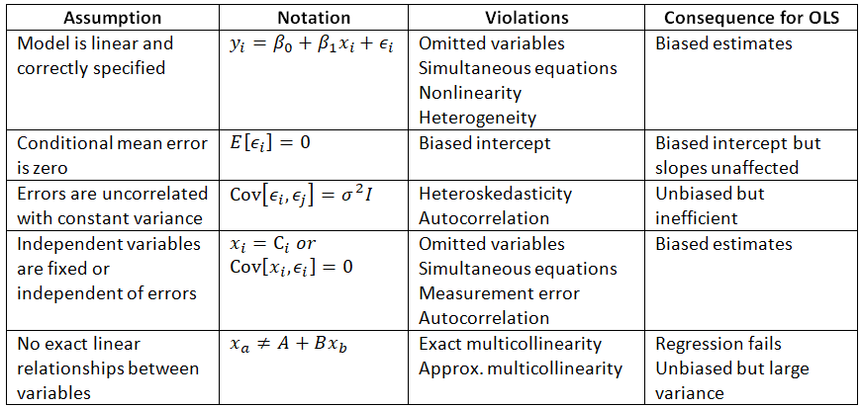
Assumptions of OLS

Slide 6
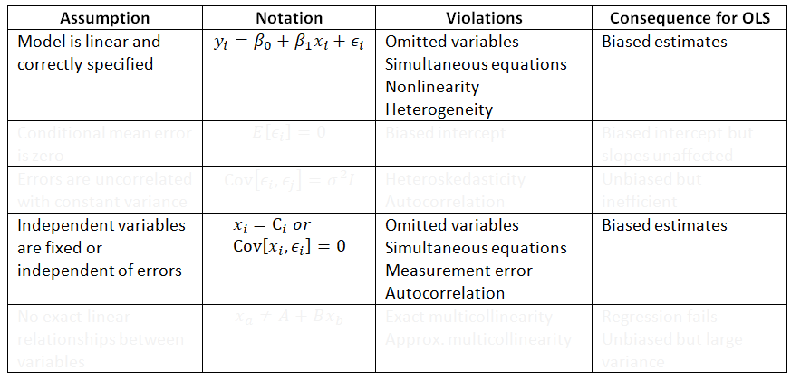
Assumptions of OLS

Slide 7
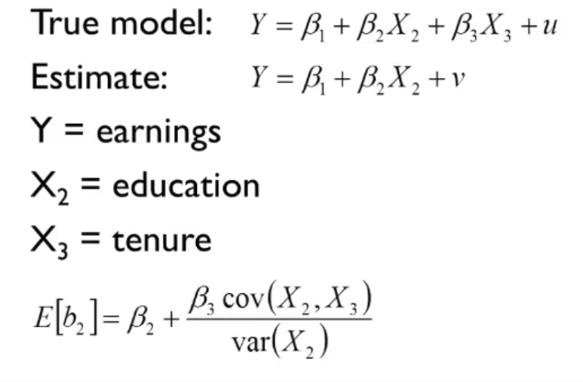
1: Omitted Variables
But our estimates will be biased if we have omitted variables.

Slide 8
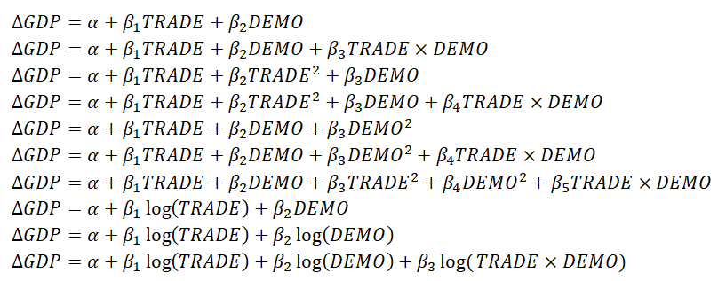
2: Model Misspecification
But our estimates will be biased if we have specified the wrong interactions and functional form.

Slide 9
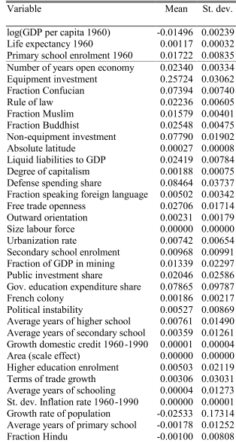
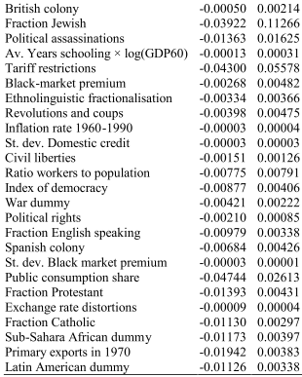
So What is the Right Model?

Slide 10
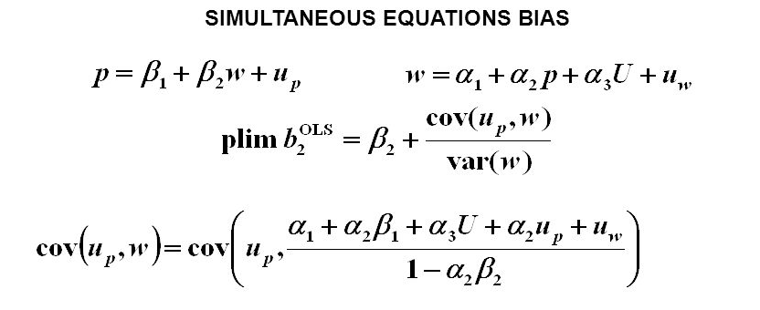
3: Simultaneity
But our estimates will be biased if we have not incorporated bidirectional causation through simultaneous equations.

Slide 11
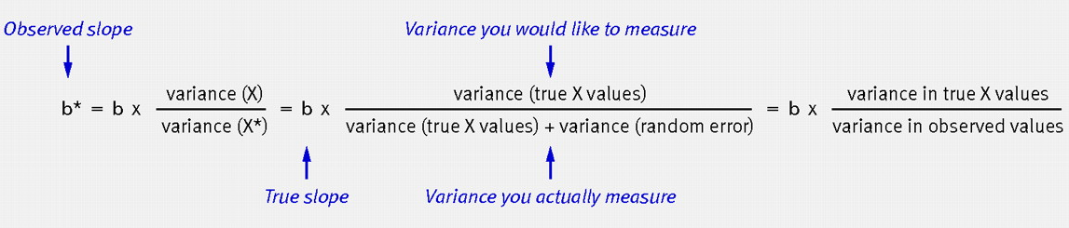
4: Measurement Error
But our estimates will be biased if we have measurement error in our independent variable.

Slide 12
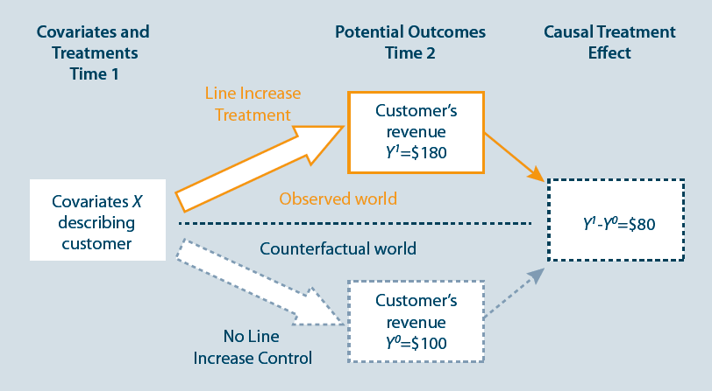
Program Evaluation Approach
Instead of trying to control for all confounding variables explicitly, we can just let random variation do the job for us.
If something is decided by chance or by some exogenous factor, it should not be correlated with any unobserved variables!

Slide 13
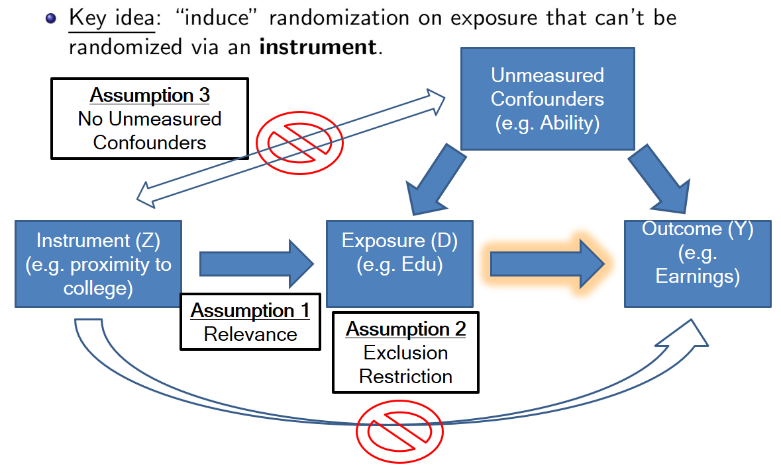
Instrumental Variables
Instrument must be correlated with independent variable (can test)
Instrument must not be correlated with errors (can’t test)
What does the result actually mean? (Local Average Treatment Effect)

Slide 14
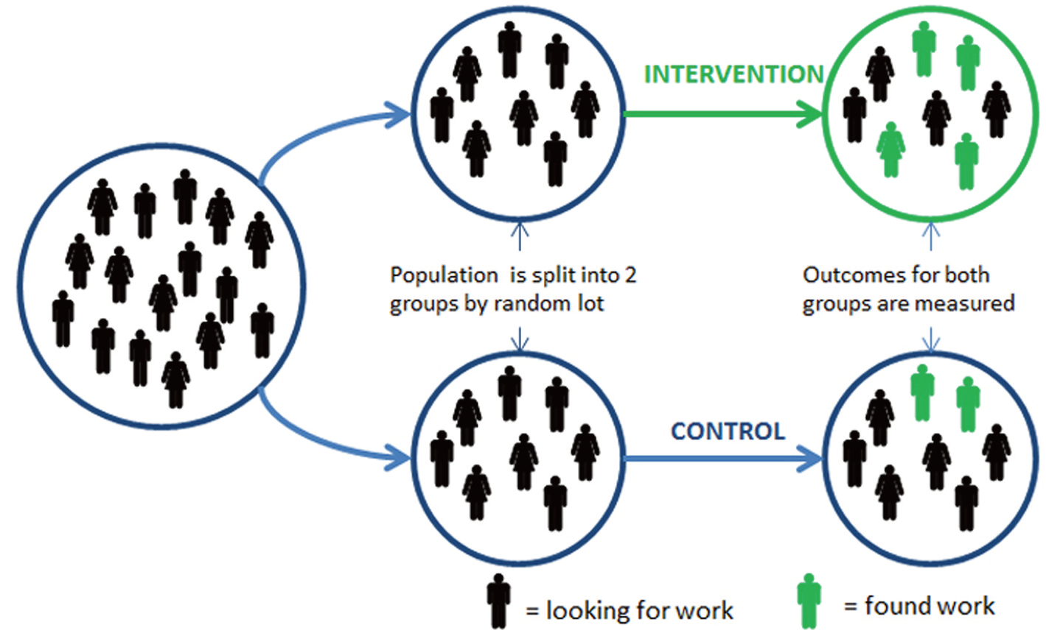
Randomised Controlled Trial
Can be hard/expensive to conduct, but if done properly there cannot be hidden confounds!

Slide 15

Randomised Controlled Trial
?

Slide 16
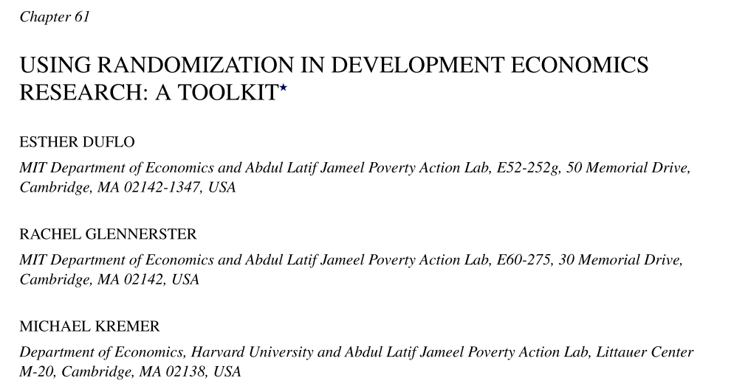
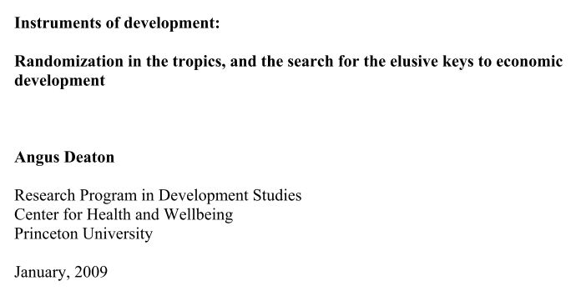


Clash of Econometricians

Slide 17
Limitations of RCTs
Expensive and time consuming, can’t conduct everywhere
Do not factor in general equilibrium effects
Do not incorporate heterogeneity of parameters
Trials differ from full-scale programs
Do not tell us why anything works or doesn’t work

Slide 18

Hard to Implement

Slide 19
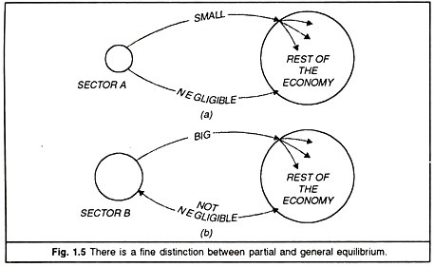
General Equilibrium

Slide 20
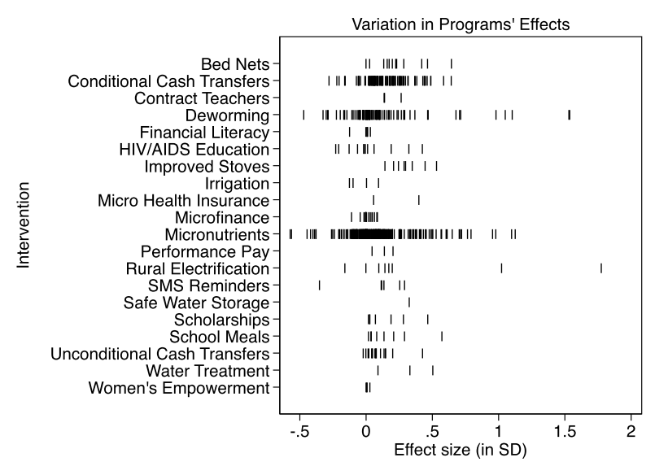
Heterogeneity
Eva Vivalt meta-analysis of RCT results.

Slide 21
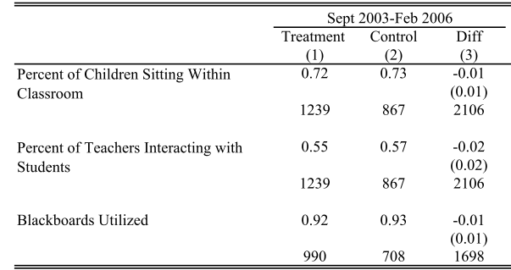
What Do RCTs Tell Us?

Slide 22
Structural Models
These make assumptions about the causal processes that generate results
Typical approach:
  Define utility function
  Define production function or resource constaints
  Define timespan and information available
  Define institutional setup
  Maximise utility subject to constraints over timespan given information
  Derive equation to estimate
  Use data to determine structural parameters

Slide 23
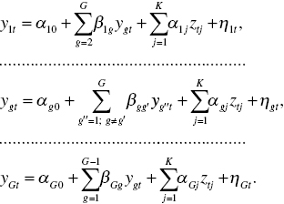
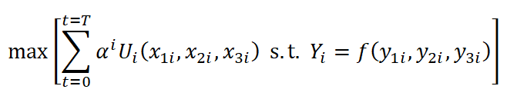
Structural Models
Actually tells you about how the system works
But requires lots of assumptions about functional forms
Also often hard to identify all parameters (not enough data)

Slide 24
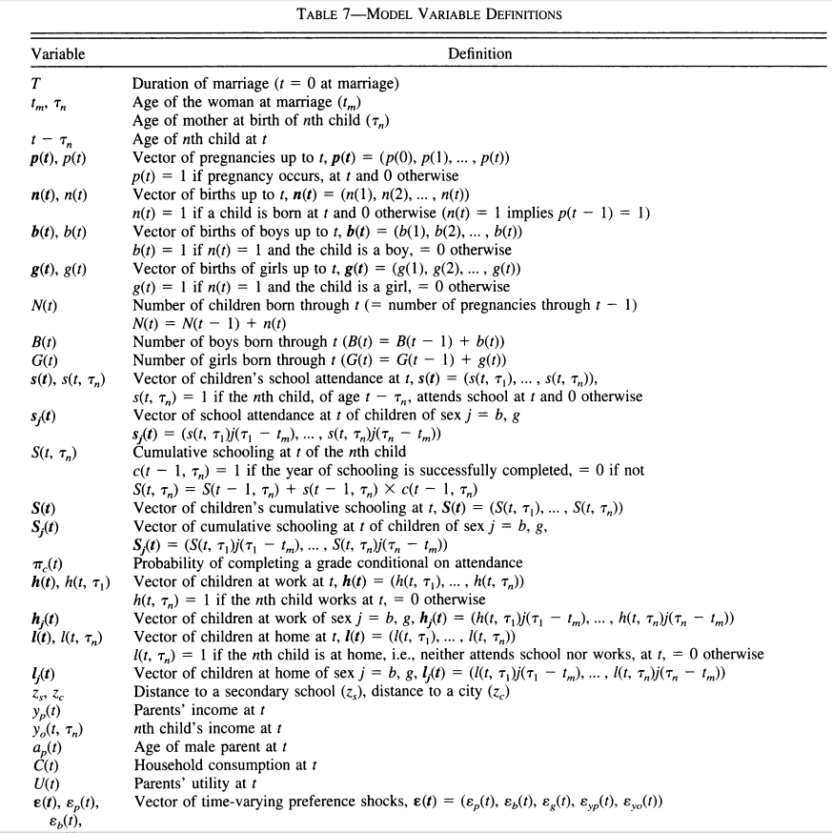
Structural Models

Slide 25
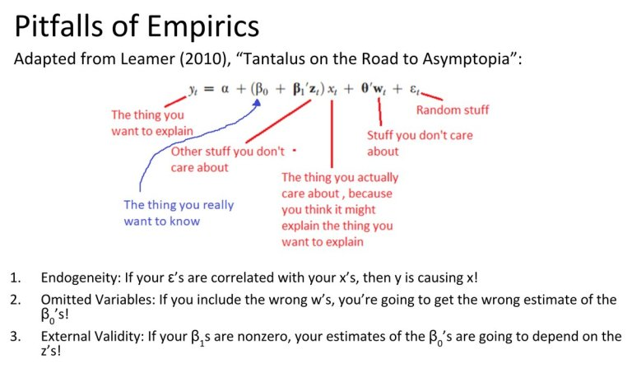
Summary

Slide 26


Book Recommendations

Slide 27

My Blog

