Slide 1
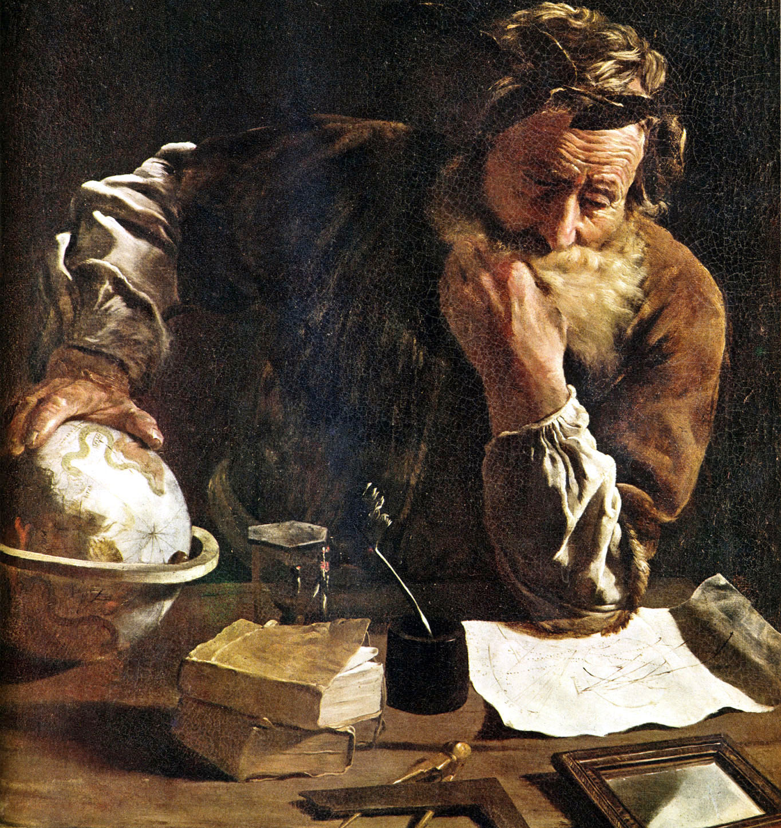
A Naturalistic Worldview
James Fodor, April 2017
Humanist Convention

Slide 2
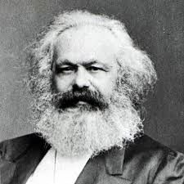

Worldviews Matter
Shape beliefs
Shape actions
Change the world

Slide 3
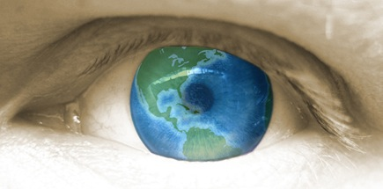
Desiderata
We want a theory that:
Is parasimonious
Has high explanatory power
Is intellectually and emotionally attractive

Slide 4
Key Ideas
Today we will consider the following components:
Principle 1: Naturalism
Principle 2: Nominalism
Principle 3: Reductionism
Application 1: The mind
Application 2: Morality

Slide 5
1. Naturalism

Slide 6
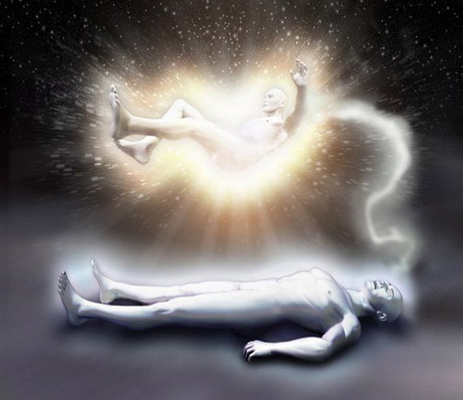
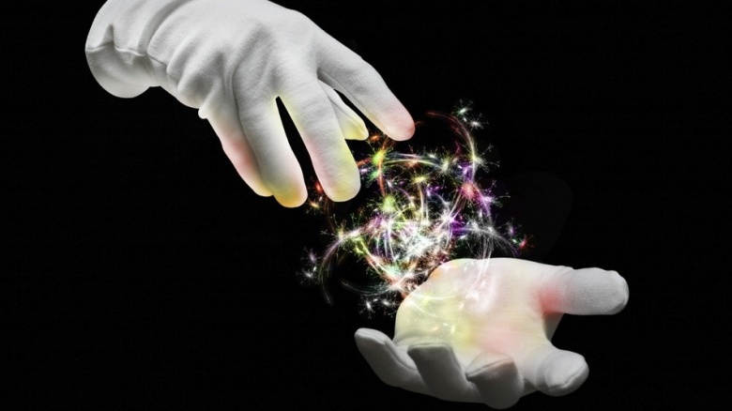

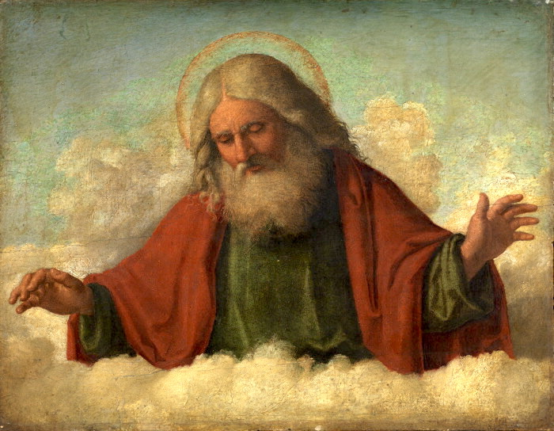

Non-natural entities

Slide 7


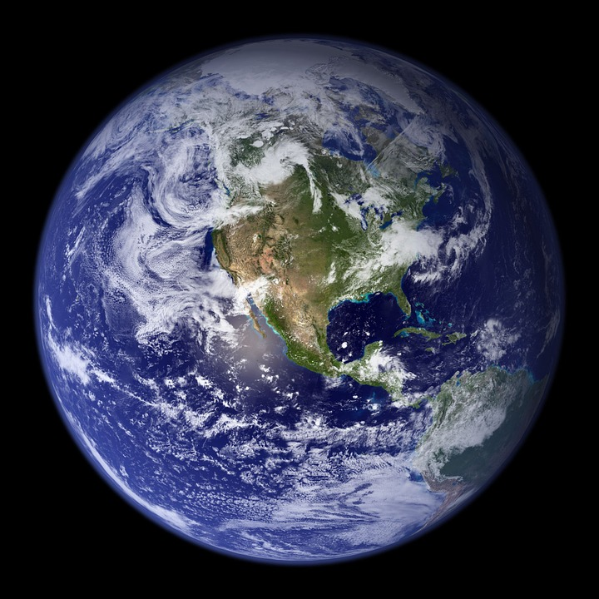

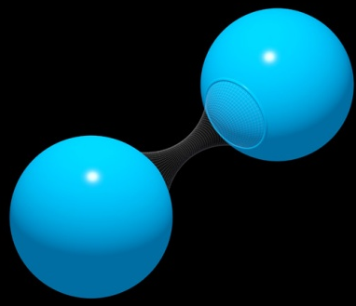

Natural entities

Slide 8
Naturalism
Non-natural entities
Things that are part of nature
Things that exist

Slide 9
Naturalism
{Things that exist} = {Things that are part of nature}
Things that are part of nature
“Reality is exhausted by nature”

Slide 10
2. Nominalism

Slide 11
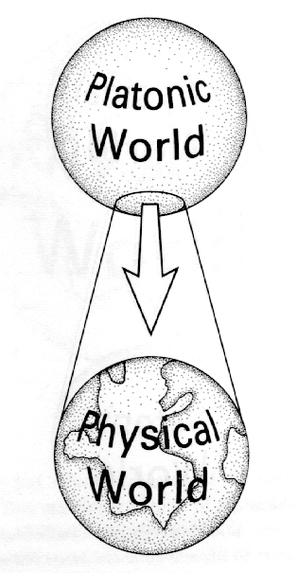
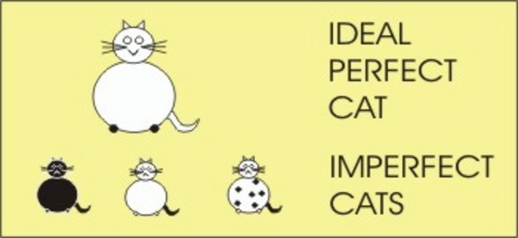
Nominalism
No universals:
No property of ‘chairness’
No abstract type of ‘mammalness’
No unembodied relation of ‘fatherhood’

Slide 12
3. Reductionism

Slide 13
Reductionism
Everything that exists is either:
A fundamental particle/field/etc, or
Exists in virtue of certain specified arrangements and interactions of particles/fields/etc
Strong reductionism needs naturalism and nominalism in order to be plausible

Slide 14

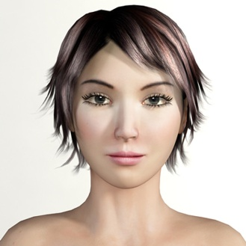
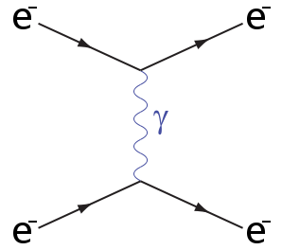
Is Reductionism Plausible?
“Bob loves his wife”

Slide 15
Is Reductionism Plausible?
Not a semantic claim about mental content
Not an epistemological claim about knowledge
An ontological claim about basis of existence

Slide 16
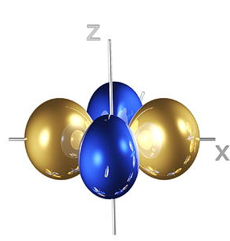
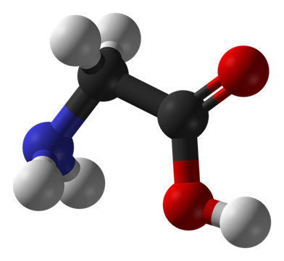
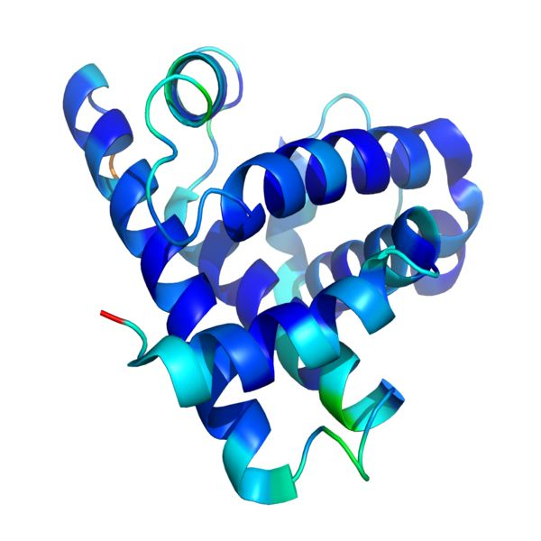
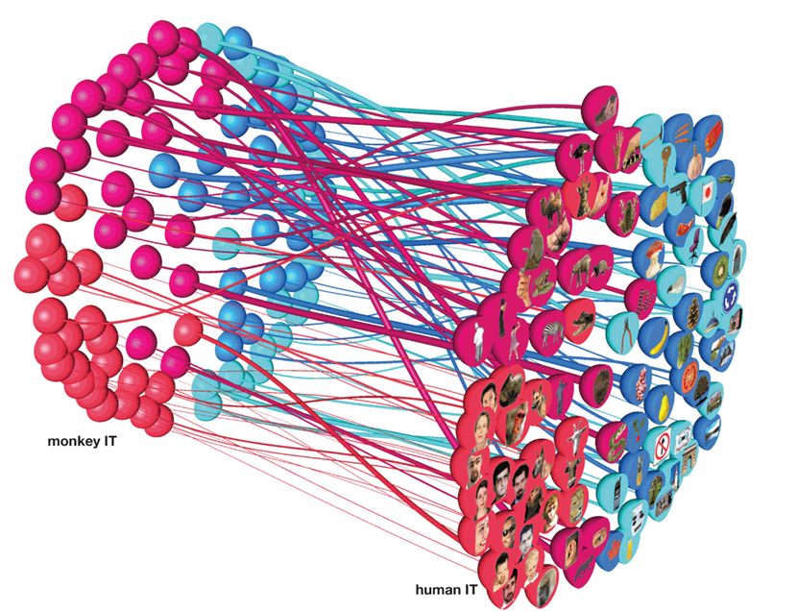
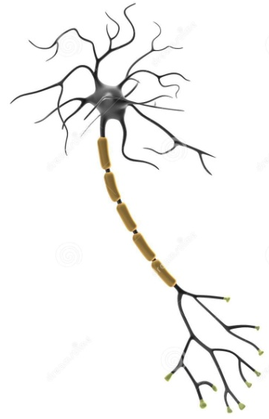
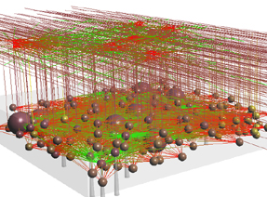
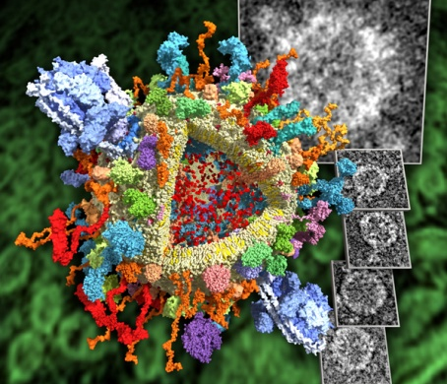
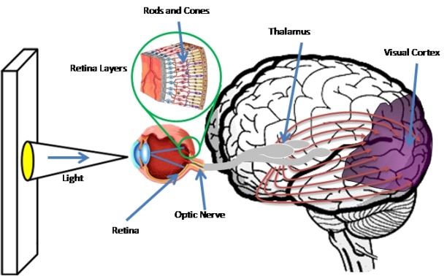


Reductionism

Slide 17
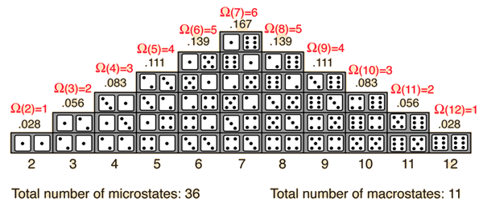
Macro and Microstates
Microstate: a single possible configuration of all fundamental particles in a system
Macrostate: a set of microstates that share some property or behaviour of interest

Slide 18
Philosophical Method
Use conceptual analysis to determine what macrostates our concepts refer to
Use empirical analysis to identify which (if any) microstates instantiate those macrostates
Iterate between the two until reaching reflective equilibrium

Slide 19
Application 1: The Mind

Slide 20
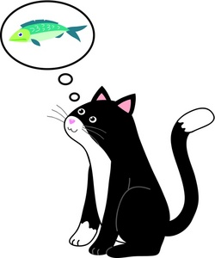

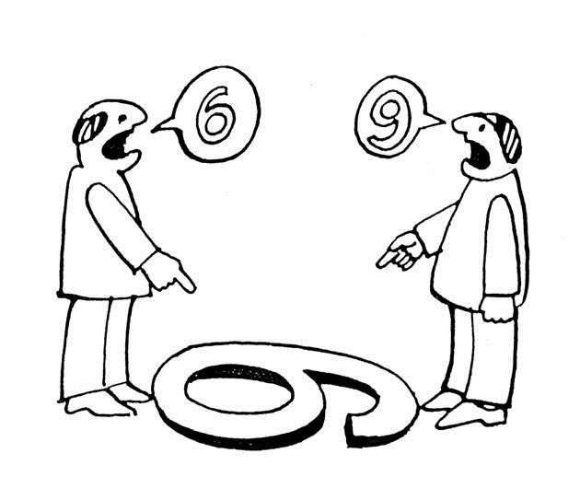
The Mind in Nature
Mental states are complex sets of physical states (materialist functionalism)
Mental macrostates: states of deciding, perceiving, remembering, etc – abstract states of complex system

Slide 21
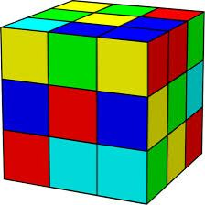
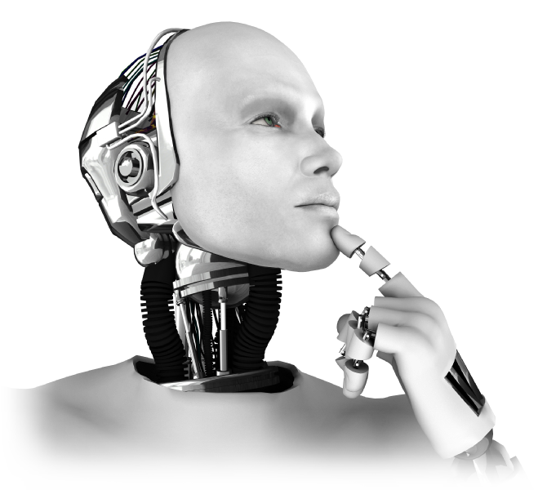
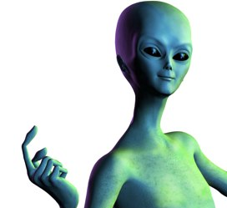
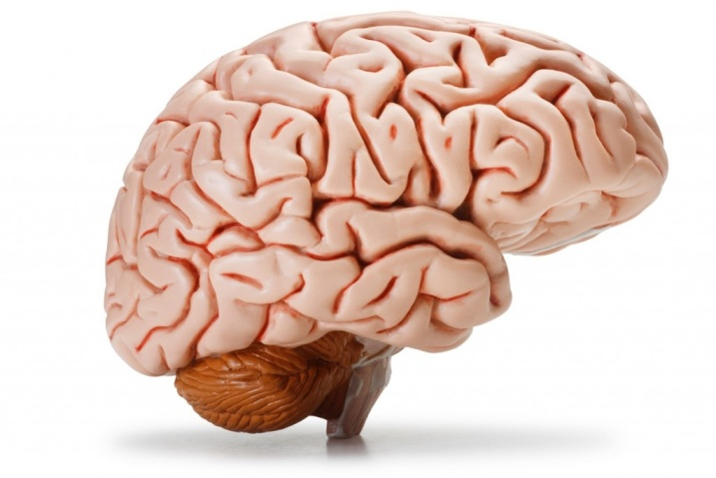
The Mind in Nature
Microstates: multiple realisability

Slide 22
The Mind in Nature
Mental states are real (contra behaviourism); supervene on physical states
Free will exists as an emergent property of a fundamentally causal system
‘How’ questions now amenable to scientific inquiry
A place for the mind in nature

Slide 23
Application 2: Morality

Slide 24
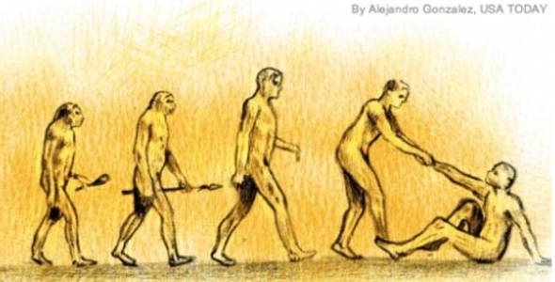
Morality in Nature
Moral statements refer to complex sets of physical states (ethical naturalism)
Macrostates: morally good states of affairs facilitate human flourishing and impede misery
Microstates: biological, social, political...

Slide 25
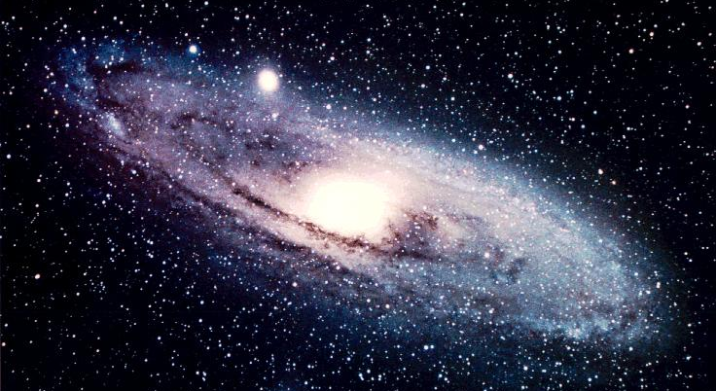

Morality in Nature
Astrophysics claims
Moral/ethical claims
True or false in virtue of...
Pertain in virtue of...

Slide 26
Morality in Nature
Morality is real and objective, based on characteristics of the natural world
Moral progress is possible as we learn more about human suffering and flourishing
Science can teach us about human flourishing
A place for morality in nature

Slide 27
Conclusions

Slide 28
Advantages of Naturalism
Parsimony: Reductive naturalism is a minimal ontology
How far can we get starting with so little?
Explanatory power: Non-natural entities do not follow causal laws; fundamentally mysterious and inexplicable
Cannot have strong explanatory power

Slide 29

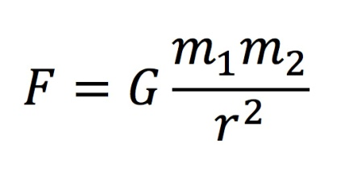
Naturalism
?
?
?
Non-natural entities
Things that are part of nature
?
?
?
Things that exist

Slide 30
Naturalism
Things that are part of nature
{Things that exist} = {Things that are part of nature}

Slide 31
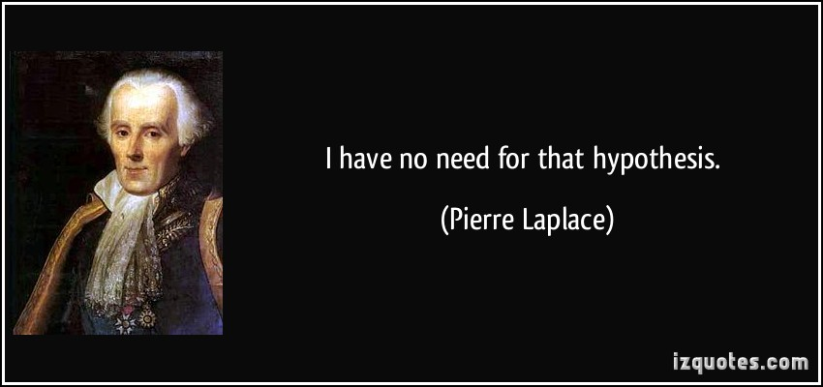
Naturalism

Slide 32
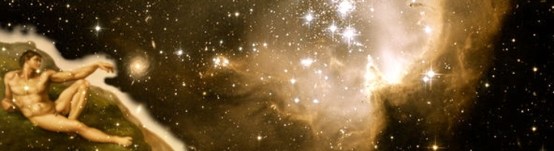
Emotionally Satisfying
Universe as fundamentally explicable
Humanity as special and important
Basis for moral action and concern
Impetus for continued learning and discovery

Slide 33
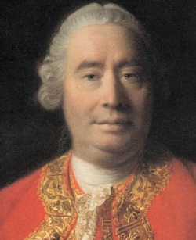
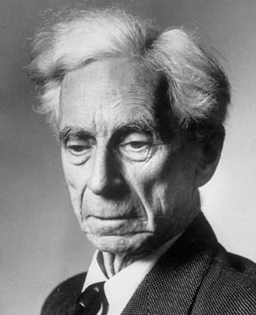
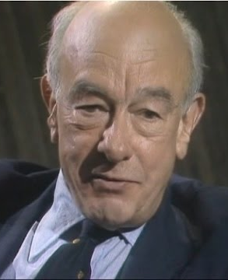
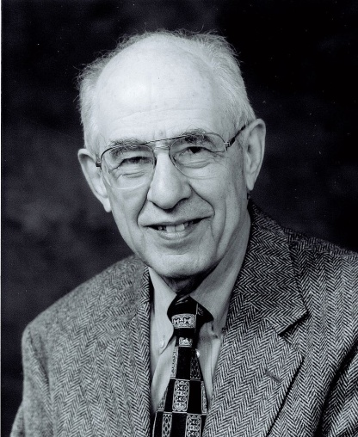
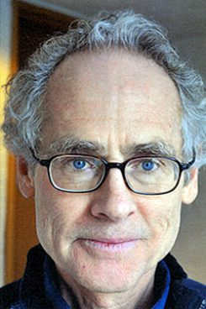
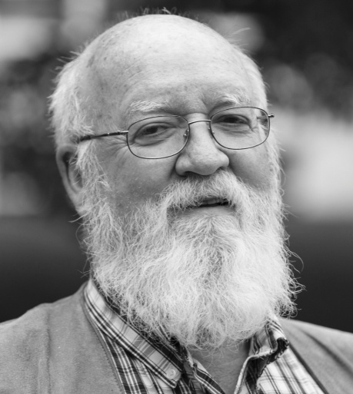
Influential Thinkers
David Hume
Bertrand Russell
Willard Quine
Hilary Putman
Peter Railton
Daniel Dennett

